Slide 1

Emmanuel
Northampton
Parish Profile

Slide 2
Emmanuel Northampton Parish Profile
27. Children & Youth
28. Our Groups
29. Our Finances
30. Our Building
33. Our Context
38. Your New Home
39. Our Diocese and Deanery
41. Contact Information
42. Appendices
Contents
Title
Contents
Who we are
9. Our Vision and Mission
11. Our Biggest Challenges
Role Priorities
The Person we are looking for
How we can support you
Our History
Our Statistics
23. Our Worship Life
25. Our Outreach and Community Engagement

Slide 3
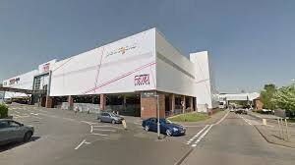
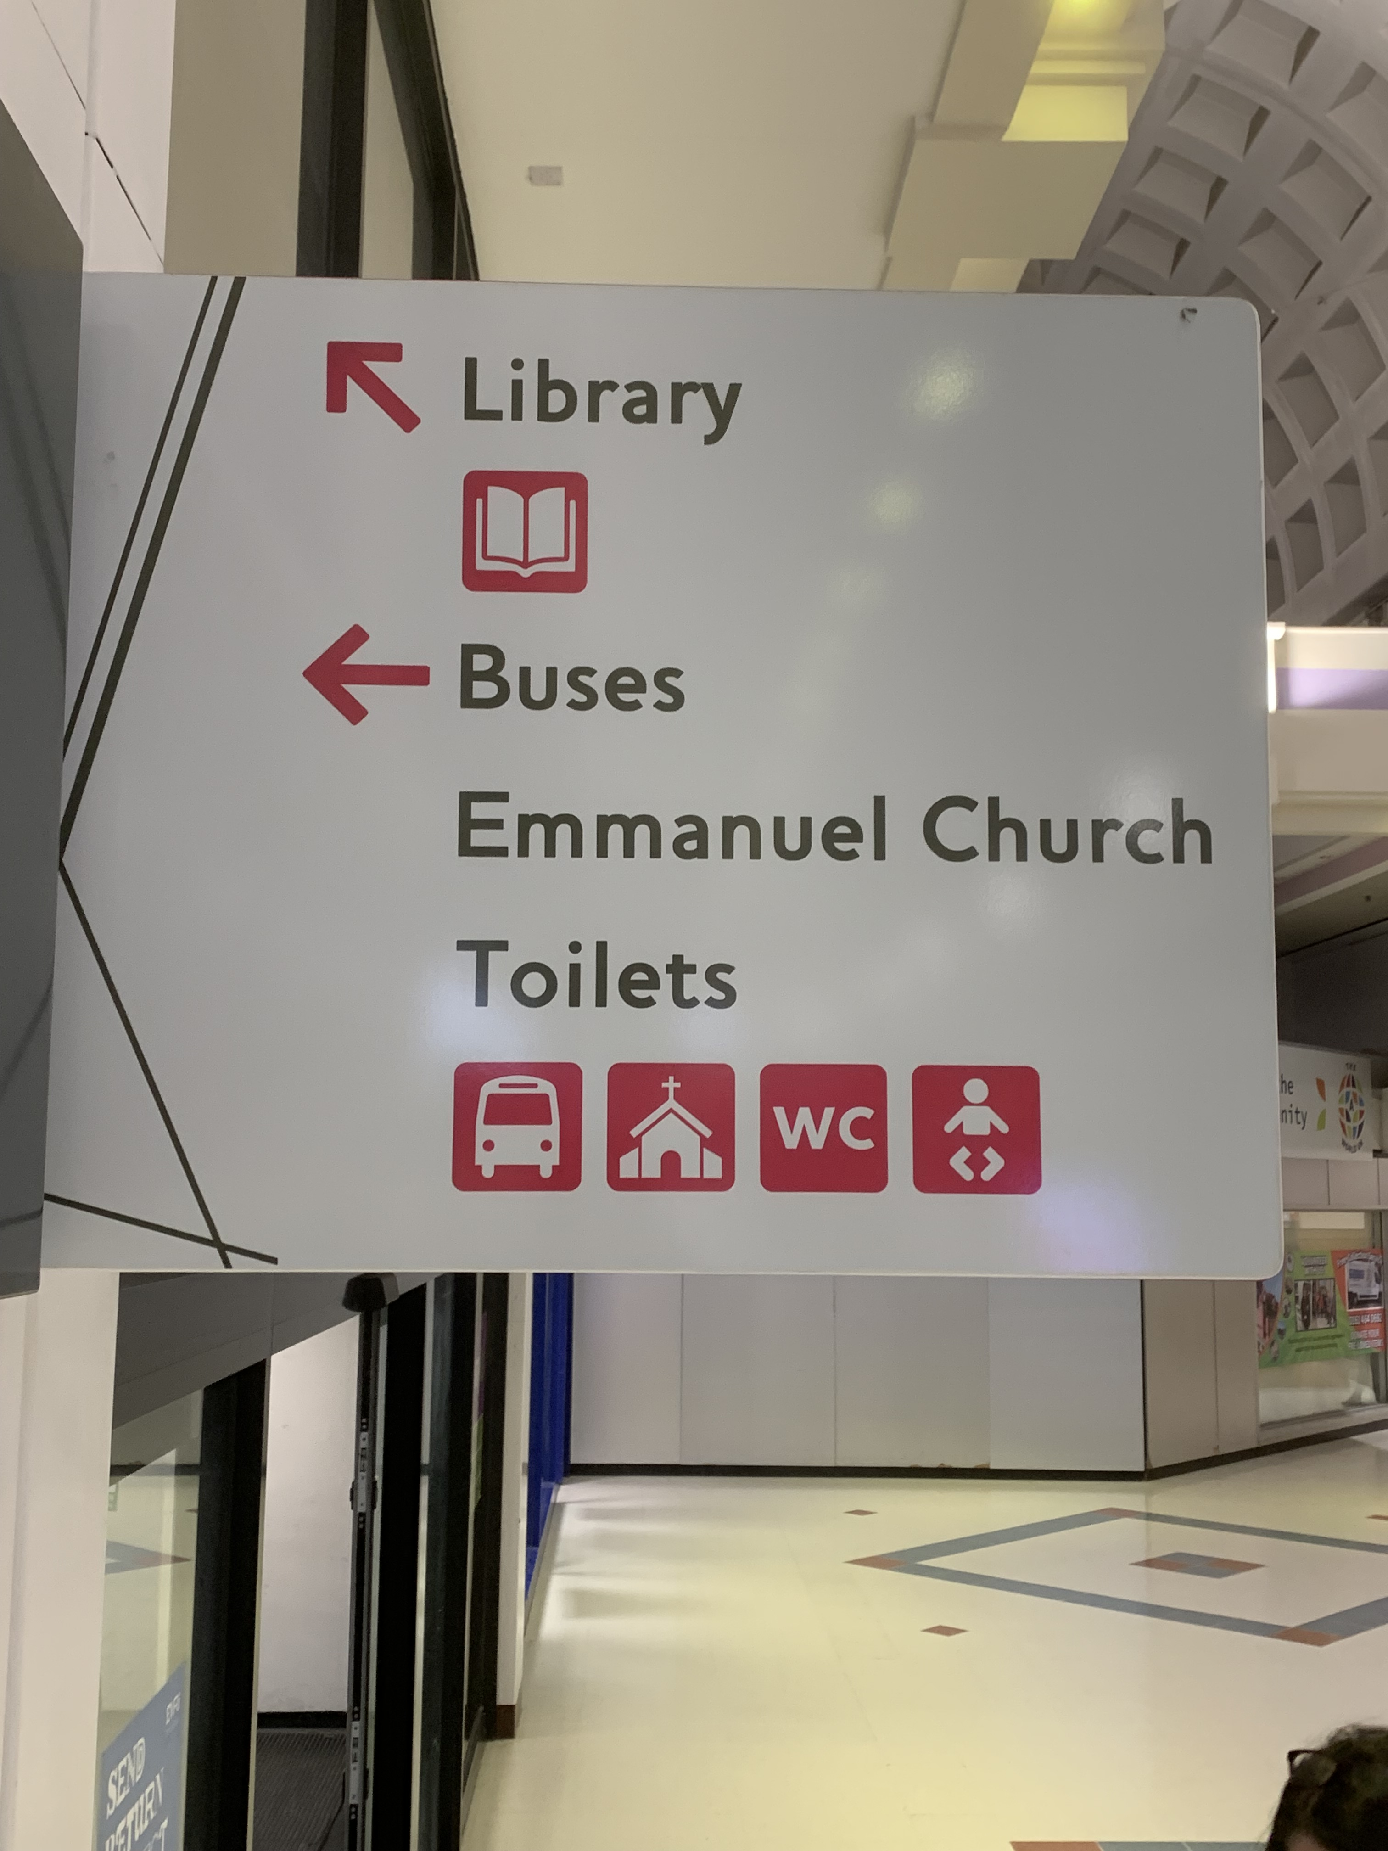
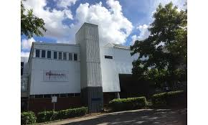
The Emmanuel Group of Churches
“A family of faith where there is always room for one more”
The Emmanuel Group combines three congregations, one coffee shop and a foodbank.
The building is situated in a busy shopping centre on the Eastern side of Northampton.
We are where chaos and community meet, bringing diversity and opportunity to reflect the light of Christ in Northampton East.
Part of the building forms the bridge over Billing Brook Road, this is a metaphor for the ministry here at Emmanuel - to be a bridge between God and the community.
Who we are

Slide 4
Emmanuel Group of Churches
Emmanuel Group of Churches, a Local Ecumenical Partnership.
We are a group of three churches on the Eastern side of Northampton. The original church, Emmanuel, was built and opened in 1974. In December 2024 we celebrated our 50th Anniversary .
In the mid 1990’s, two church plants were created, one at Boothville and the other at Rectory Farm, both within the parish boundary.
The Emmanuel Group is now made up of Anglicans, Methodists, Baptists and Shared Members. While respecting and valuing our supporting denominations, we now see ourselves working in a post-modern society as an Ecumenical Church with people of all Christian traditions, some of whom are not affiliated to any specific denomination.
We have a joint team ministry which, until recently, comprised of an Anglican Team Rector, an Ecumenical Church Minister (Baptist) and an Assistant Priest (retired). The post of Ecumenical Church Minister alternates between Methodist and Baptist. We have three Lay Readers and one in training. It is important to understand that, as with our congregations, unity is key (John 17: 18-21) therefore working collaboratively is vital within the ministry team.
The three churches are all different, but we have a shared vision , ministry and finances.

Slide 5
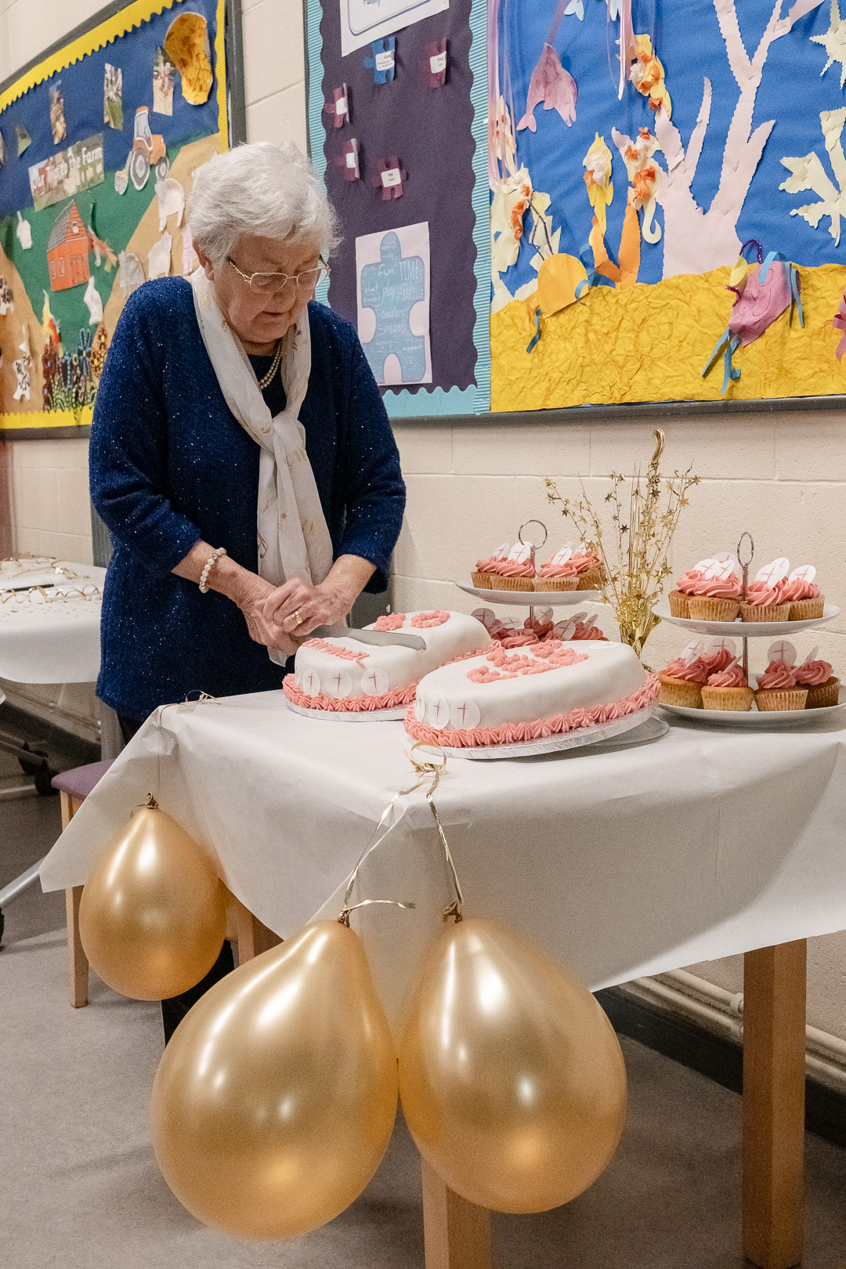
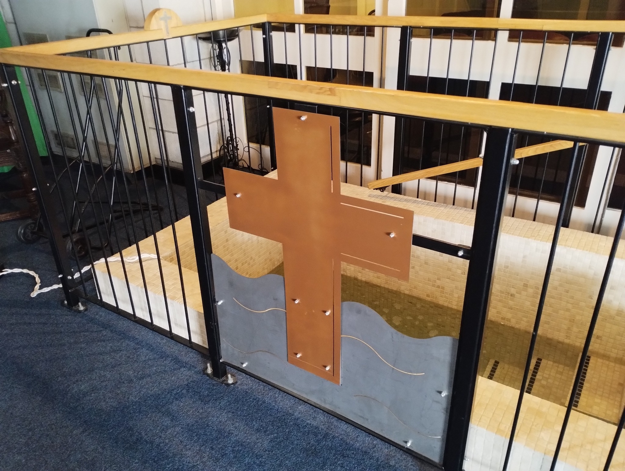
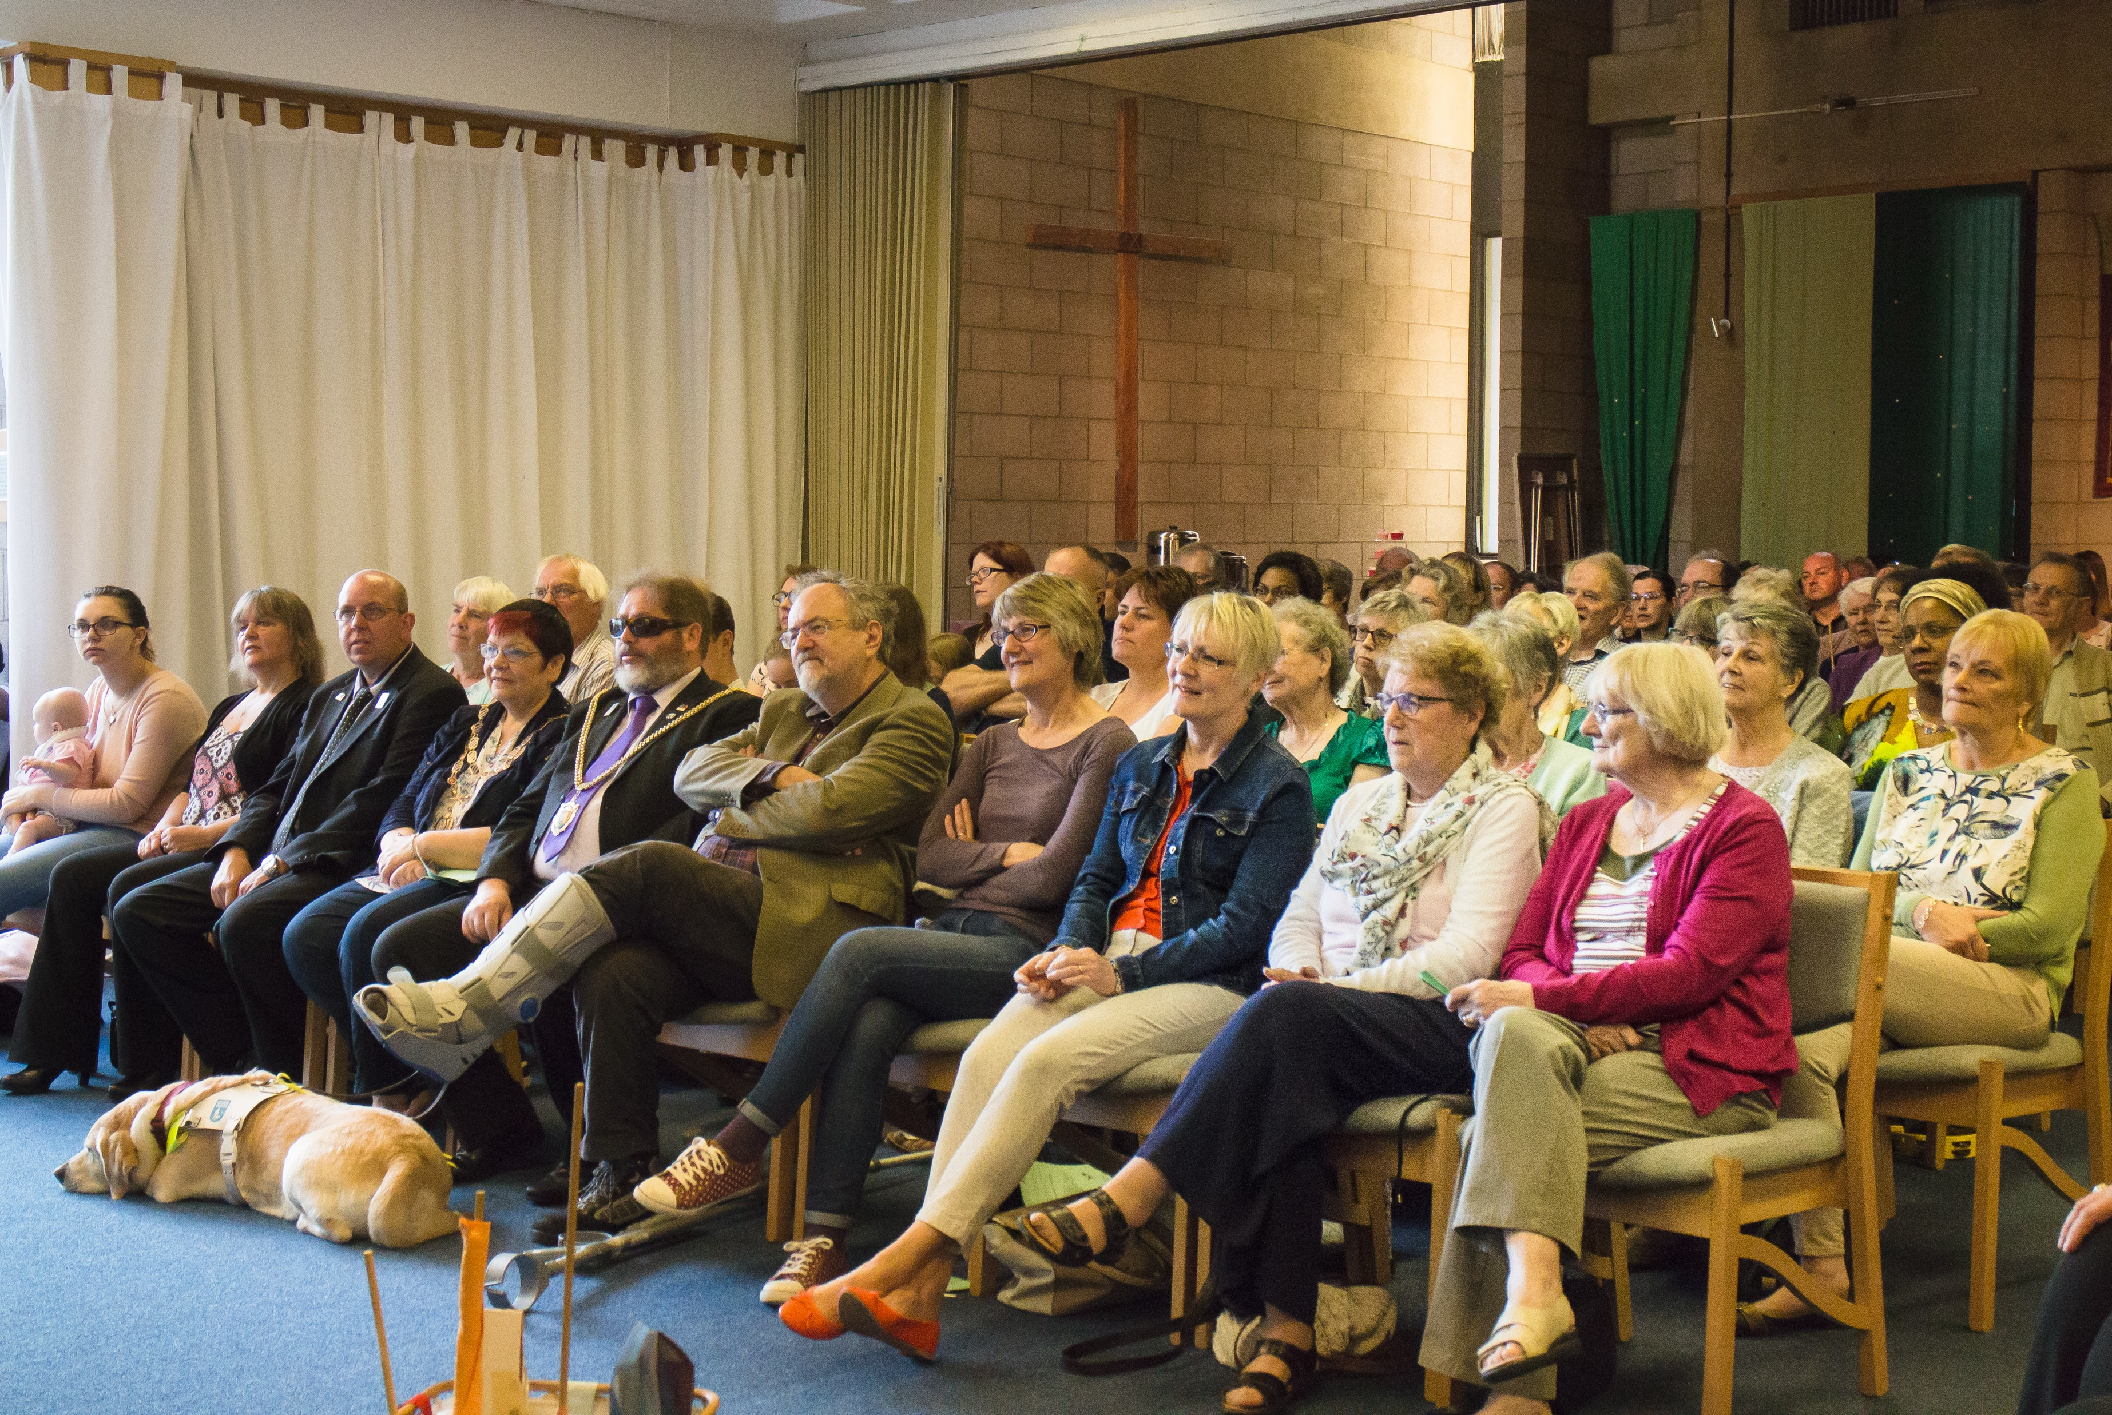
Emmanuel Church
The congregation meet on the middle floor of the building which is used as the main worship area.
There was a tradition around using the lectionary, however in the past 2 years we have introduced some series to the preaching plan. Such as ‘What is the Church? and what is it for?’ ‘Holy Habits’ and ’Sidekicks’ . This has been accompanied by a takeaway booklet for further reflection which most of the home-groups have picked up and used. This has been well received and has encouraged further engagement with the texts, building discipleship.
Booklets have also been written for Prayer and a guide to Epiphany. These are to build more connections between life and faith and to strengthen unity.
The ‘chapel area’ also has a baptistry for full immersions, which demonstrates the diversity of the congregation and building.

Slide 6
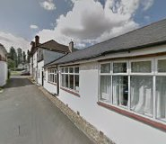
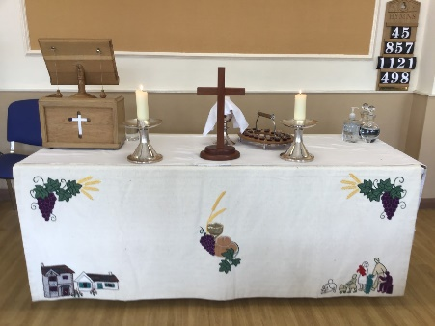
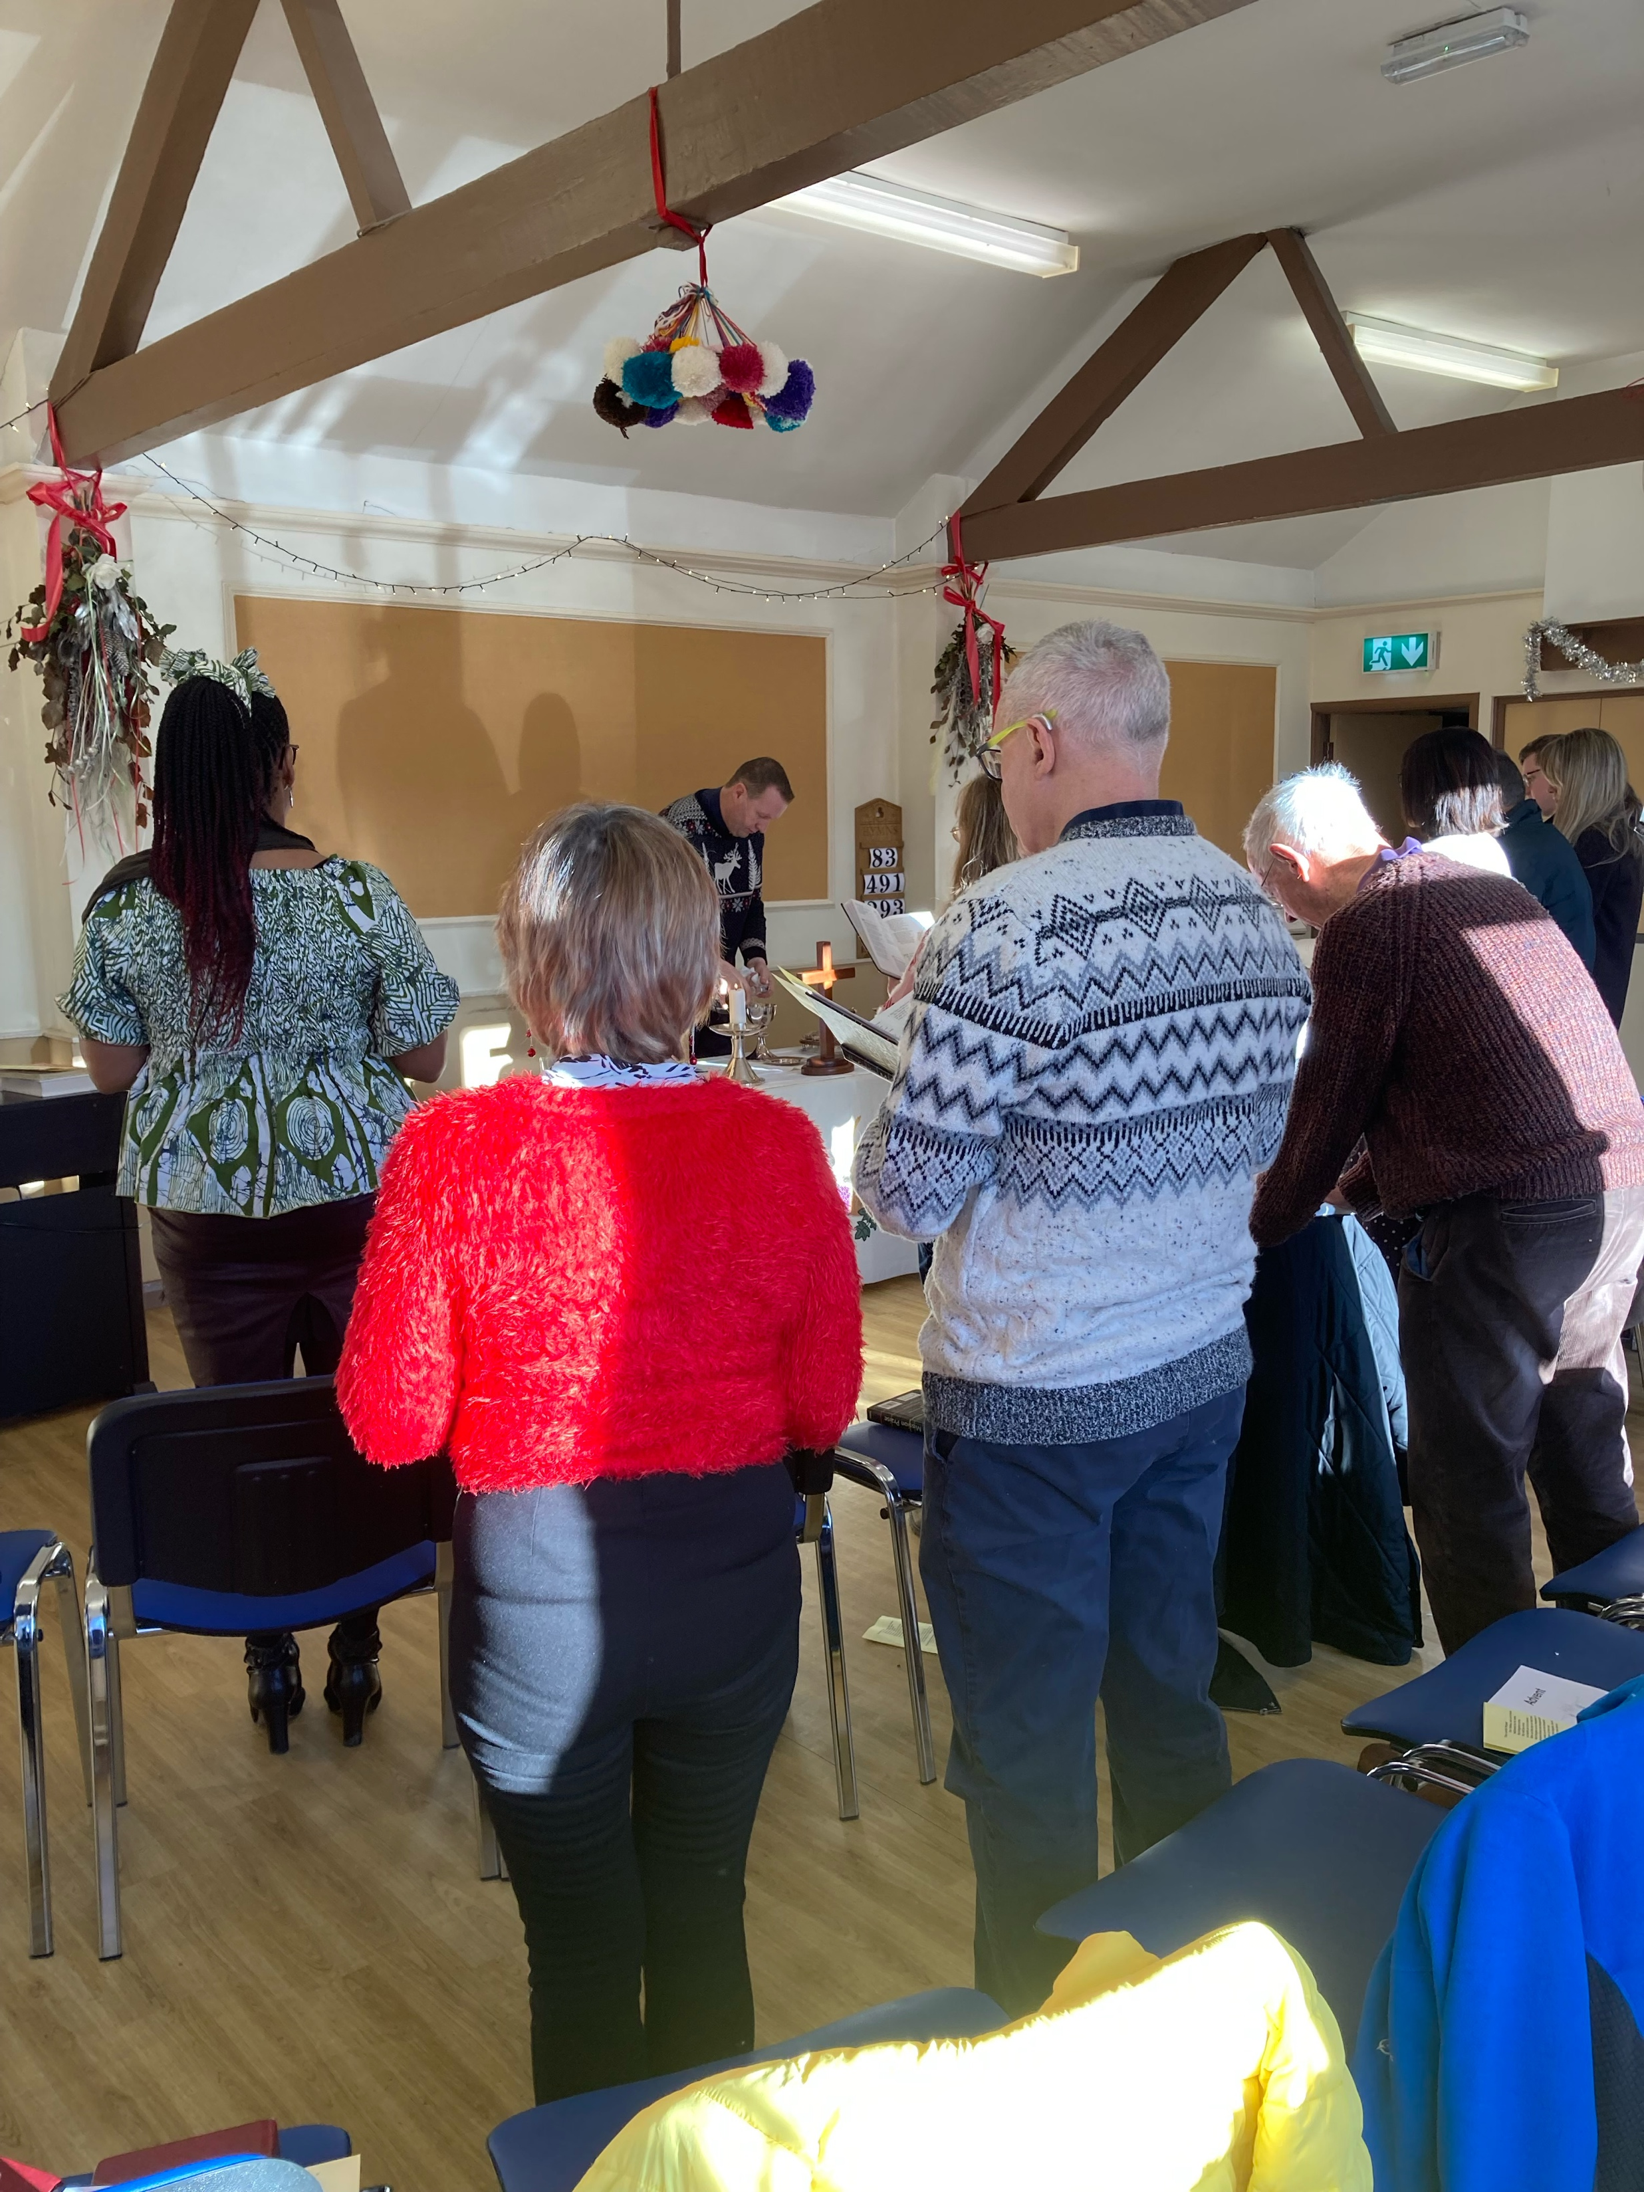
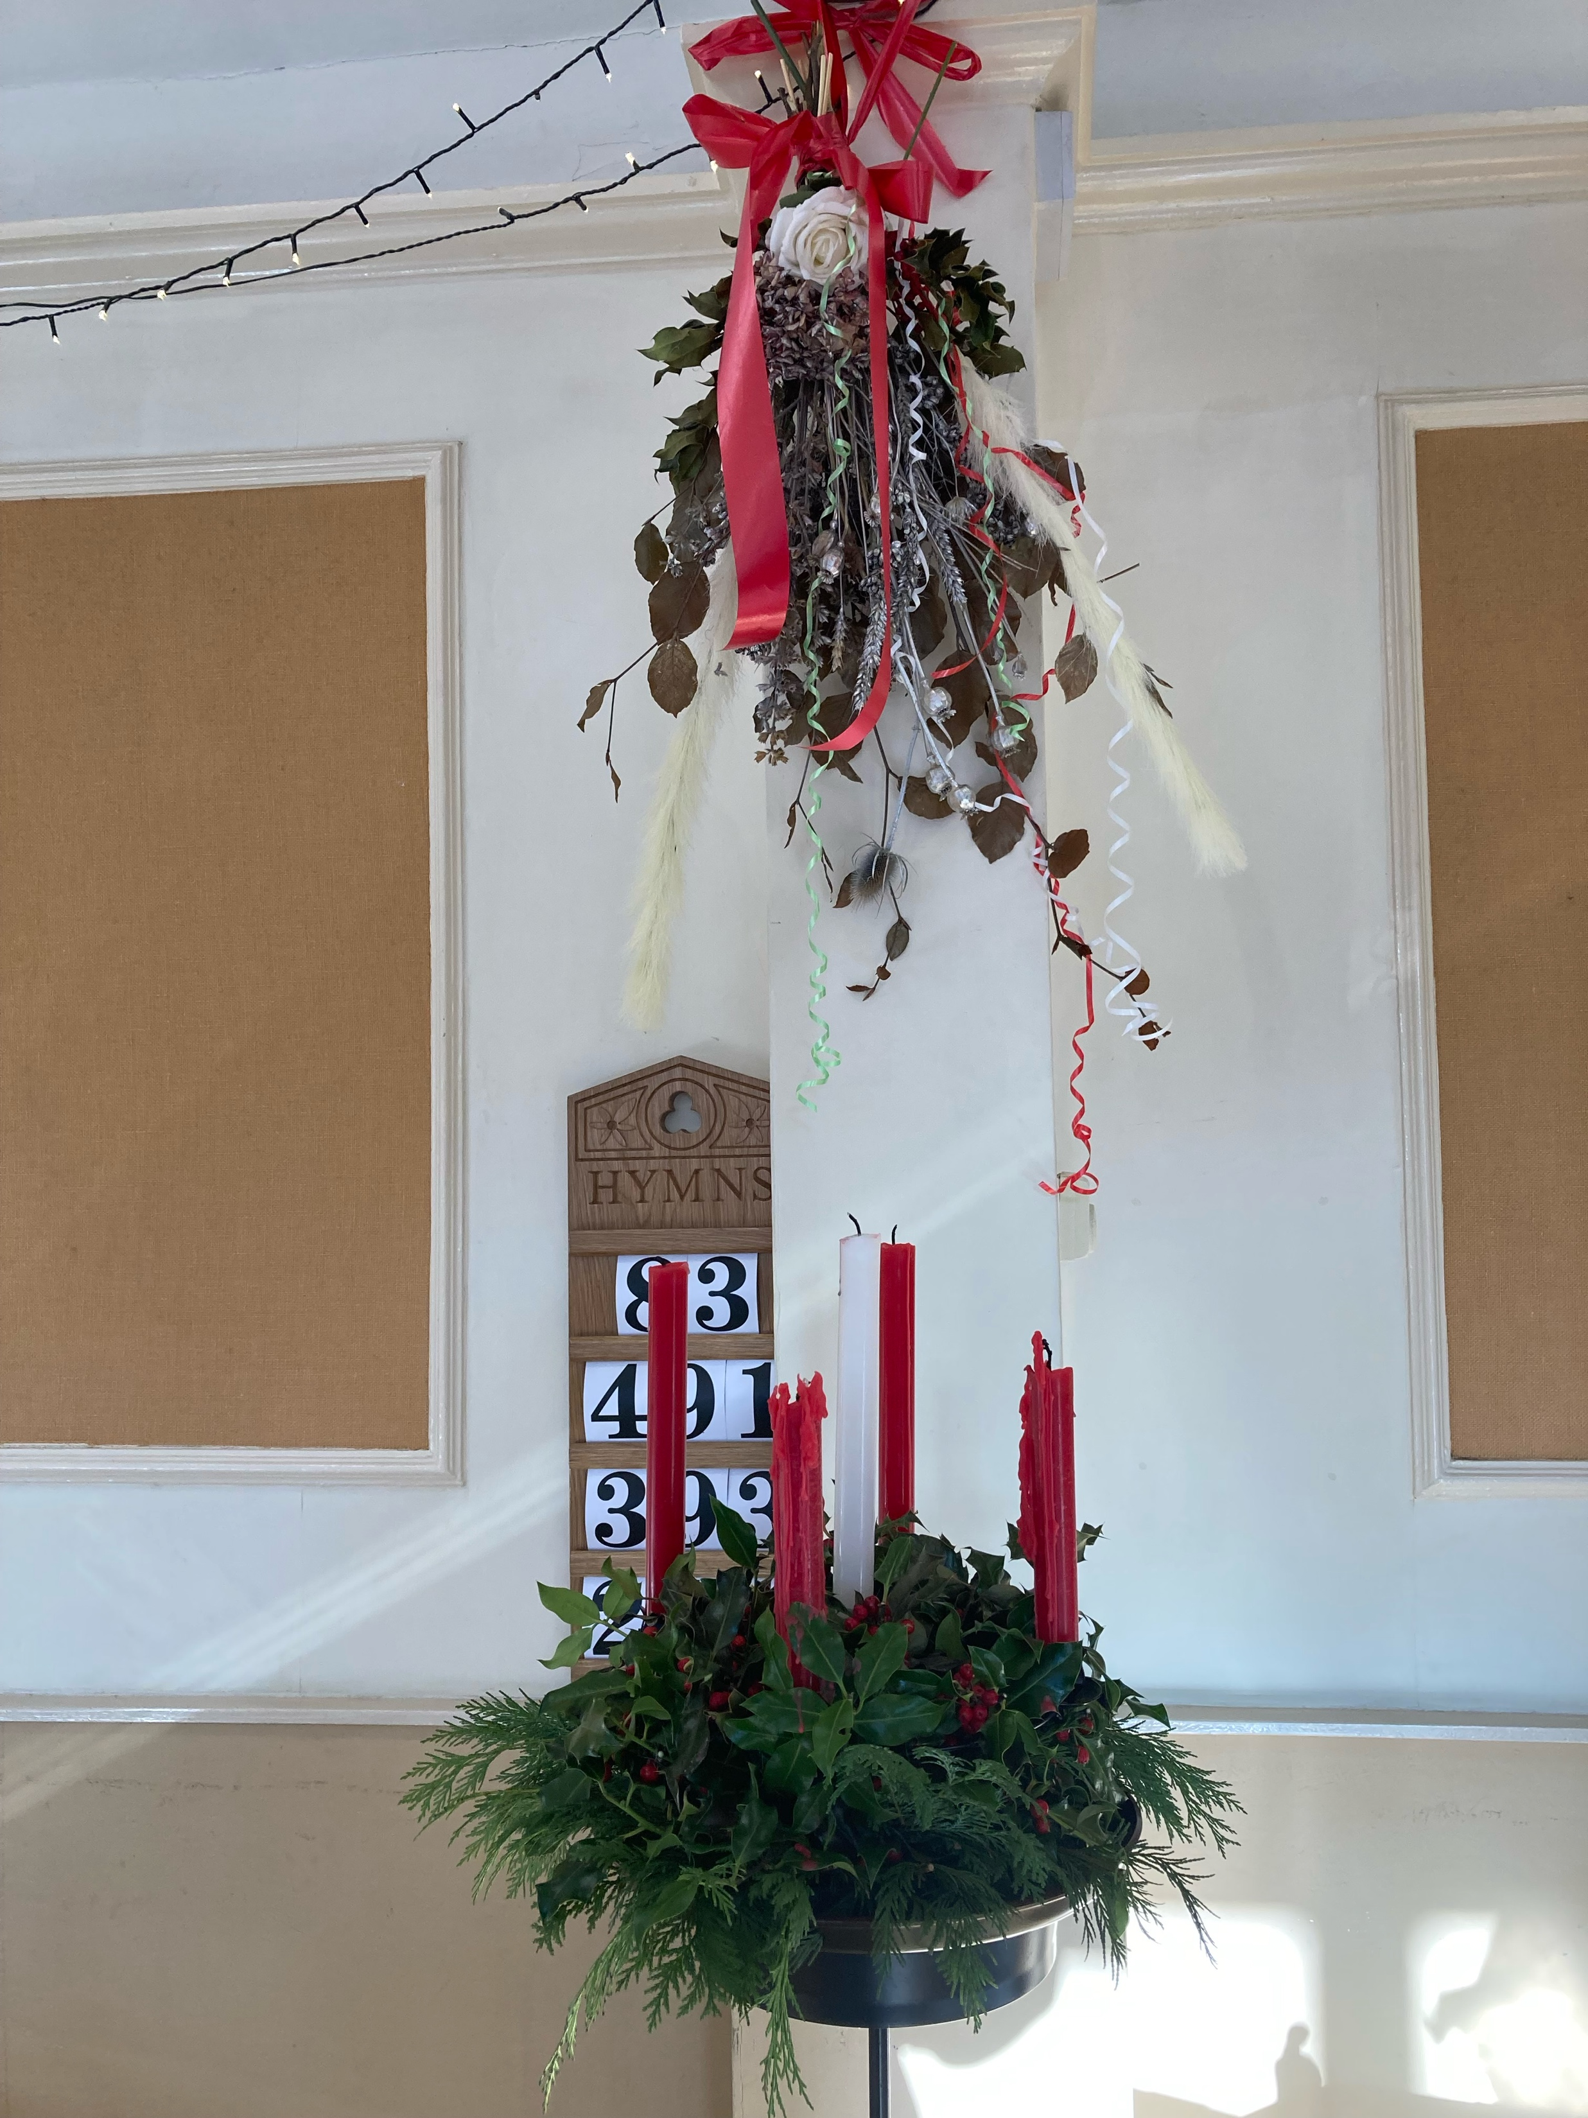
Boothville Community Church
The congregation meets in the Boothville Community Centre each Sunday at 10.30 a.m.
The monthly pattern of worship is two services of Holy Communion and two of Morning Worship.
There is lay involvement in worship with an experienced and reliable musician, readers of lessons, people to lead intercessions and communion assistants.
Boothville Community Church continues to develop links with the local community. The church currently provides two of the six trustees for the Community Centre, and the administration and book-keeping for the centre are done at Emmanuel.
Boothville Community Choir (not a church organisation) includes a number of church members.

Slide 7
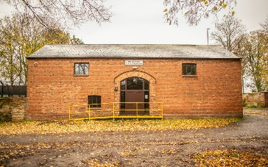
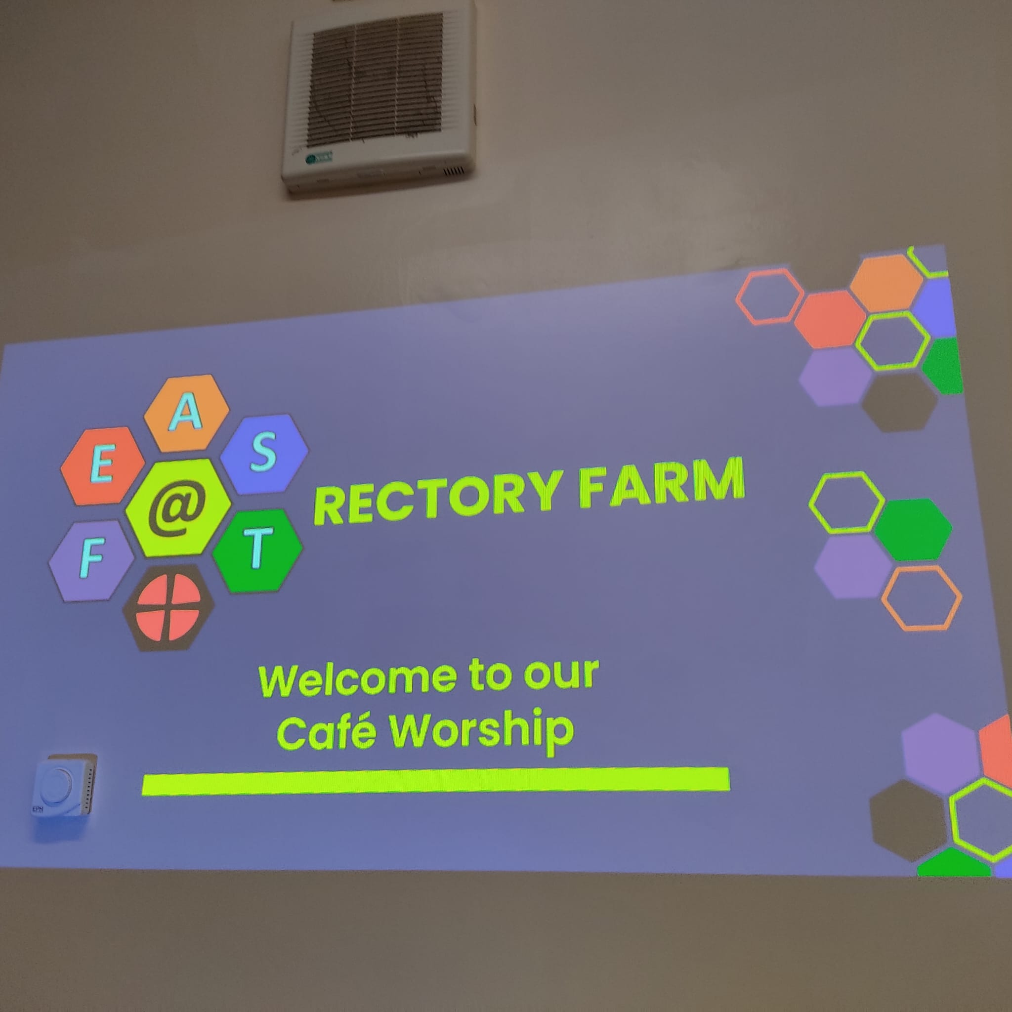
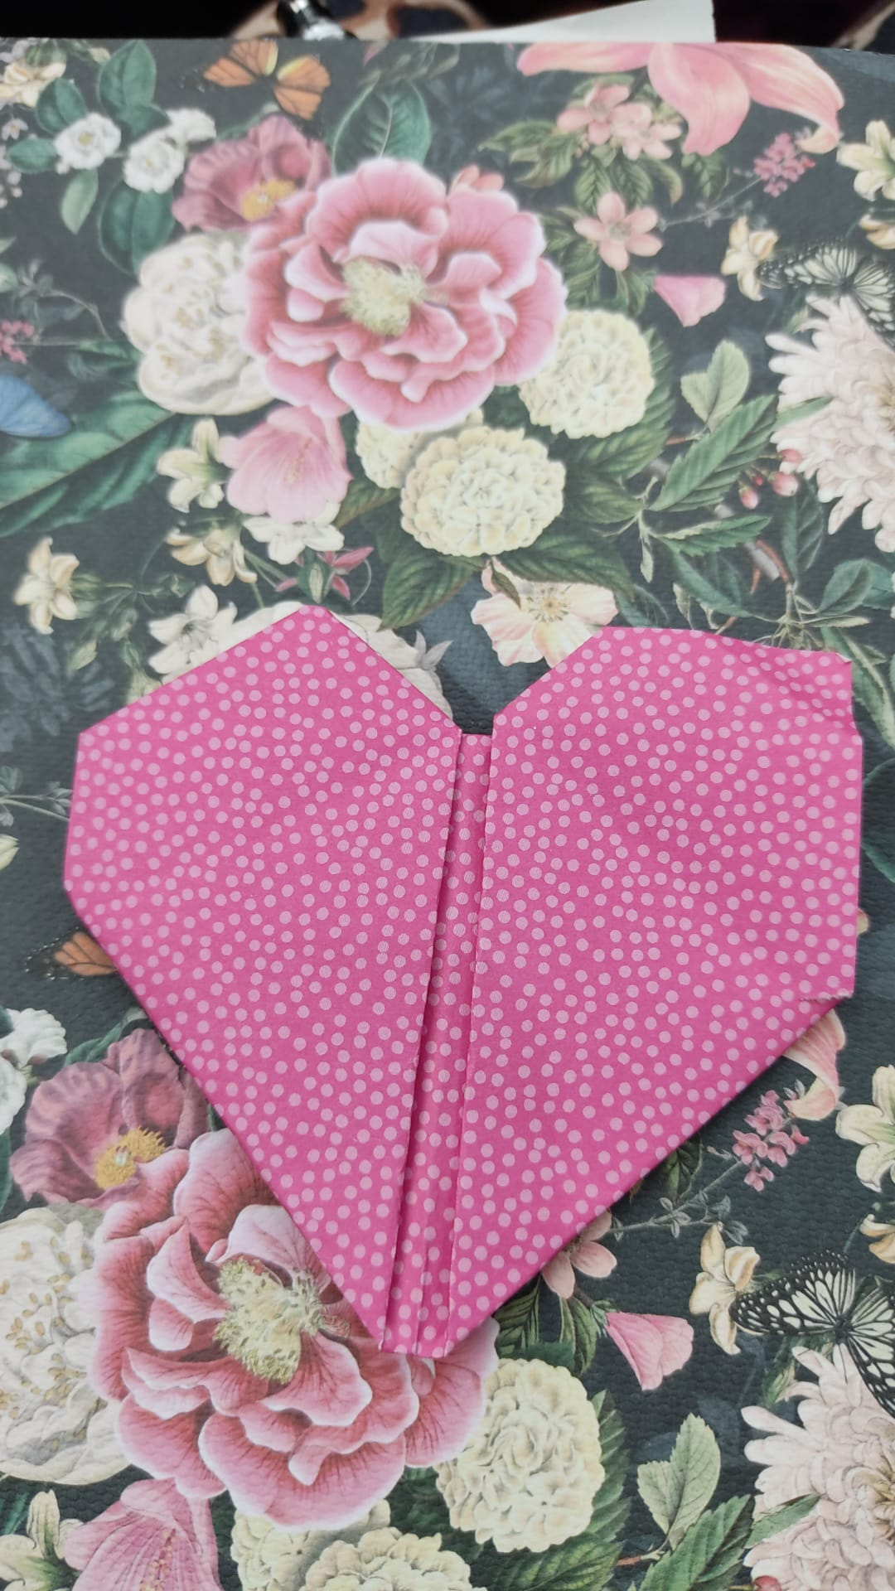
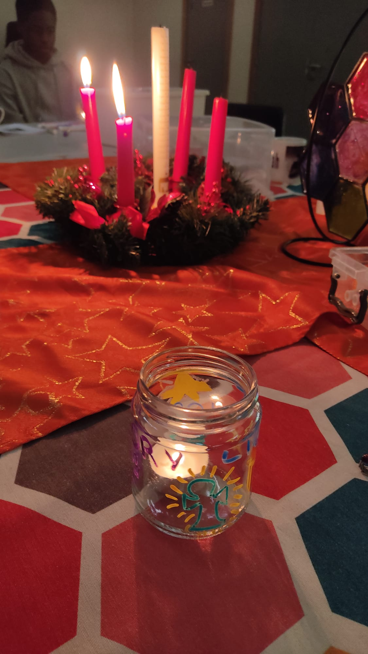
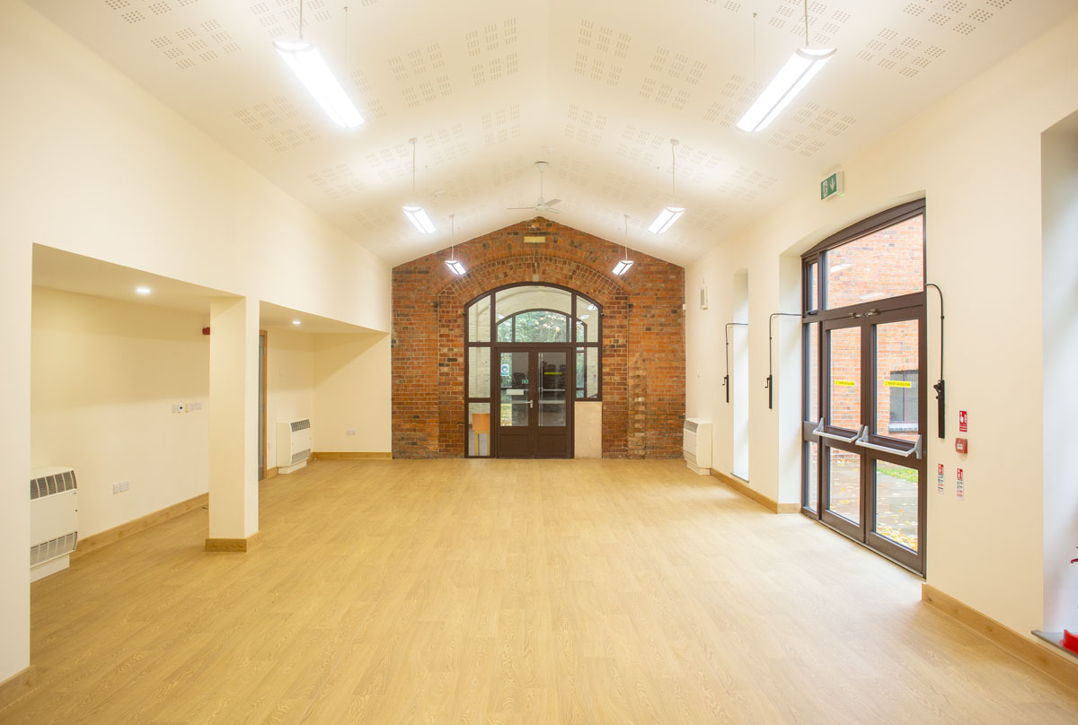
Rectory Farm Community Church
Family worship has been the heart of Rectory Farm gatherings. The services held here are intentionally open to all ages.
The church meets in Rectory Farm Community Centre and aims to be a family where everyone belongs and is important. The church is committed to growth in our relationship with God, growth in relationships with each other and growth in numbers.
We desire to be a welcoming and supportive family. Many people cite our fellowship and support as reasons they look forward to coming to church on a Sunday, alongside worship, prayer and deepening our relationship with God. As of Autumn 2025 Rectory Farm are meeting fortnightly with the first Sunday being a relaxed ‘Café Style’ and the third Sunday a communion service.

Slide 8
Who we are
The Emmanuel Group’s diverse identity is a source of blessing and challenge. We have undergone a period where we have refocused on our identity as a church first.
The Emmanuel Group has an Ecumenical identity and oversees projects in the community and partners offer group’s work too.
Thank you for your generosity, your felxibility and your unwavering support, of our young people and the Arts.
We are happy to be a part of something special! Merry Christmas everyone!
Silhouette Youth Theatre
Thank you so much for helping me find some confidence.
Weston Favell shoppping Centre
Work Experience student from Café Emm.

Slide 9
Our Vision & Mission
We are Christians who intend – with God’s help – to create:
A church
A mission centre
A home for the community
A healing community
A family
We hold these values in common as foundational to playing an active part in the church, the body of Christ. Connecting our identity as a church with our communities, as we continue to aspire to being:
“A family of faith where there is always room for one more”
We believe that the Bible is God’s living and active Word and the means by
which he speaks to his people today.

Slide 10
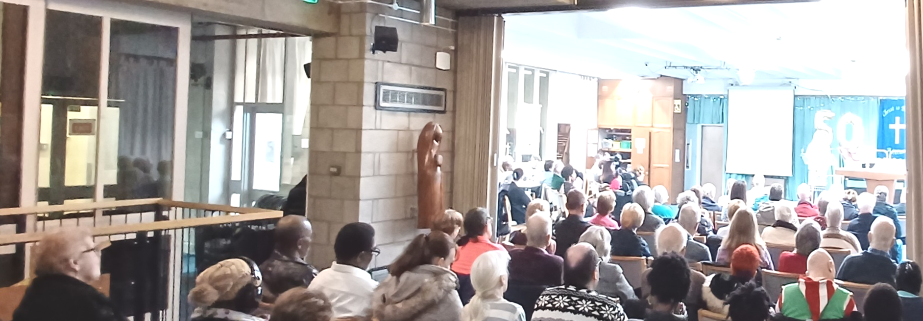
Our Vision & Mission
“A family of faith where there is always room for one more”. Is the Emmanuel Group’s vision statement. It encapsulates Jesus’ teaching about reaching out to the poor, the oppressed (Matthew 5.3-10) and the ‘unwell’ (Luke 5.31-32). The Emmanuel Group is diverse, its’ people are all different with a number having additional needs.
Emmanuel has undergone a shift in priorities recently and we need to rebuild on our identity as a church - God’s church.
There is an element of the unknown to this, our new associate minister will be part of the listening and exploring. There are opportunities for growing links with Schools and further ways of engaging with the community.

Slide 11
Our Biggest Challenges
The Emmanuel Group has been going through a tough period where we have been returning to our primary identity as Christ’s people here using the tagline – ‘We are a church’.
The culture is changing from a charity with a church attached to it, to an active church. This is an ongoing change but by God’s grace we have made significant progress.
We continue to rebuild after Covid. The Boothville congregation recovered quickly, Rectory Farm and Emmanuel are still undergoing recovery.
There are ongoing constraints around finance and other resources. We are focusing on discipleship and reimagining our part in God’s will.
The Group’s identity offers various challenges. For instance, within the L.E.P framework we have been exploring how to validate the members of the church who have not aligned to a particular denomination.
There is a feeling that we need to have an increased sense of an intentional missional approach. Refreshing our relationship with local schools and the Shopping Centre.

Slide 12
Role Priorities
To work with the Team Rector in establishing a missional focus at the Emmanuel Group of churches.
To be part of the Ministry Team, discerning and exploring God’s will for his church in this place and casting that vision to the people.
To grow and develop links with local schools and existing projects –see statistics.
To help update and strengthen our online presence through the website (currently being re-built) and social media platforms.
To share in the discipling and nurture of the people in and around the Emmanuel Group.
There is an element of the unknown in this opportunity. We are excited to see what gifts and experience our new Associate Minister brings with them and how we can work together for the Kingdom of God.

Slide 13
The Person that we are looking for
Essential Characteristics
Mission Focused.
Strong personal faith and prayer life.
Team Player.
Collaborative leader.
A heart for Schools work.
Vision seeker.
Sense of humour.
A commitment to Safeguarding and growing a safer church culture.
Desirable Characteristics
Confident in the digital world
i.e social media, online presence.
Have a heart for estate ministry.
Open to a breadth of worship styles.
Experience of working with other denominations.
Ability to communicate well with others.

Slide 14
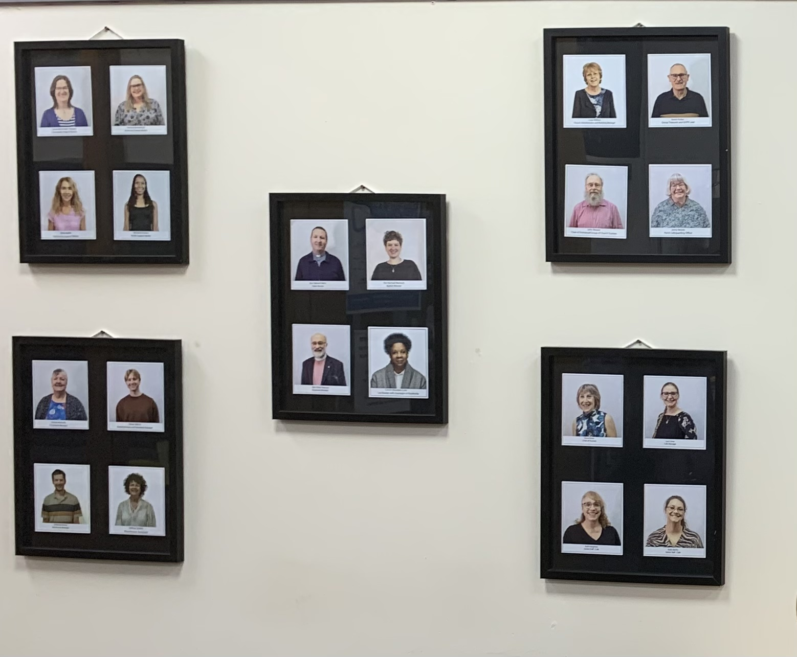
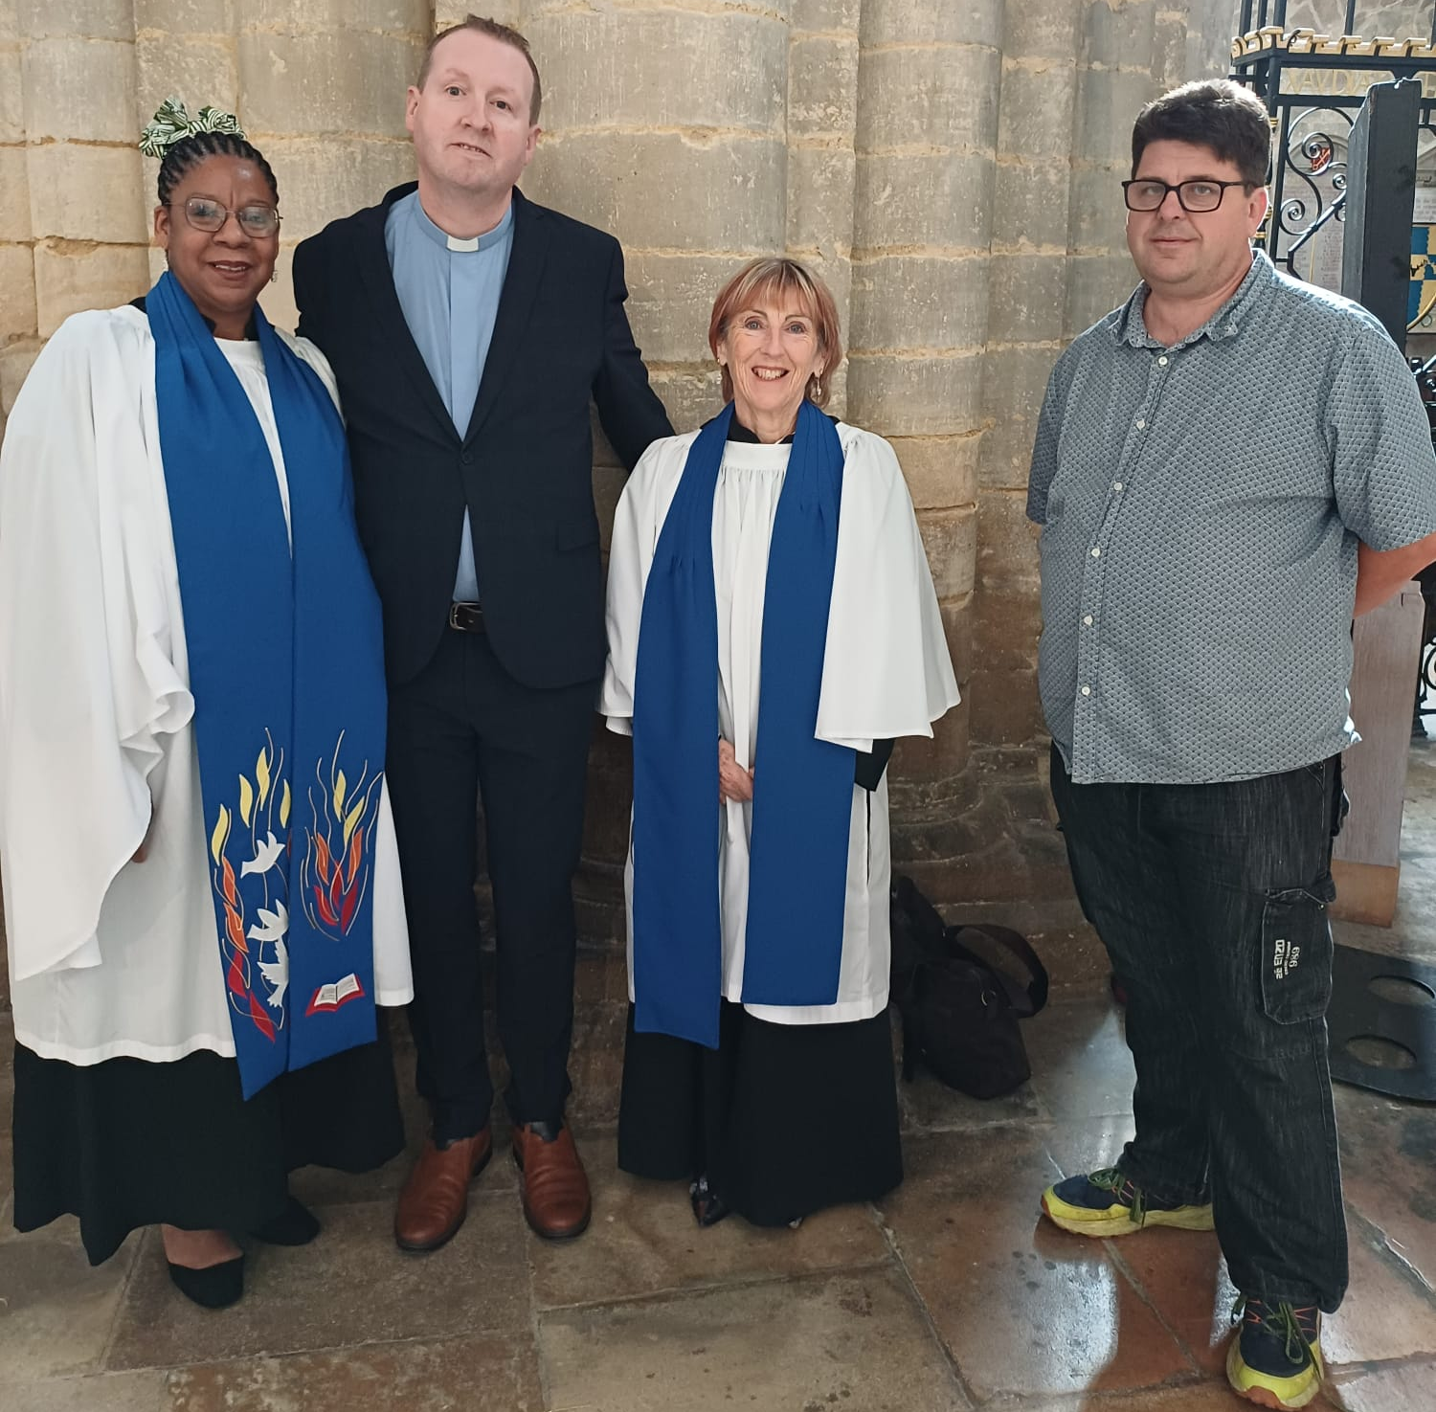
How we can support you
The ministry team meet regularly together to support one another, to pray together, sharing concerns and reflecting on the life of the church.
The Emmanuel Group operates with a ‘Group Council’ which can be likened to a PCC. This is currently chaired by a lay person and has representatives from the three congregations and the community.
The ‘Constitution Council’ has delegated responsibility for the Constitution and denomination matters, Care of Clergy, Clergy Vacancies and allocating the Tithe fund.
There are two other sub-committees – the Finance Committee and Steering Group, who have a remit over operations of staffing and community.
Café Emm is a separate legal Charity currently the trustees are all church members.

Slide 15
The Teams that will support you
Ministry Team:
Team Rector
Ecumenical Church Minister: Vacant
1 x Assistant Priest
3 x Licensed Readers, one of whom has Pastoral Responsibility for Boothville
1 Lay Preacher: Baptist
1 Reader in training
Other Church Work
• Community Projects Director
• Mission Support Worker (A new post that began in February 2026)
• Part-time Young Families Worker
Team Rector
Rev Stewart Betts, came to Northampton in Autumn 2023, with Zoe his wife and Joanna their daughter. They were called from a 3 church benfice in South West Leicester. Stewart had also previously served his curacy in Leicester Diocese having been ordained in 2018, previously Stewart worked in food retail for 22 years before leaving in 2011 to begin a theology degree. Stewart has an appreciation of good coffee, is a master of the ‘dad joke’ and is an avid Leicester City fan and therefore appreciates prayer!

Slide 16
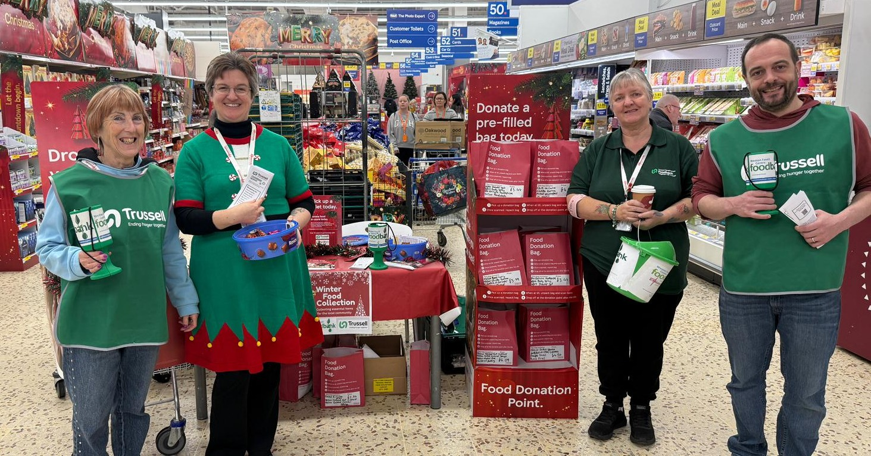
The Teams that will support you
Administration
• Church Administrator: paid; 32 hours per week
• Church Office open Tuesday – Friday, 10 a.m. to 2 p.m. staffed by volunteers. We offer photocopying and fax facilities to the public and often sit on the front line of serving the needs of people who walk in.
• 2 Church Wardens
• Baptist Secretary
• Methodist Steward
• Safeguarding Coordinator
Foodbank
• Manager
• Coordinator
• Administrator
• Volunteer & Training Development Manager

Slide 17

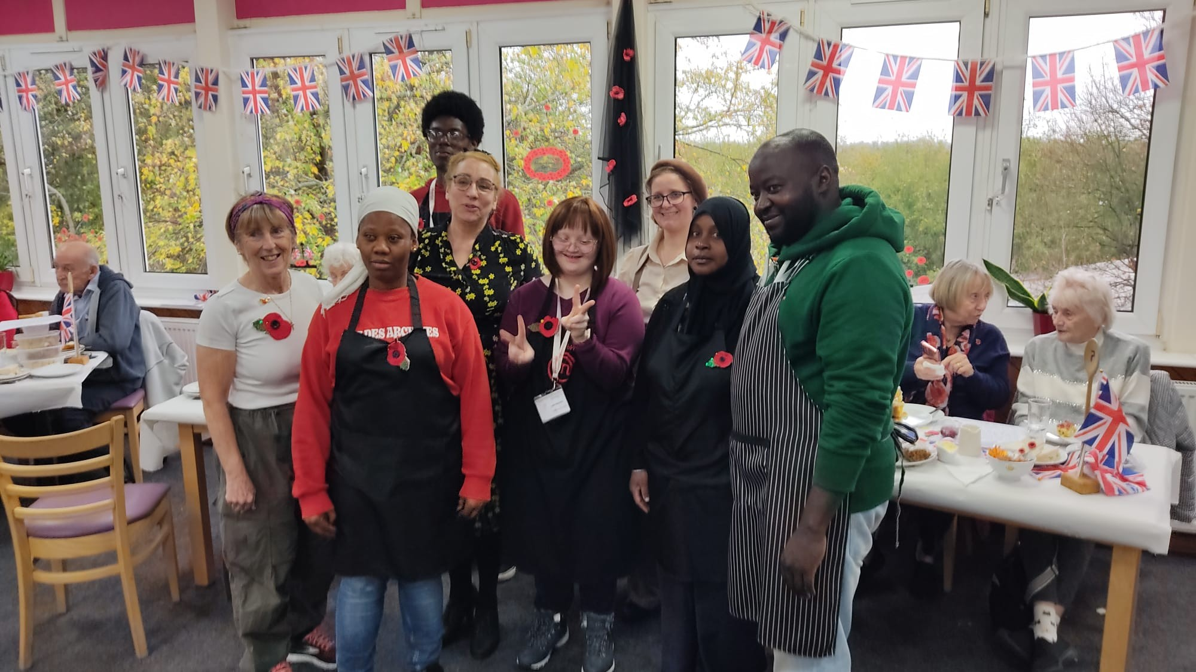
The Teams that will support you
Cleaning
• Part-time cleaner & light maintenance
Café Emm
• Manager
• Cook/supervisor
• Part-time cook
• Community Support Worker

Slide 18
Our History
Emmanuel, was built and opened in 1974. It formed part of the Weston Favell Shopping Centre - an out-of-town shopping centre built to serve the numerous new estates which were being constructed.
The Emmanuel Group was originally made up of Anglicans, Methodists, Baptists and URC members.
LEPs (then known as Local Ecumenical Projects) were very new at the time, and still very much experimental. Emmanuel was held up as being a new, exciting way of being church.
In the mid 1990s, two church plants were created,. One at Boothville and the other at Rectory Farm, both within the parish boundary. The Emmanuel Coffee Shop – which would later become Café Emm - was opened around this time too.
December 2024 we celebrated our 50th Anniversary .
Now the Emmanuel Group is made up of Anglicans, Methodists, Baptists and Shared Members. Over the last 50 years we have evolved. While respecting and valuing our supporting denominations, we now see ourselves working in a post-modern society as an Ecumenical Church with people of all Christian traditions, some of whom are not affiliated to any specific denomination.

Slide 19
Our Statistics
49
People

Slide 20
Our Statistics

Slide 21
Our Statistics
Service and location | Children & Youth (0 – 16 yrs) | Adults | Totals
Emmanuel 10.30 a.m. service | 5 | 35 | 40
Boothville 10.30 a.m. service | 0 | 30 | 30
Rectory Farm 3.30 p.m. service | 2 | 6 | 8
Average attendances from late 2024/25

Slide 22
Our Statistics
Groups that are ‘Café owned’ | Average attendances 2025
Memory Cafe | 20
Singing for the Soul | 40
Table Games | 12
Tots | 30
FI.S.H | 30

Slide 23
Our Worship Life
The worship style in all three congregations is relaxed with leanings towards Free Church style services. The Communion services use liturgy, either Anglican or Methodist/Baptist. We use a laptop and projector with Power Point for worship songs, readings and liturgy at Rectory Farm and Emmanuel. If no musician is available, we use suitable recordings for worship including YouTube.
At Boothville, Mission Praise books are used, there is a regular pianist.
We rarely use robes, apart from occasional special services.
We communicate in a variety of ways, some people prefer electronic and some paper. We provide a weekly prayer and notices sheet. We have a bi-monthly parish magzine called B.E.R.T and use ‘Church Suite’.
Home groups are are not only an extension of our worship and discipleship but also a strong source of fellowship and pastoral care.

Slide 24
Our Worship Life
Current Monthly Service Structure
Monthly Pattern | Emmanuel | Boothville Community Church | Rectory Farm Community Church
First Sunday | 10.30 a.m. Holy Communion | 10.30 a.m. Morning Worship | 3.45 p.m. Café Style Service
Second Sunday | 10.30 a.m. ‘All-Together’ | 10.30 a.m. Holy Communion
Third Sunday | 10.30 a.m. Holy Communion | 10.30 a.m. Morning Worship | 3.45 p.m. Holy Communion
Fourth Sunday | 10.30 a.m. Morning Worship | 10.30 a.m. Holy Communion
Fifth Sunday | We are in talks about ‘Emmanuel group’ gathering together for worship on 5th Sundays

Slide 25
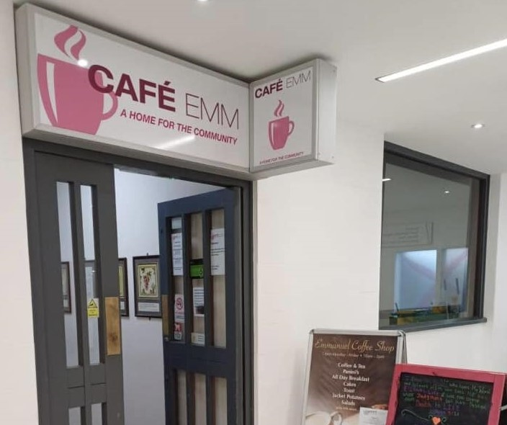
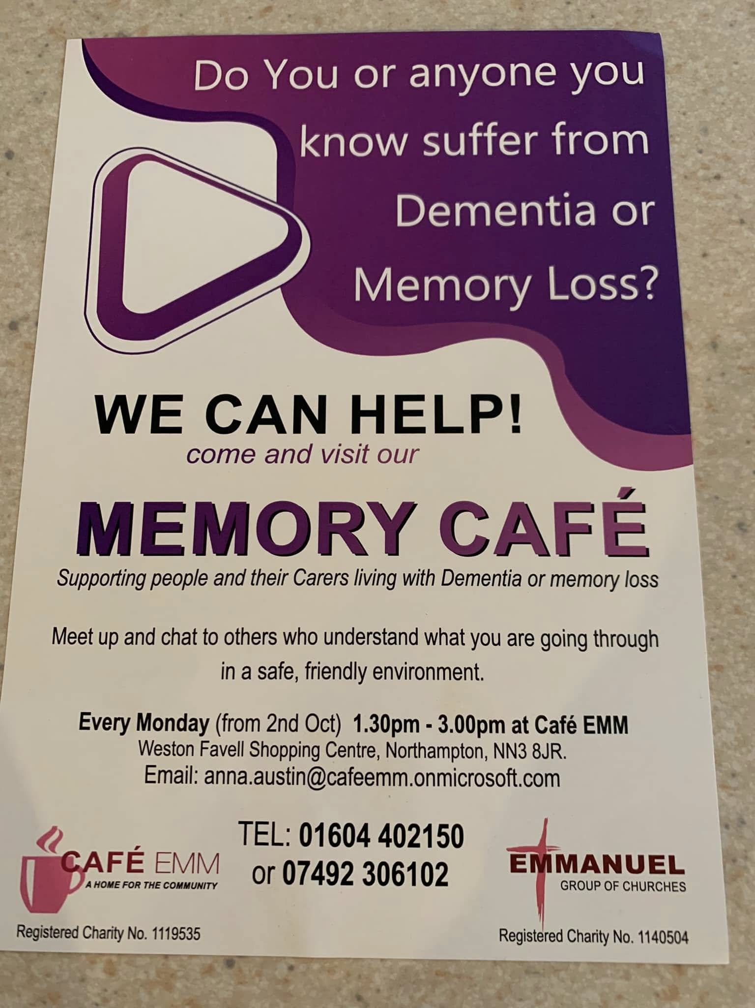
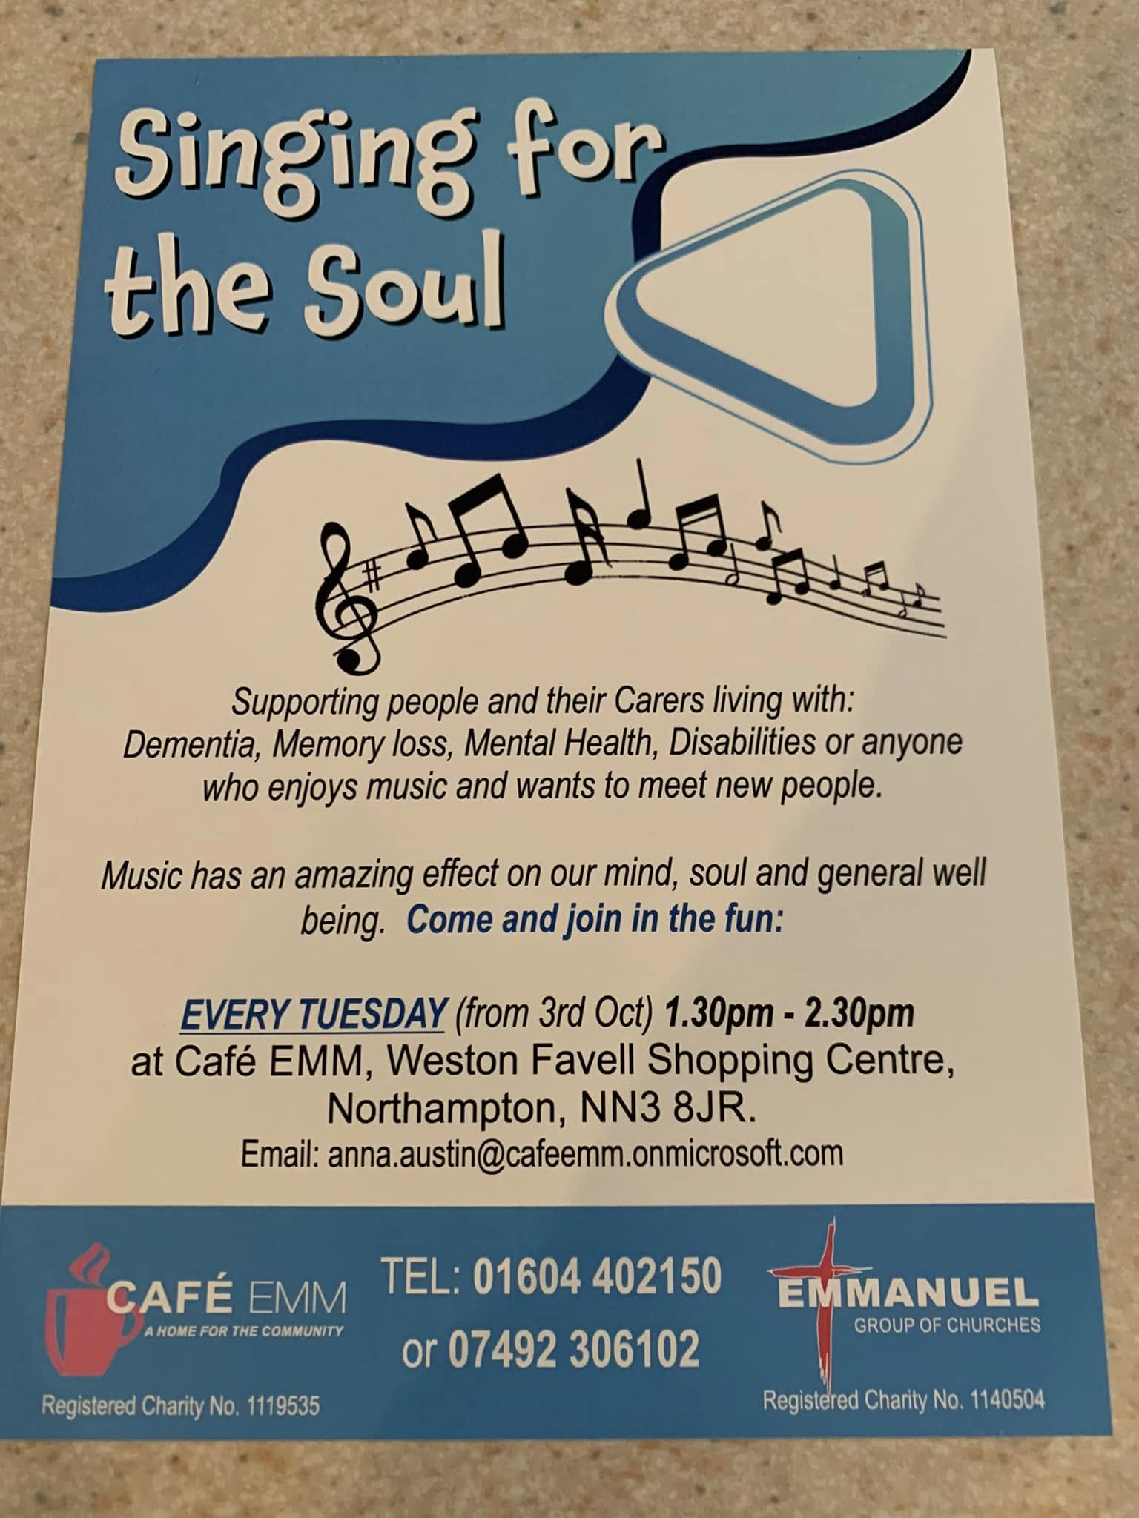
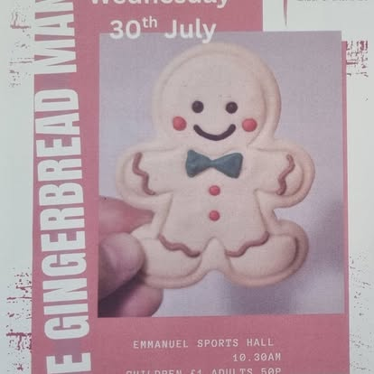
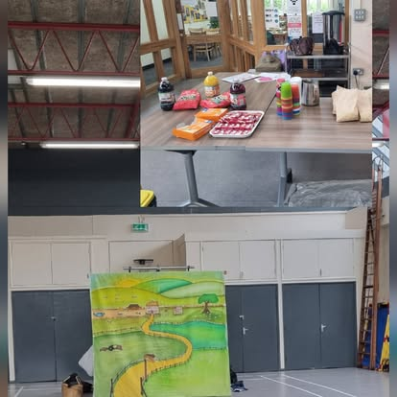
Our Outreach and Community Engagement
Family Tots at Emmanuel provides a relaxed atmosphere and safe play where adults, toddlers and babies can enjoy meeting. We aim to help them to make friends and develop social skills. We have sessions every Wednesday and offer play, craftwork, drinks and snacks, singing and music. At Christmas we hold a short Carol Service and Christmas party. Two new groups have commenced since lockdown, a smaller group supporting individuals who experience of have experienced domestic abuse, and a Grandparents Group.
Check out the groups in action on :
https://www.facebook.com/TheEmmanuelGroupOfChurches

Slide 26

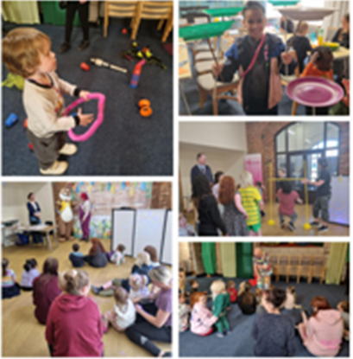
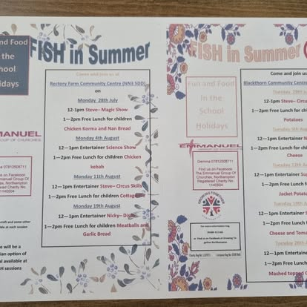
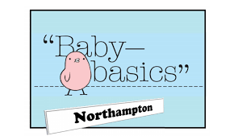
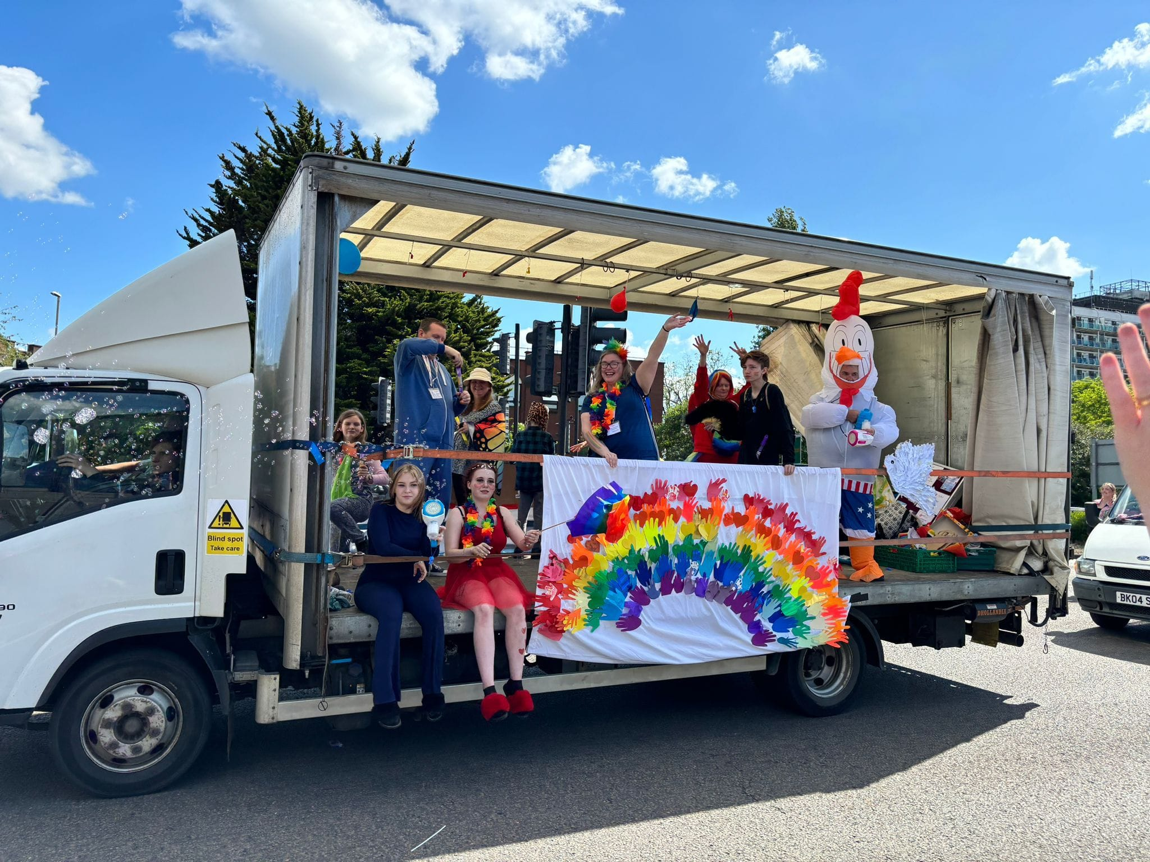
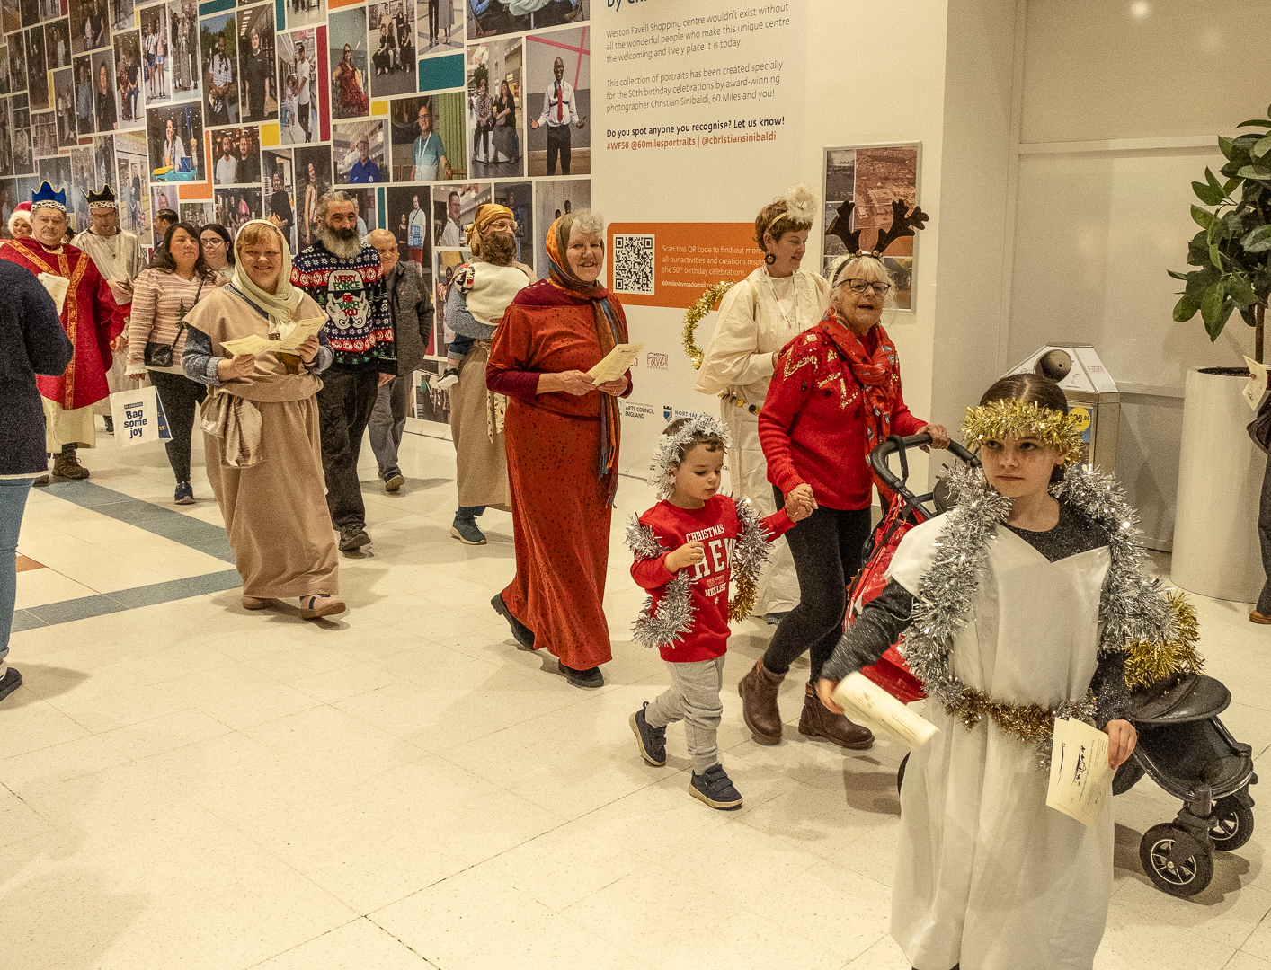
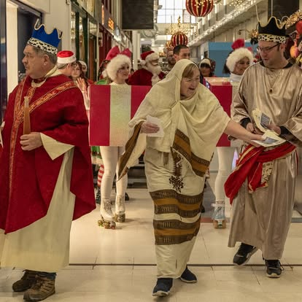
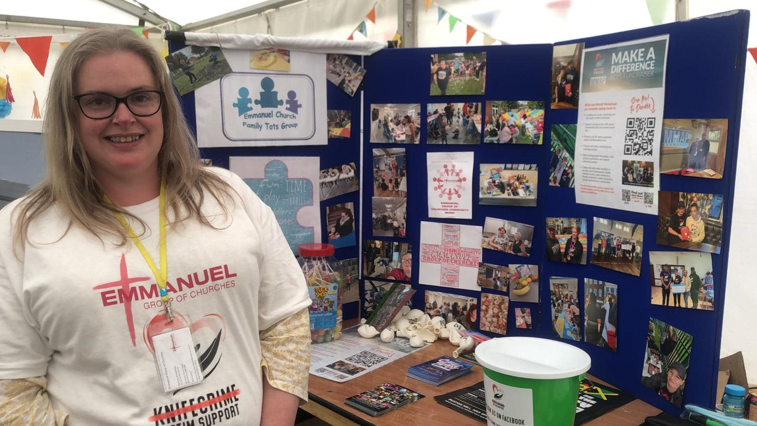
Our Outreach and Community Engagement
F.I.S.H
Food, Faith and Fun In
School
Holiday’s
Collection point
Summer Canarnival, The Christmas Parade and The Christmas Fair!

Slide 27
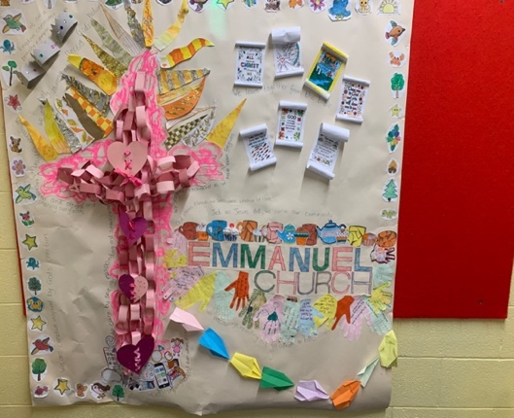
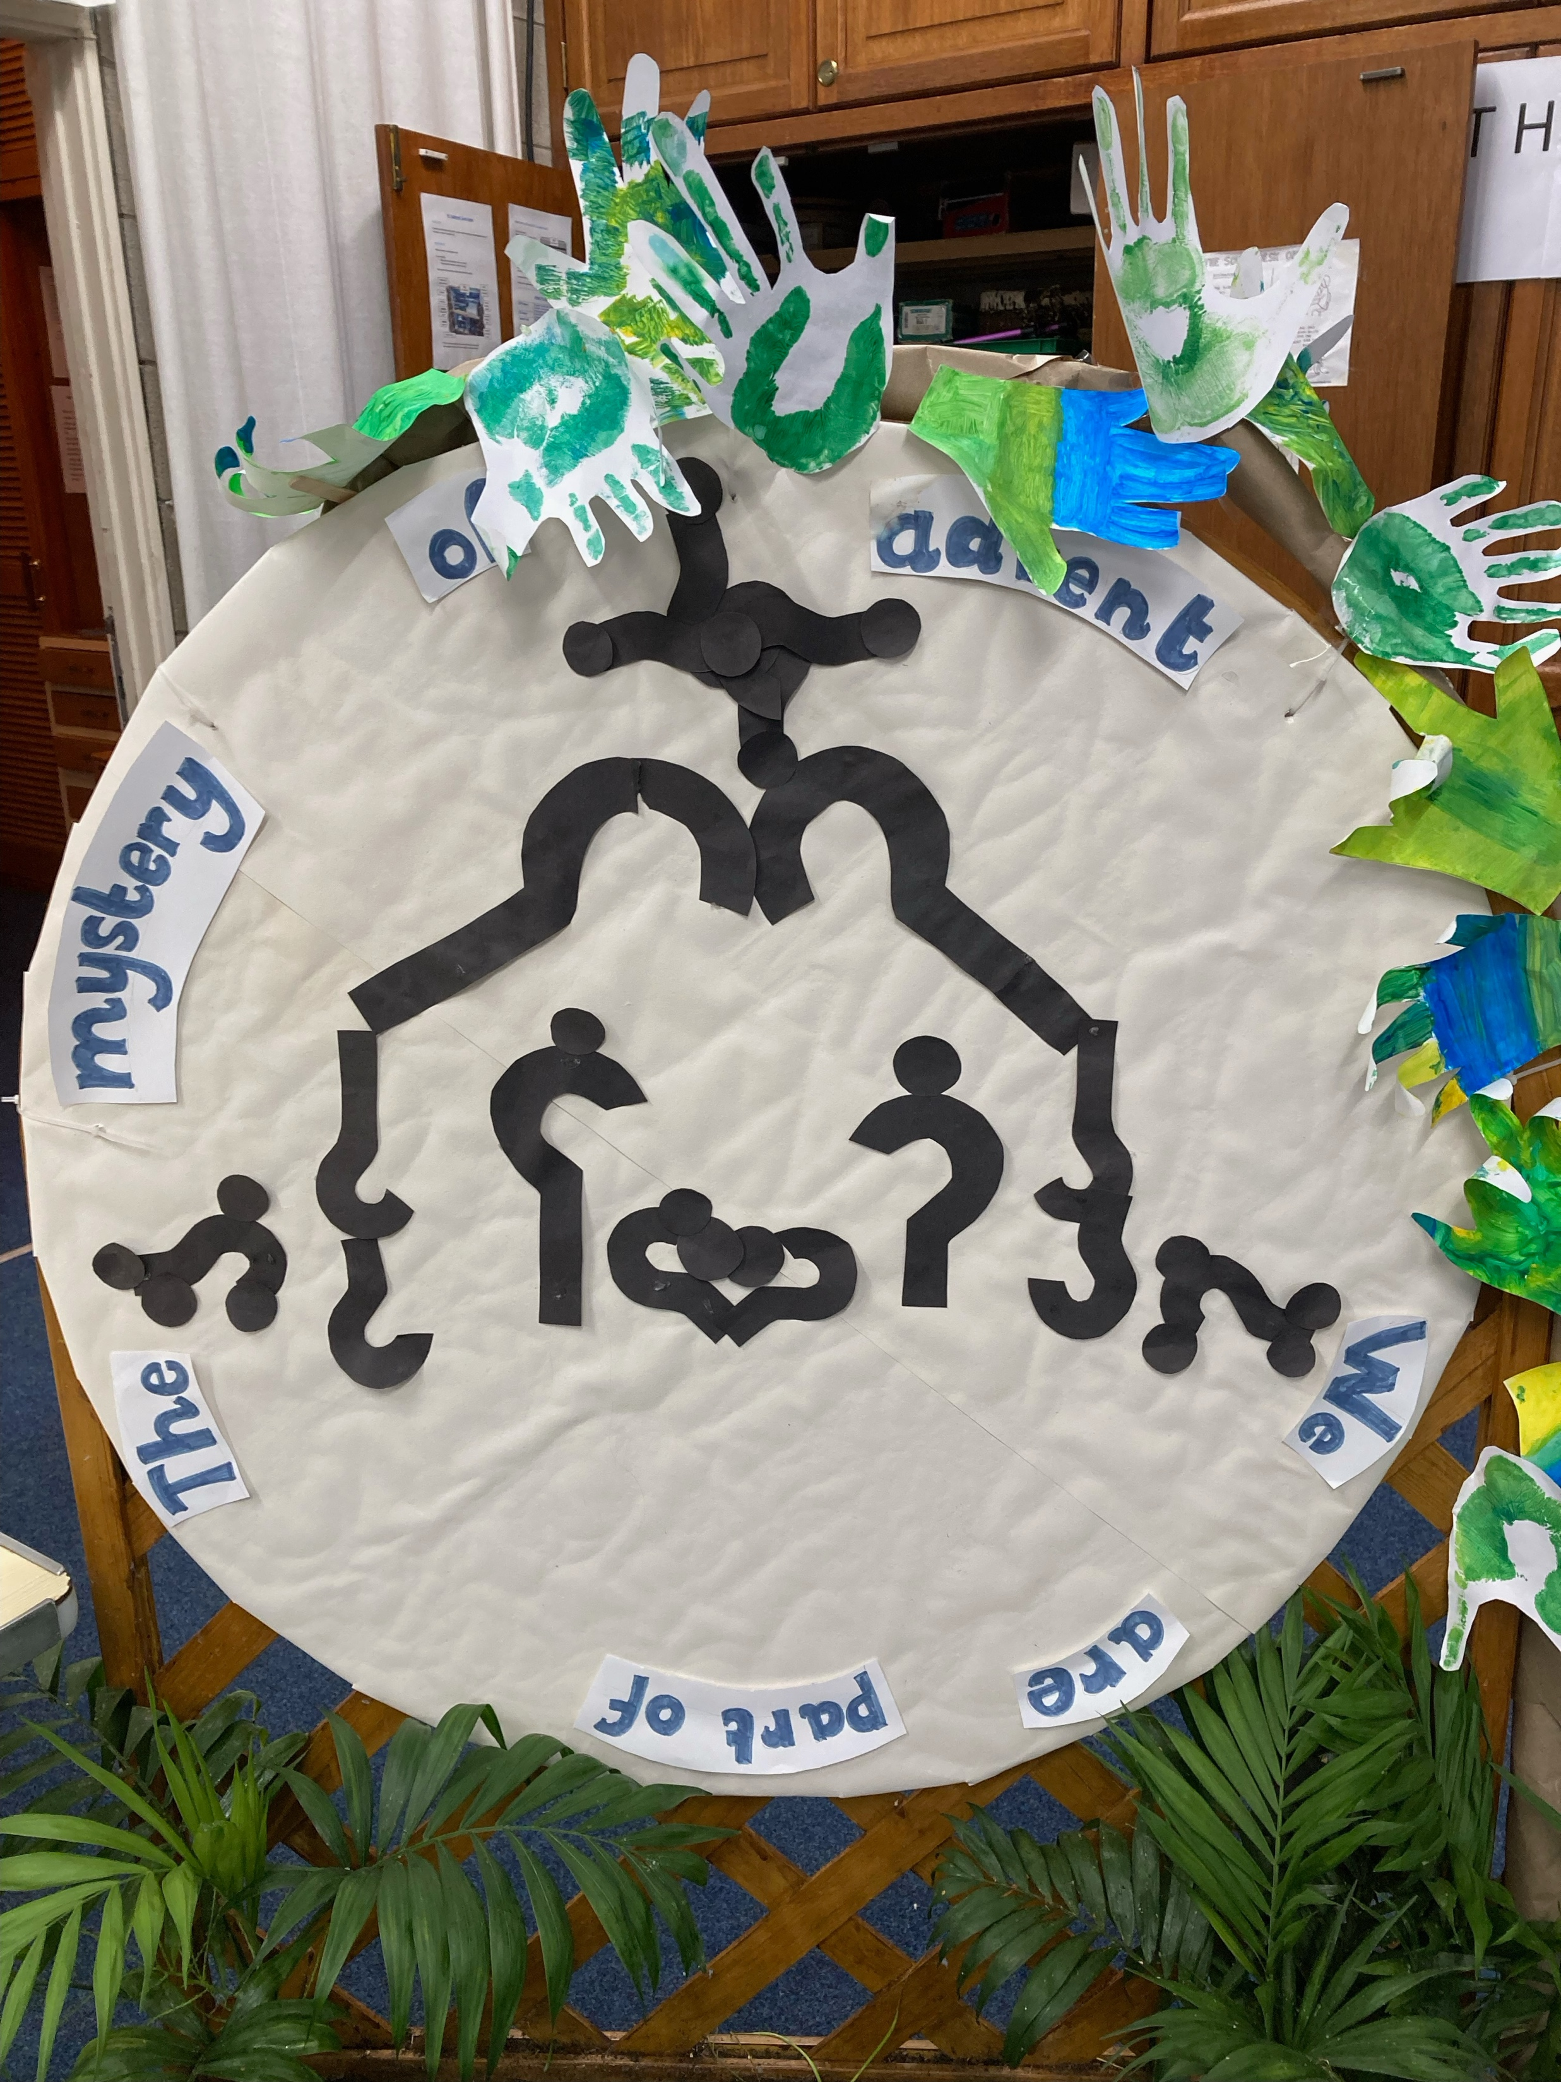
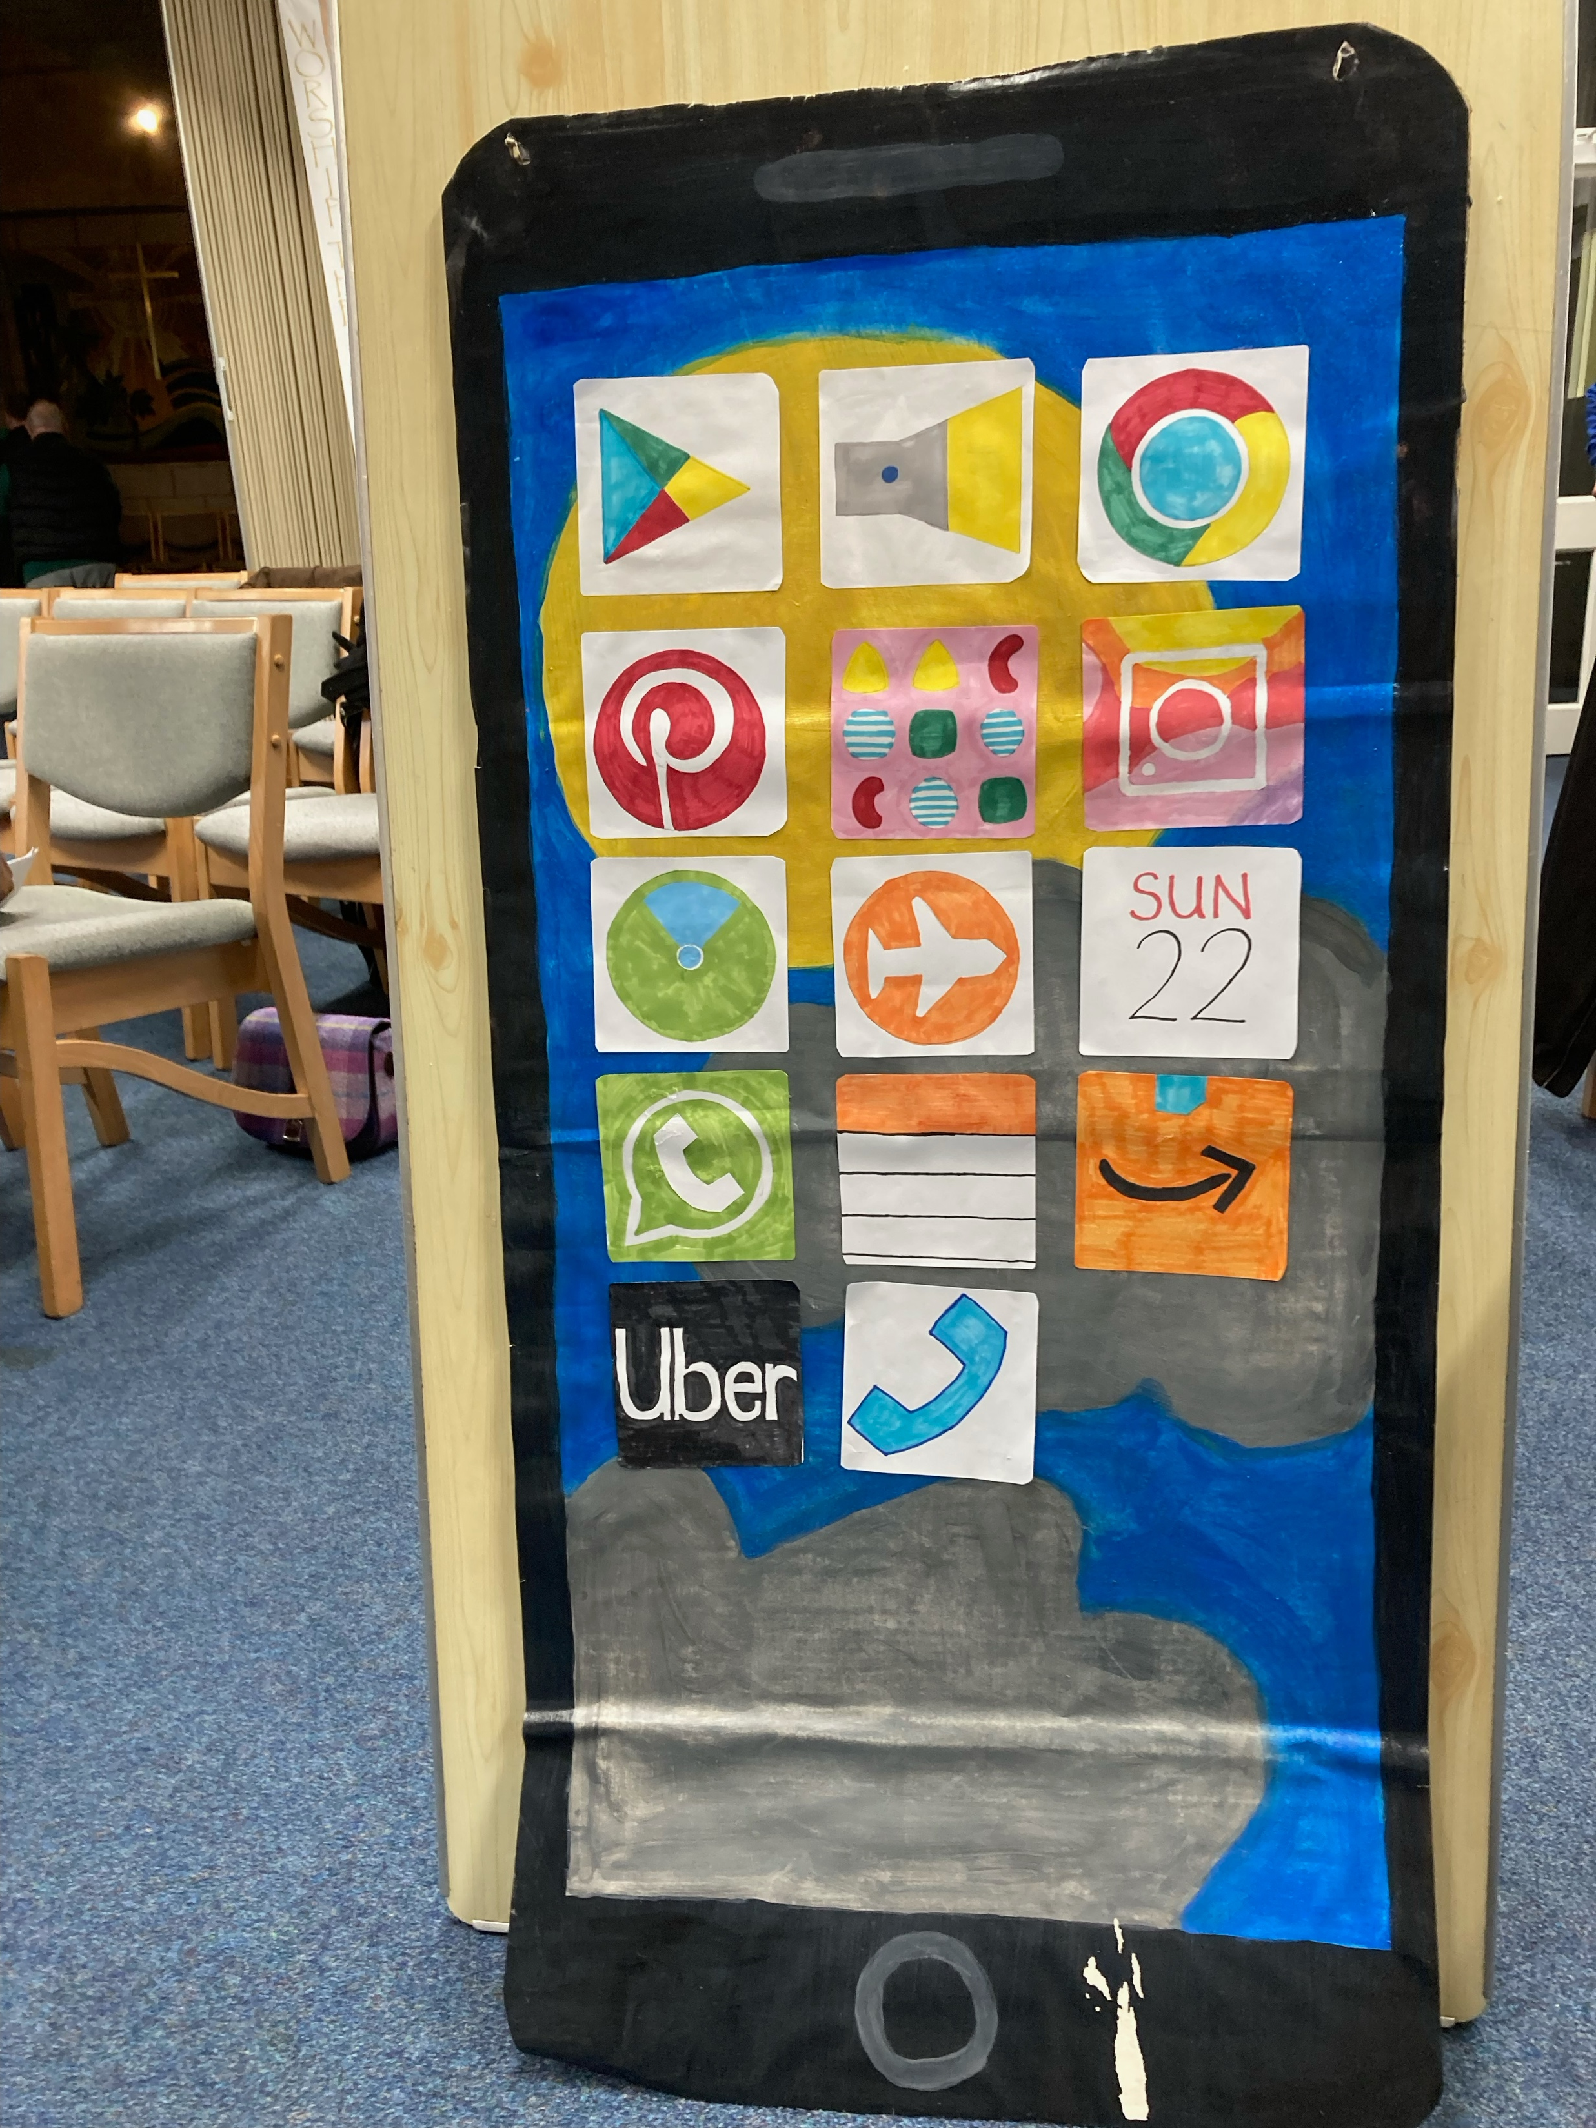

Our Children and Youth
At Emmanuel we have a dedicated and gifted church member who provides creative and thoughtful children’s activities on Sunday mornings with a small team of helpers. The number of children can range from 1 to 10 on any Sunday and the ages range from 4-14. The ‘children’s activity’ is always based on the theme of the service. These murals were built up through some of the sermon series themes in 2024/5.
Advent-
We are all part of the
mystery of Advent.
What is the Church?
What is it for?
Prayer
RZone Youth Club
Mondays
Rectory Farm
https://www.facebook.com/TheEmmanuelGroupOfChurches

Slide 28
Our Groups
We hold a weekly Monday Night Payer Meeting, although this has been on Zoom we have introduced a monthly ‘in-person’ meeting.
We have 5 regular home-groups with a different level of engagement with the material. We use a mixture a home produced and pre-published materials.
We have monthly social events where church folk and some of the people on the ‘fringes’ meet together in a relaxed setting. These include -
Emmanuel for Men
Men’s Pie and Pint
Women and Wine
Our annual AGM has also become a time of celebration, fellowship and of course food. This has been a good opportunity to bring the congregations together for business and relationship building purposes.

Slide 29
Our Finances
The Emmanuel Group finances are overseen by our treasurer and the Finance Committee.
Parish Share, Methodist Assessment and Baptist Capitation fees have been paid in full.
Clergy expenses are reimbursed.
There is a benevolent fund for discretionary help for those that in particular need.
We have introduced the Parish Giving Scheme as a preferred means of regular giving, 20 people currently give through the PGS.
Emmanuel Group operates a ‘Tithe Fund’ which is a commitment to give away 10% of total giving to local, national or international causes. The constitution Council have responsibility for allocating these funds.

Slide 30
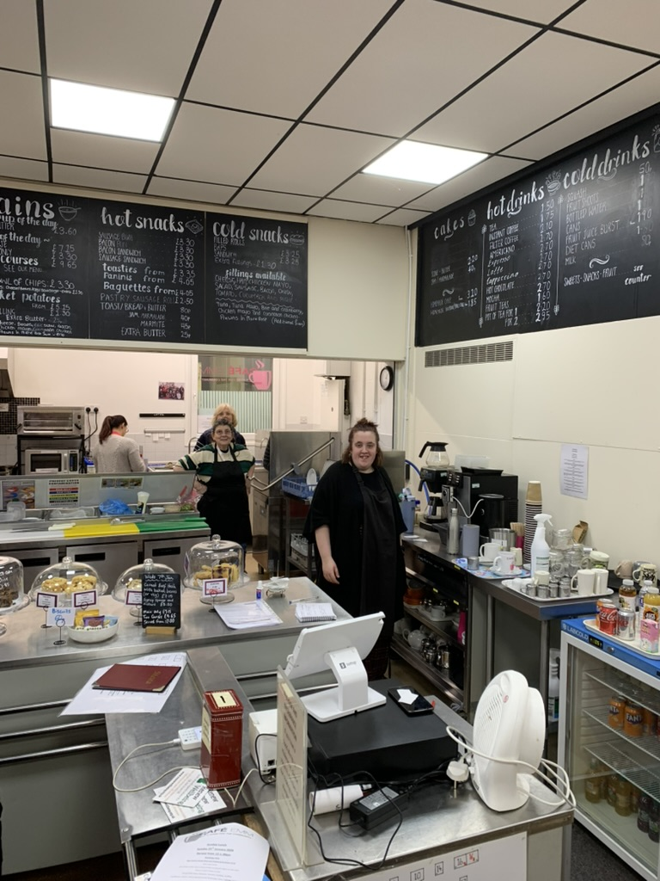
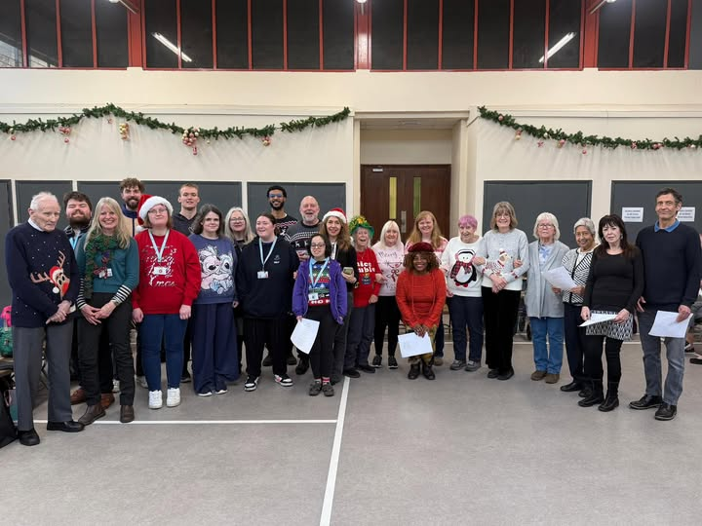
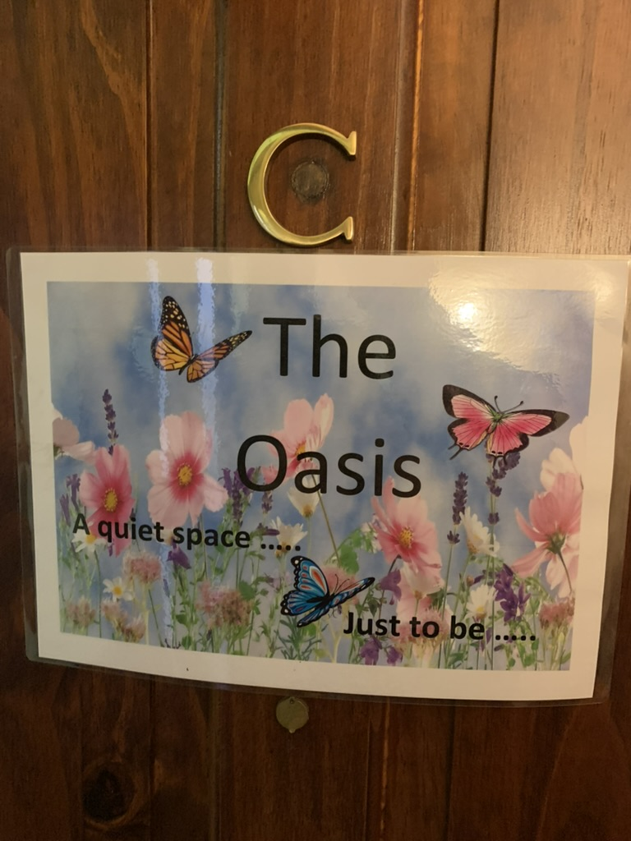
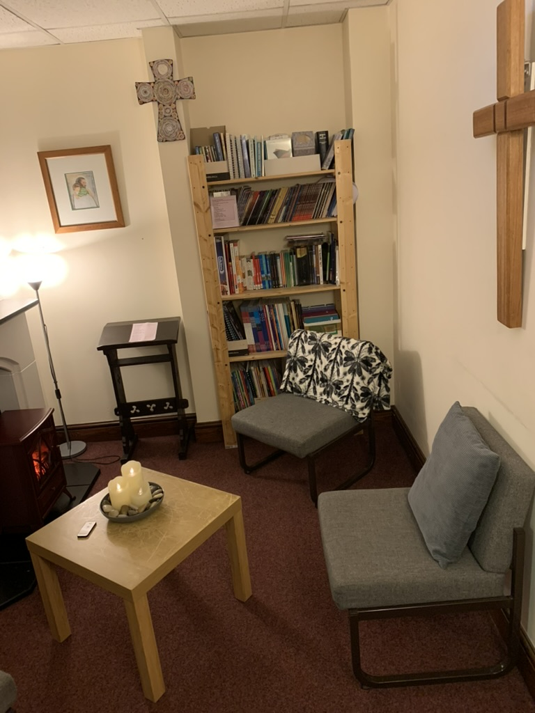
Our Building
Emmanuel Church
The worship centre is on the “High Street of Weston Favell Centre”. There are two main entrances to Emmanuel, one on the ground floor on Billing Brook Road by the bus stop, and the other on the shop level, either into Café Emm or to the Church offices.
The top floor comprises a sports hall, prayer room, coffee shop (Café Emm), several church offices, toilets and coffee shop store and preparation room. There is a lift to the lower floors. The sports hall forms a bridge over the road below.

Slide 31
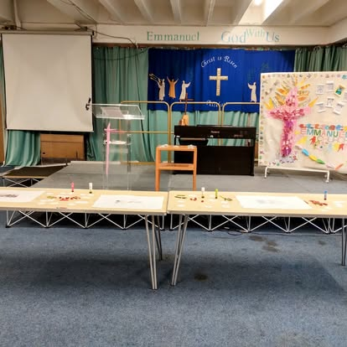
Our Building
Emmanuel Church
The middle floor is used as the main worship area. This comprises of a large worship area with a stage, a smaller chapel with sliding screens that can be drawn back to enlarge the main hall. The chapel has an open baptistry for full immersion. There is a smaller lounge area which can also be opened into the chapel. When all areas are open, we are blessed with a versatile space.

Slide 32
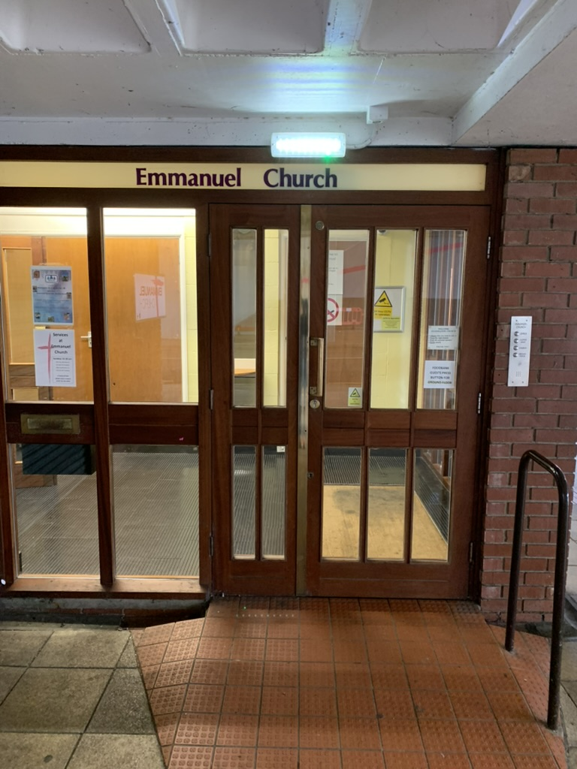
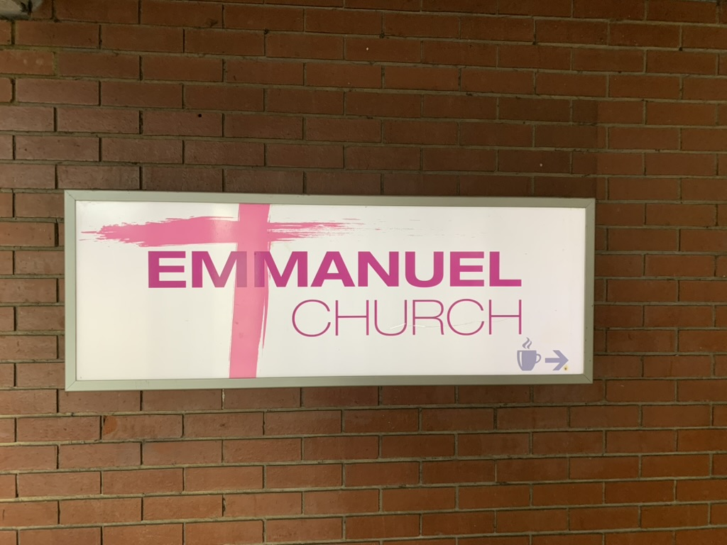
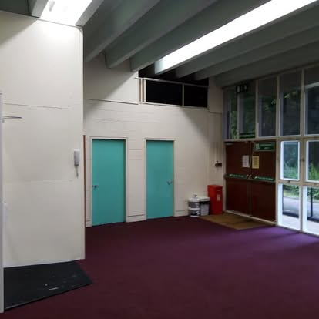
Our Building
Emmanuel Church
The ground floor has an entrance hall, disabled toilet and a Family Room which can seat about 30 people. This room is below street level and can be reached by six stairs or by a wheelchair lift. It serves a variety of uses as a smaller space for some external groups and the distribution point for the Foodbank.
There are no church grounds or church yard. We have access for parking for specified vehicles in a carpark adjacent to the church, but generally, cars are parked (time limited) in the Weston Favell Centre.

Slide 33
Our Context
Northampton is in the East Midlands approx. 60 miles North of London. This area was developed as a London overspill during the 1960’s and today comprises of 14 housing estates and is known as Northampton East.
Emmanuel Parish – Northampton East made up of several housing estates. Our Foodbank provides help for over 700 families on average per month.
Church urban fund data can be found on this link: https://cuf.org.uk/parish/280114 Or accessing Church Urban Fund – Emmanuel Northampton.
The Parish has a population of over 35,000 people. Split between owner-occupied, rented and social housing, almost all of which has been built over the last 50 years.
There are several industrial estates adjoining the parish and a diverse mix of nationalities. Census data can be found on this link: https://www.nomisweb.co.uk/sources/census_2021/report?compare=E06000062
The housing estates built from the 1960’s to 1980’s generally have local retail outlets; some have primary schools, takeaway food outlets and pubs. There are good bus services running to the Weston Favell Centre (WFC) and on into the town centre.

Slide 34
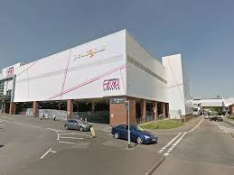
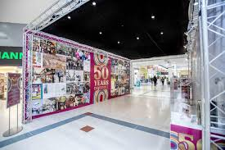
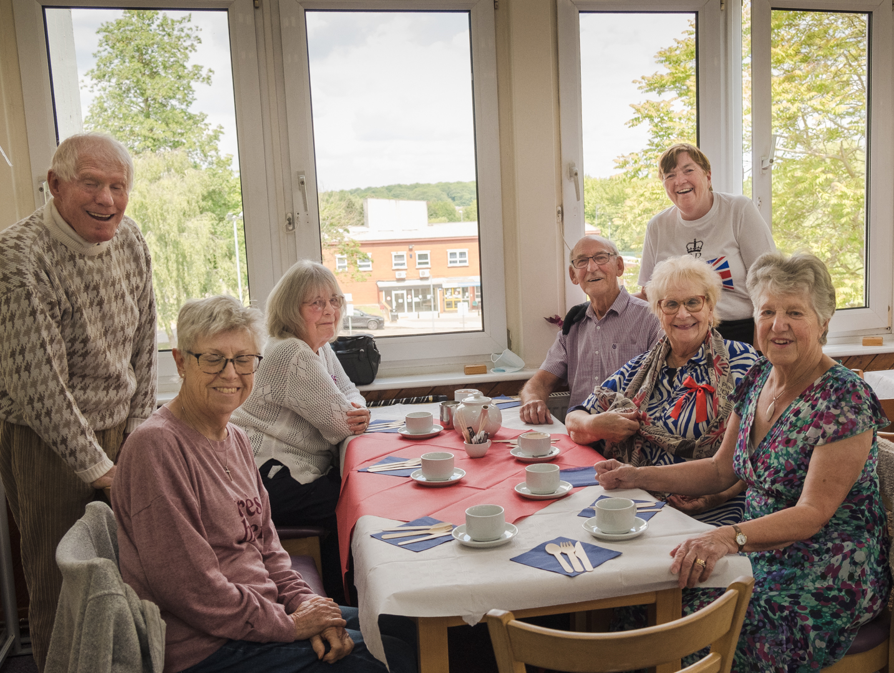
Our Context
The Weston Favell Centre is a large Shopping Centre built over 50 years ago to serve the East side of Northampton and has free parking for 3 hours. The Centre contains a Tesco superstore, many chain stores, eating places, banks, estate agents, gym, library and a ‘Clip n Climb/Pinnacle’ Climbing Centre. These stores provide much needed employment in the area. Adjoining the Centre is Lings Forum, a sports complex with a small cinema.
Part of the Emmanuel Church building forms a bridge over the Billing Brook Road, joining the shops, sports facilities and bus stops. Our Coffee Shop, Café Emm, is a welcoming meeting place for people to come for refreshment. We have a good working relationship with the Centre management - something we aspire to grow further in the coming year.

Slide 35
Our Context
Character
Northampton East is very diverse with a good mix of ethnic groups and faiths. The varied types of housing mean that amongst the population are those with a variety of social needs; one area has been identified as a “left behind” area. Although several of the estates have community centres and community associations, there is still much work to be done.
Schools & Education
Northampton East is well served with educational facilities. In the parish there are eight primary schools, one secondary age academy, two schools for students with special needs and a Charitable Specialist college, also a college of Further Education.
Billing Brook School is for students with special needs. This is close to Emmanuel Church and student groups come into our coffee shop on a regular basis.
The church is involved with assemblies at the local schools and offers pastoral support to staff when needed. There is a huge opportunity for growing our relationship with the local schools and sharing the love of Jesus. Currently none of the local schools are Church of England schools.

Slide 36
Our Context
Health Care
The Weston Favell Health Centre is close to Emmanuel church. This offers doctors, dentists, nurses, physiotherapists, and various other clinics. Other doctors and dental practices are available at Woodview Medical Centre, Thorplands, and Rillwood Medical Centre, Lumbertubs. We also have a large General Hospital in the centre of Northampton.
Other Churches in Emmanuel Parish
In the parish of Emmanuel we have a Roman Catholic Church and the Storehouse Church. We receive support from St Peter’s Church Weston Favell in the operating of the Foodbank.
Emmanuel is a parish worship centre. As such, anyone who is entitled to be married at Emmanuel may choose instead to be married in an adjoining parish.
Some independent Pentecostal Churches also hire our premises at Emmanuel on a regular and ad hoc basis. This is done with a stipulation that the Apostles Creed is fully believed in.

Slide 37
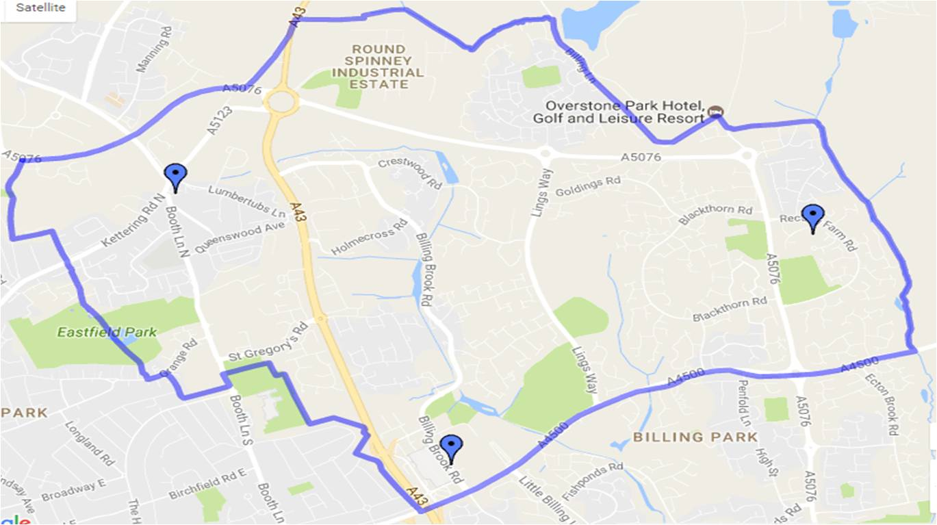
Our Context
Emmanuel Parish – Northampton East Map

Slide 38
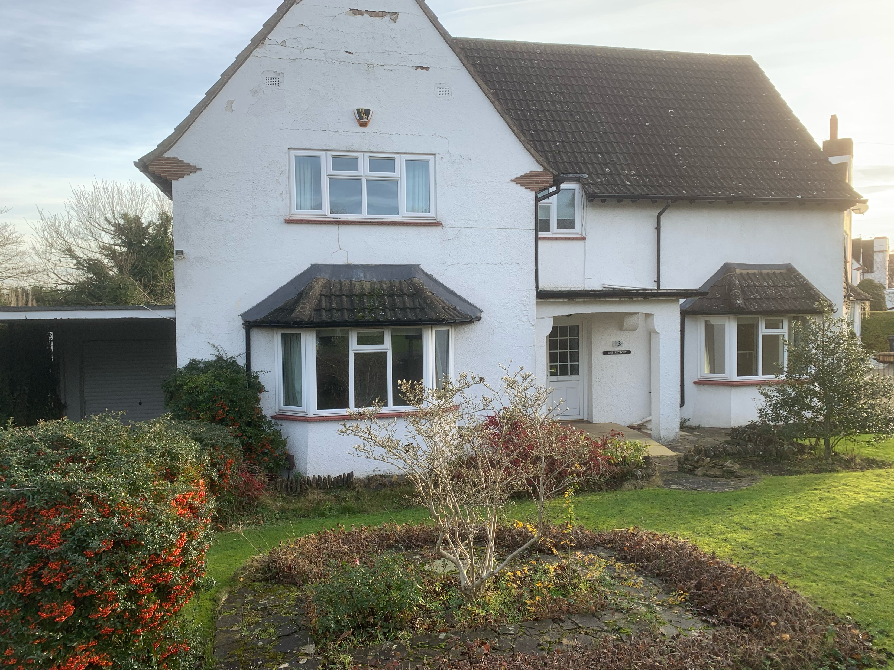
Your New Home
13 Boothlane North, Northampton.

Slide 39
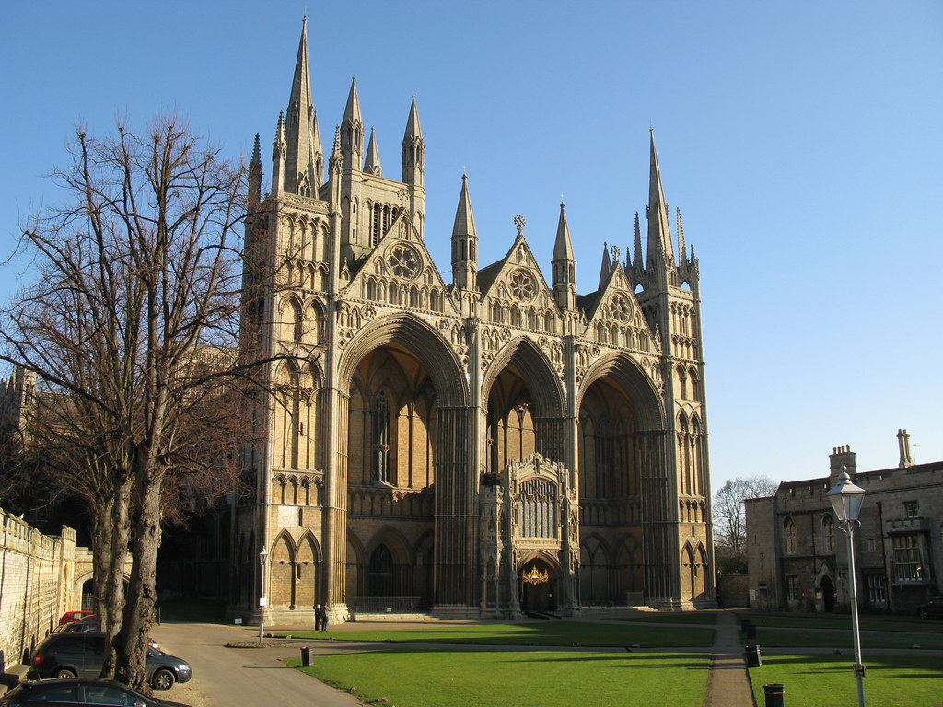
Our Diocese and Deanery
The Diocese of Peterborough
The Diocese of Peterborough, founded in 1541, has 348 parishes and 379 churches covering Northamptonshire, the northern part of Peterborough and the county of Rutland. Peterborough Cathedral is our mother church. With around 200 clergy and a similar number of lay ministers, we serve a population of just under a million people.
Our worshipping community consists of over 20,000 people of all ages and backgrounds and around 12,000 people attend a service each Sunday. Almost 20,000 4-18 year olds attend over 100 church schools in the diocese.
The Diocese is led by The Bishop of Peterborough, assisted by the suffragan Bishop of Brixworth. The 39th Bishop of Peterborough is the Right Reverend Debbie Sellin. Bishop Debbie was installed at a service in Peterborough Cathedral on 3 March 2024.

Slide 40
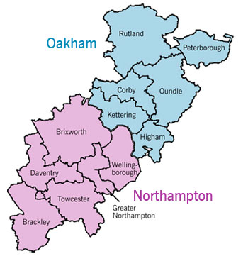
Our Diocese and Deanery
The Diocese is divided into two Archdeaconries, Oakham in the north and Northampton in the south. There is an archdeacon who has oversight over each archdeaconry.
Greater Northampton Deanery
Rural Dean: The Revd Oliver Coss
Assistant Rural Dean: The Revd Canon Jane Butler
Lay Chair: Clare Pearce

Slide 41
Contact Information
Want to know more?
If you feel that God is calling you to explore this vacancy and you would like to find out more please feel free to have an informal chat with Stewart the Team Rector or Archdeacon Richard. Details below.
Rev Stewart Betts, 07919890094 or email rector@emmanuelgroup.org.uk
Ven richard Ormston, Archdeacon of Northampton. 01604 88700
Archdeacon.Northampton@peterborough-diocese.org.uk

Slide 42
Appendices
If you would like to receive a copy of this report please contact the Church office.
linda.withers@emmanuelgroup.org.uk

Slide 43
Appendices
If you would like to receive a copy of this report please contact the Church office.
linda.withers@emmanuelgroup.org.uk

