Slide 1
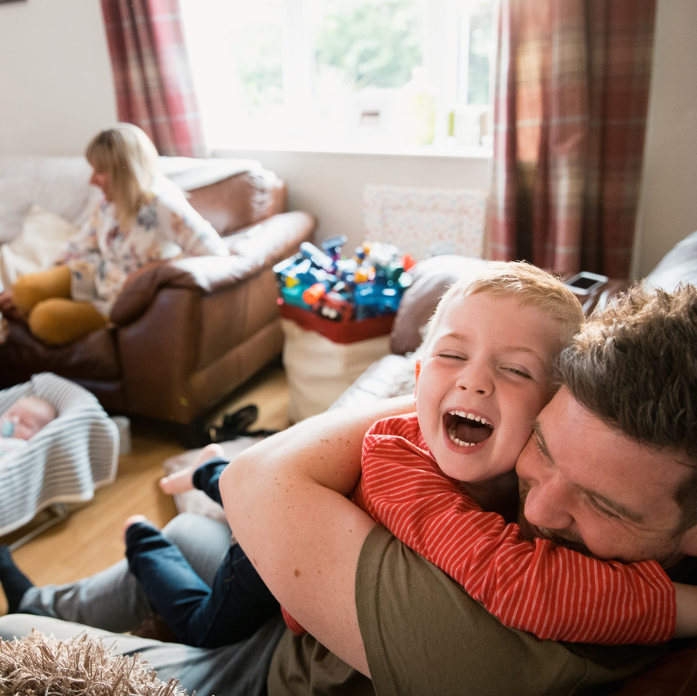
Clergy spend their lives serving others. Clergy Support Trust exists to serve them.

Slide 2
I was hungry and you gave me food, I was thirsty and you gave me something to drink, I was a stranger and you welcomed me, I was naked and you gave me clothing, I was sick and you took care of me, I was in prison and you visited me. Matthew 25.35-36

Slide 3
Wellbeing: the heart of ministry and mission
Care of others is the heart of our faith
Existing in relationship is Godly
Without ministers who are well-resourced, mission & evangelisation will struggle
Ministerial wellbeing is therefore central to the Church’s mission, and to our collective call

Slide 4
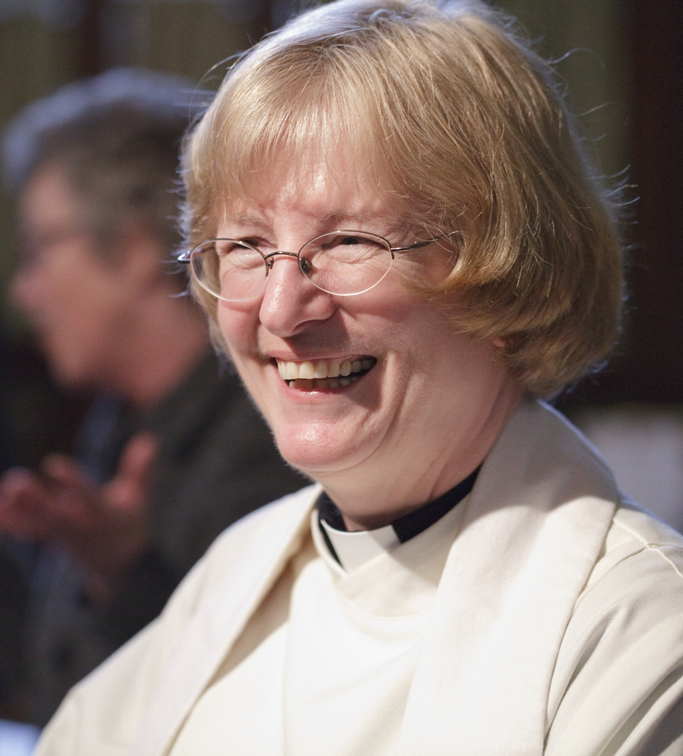
For clergy and their families, in times of need: financial, mental and physical wellbeing
UK, Ireland, Europe
Independent
Confidential
Inclusive
Ancient

Slide 5
The national picture to 2023

Slide 6
…and to 2024

Slide 7
“If 22% of nurses were going to an independent charity for this help, I would be making speeches about it.”

Slide 8
In 2023:
22% of clergy in England & Wales came to us
30% increase in grants from 2022
17% increase in households from 2022
How does this feel?
Why is it the case, and how might it not be?

Slide 9
Grants
Emergency
appliances, technology, car repairs, bills…
Financial support
larger grants: additional means-test
Wellbeing
holidays, retreats, sabbaticals, fitness, leisure, hobbies…
Health
addictions, diagnostic tests, rehabilitation…

Slide 10
Services and resources
Talking therapies & coaching
Resource Bank
Debt support
Sleepstation insomnia therapy

Slide 11
Popular grant categories by value

Slide 12
Eligibility
Serving clergy
Retired clergy
Spouses and partners some variations in programme
Former partners
Dependent children
[Ordinands]
£16k savings if property-owner (for grants)
£200k savings if no property (for grants)
Additional means-testing for Financial Support Grants

Slide 13
Dioceses with highest application rates

Slide 14
The Diocese of Peterborough
17% of clergy supported
In 2023, 68 grants for 32 households
49 dependent children in households supported
Almost all grants were Emergency & Wellbeing, but with some Health, Financial Support & Wellbeing Support Grants accessed

Slide 15
Possible areas for reflection and discussion:
What does sustained, sustainable wellbeing look like?
How much are these challenges about the stipend?
What else might help? Who should do it?
What are the specific, local or diocesan factors here?
What should CST be saying to the national Church?
How have recent events affected us? What more can be done?

Slide 16
How to get in touch
Grants & Services Team
Call 0800 389 5192
Email grants@clergysupport.org.uk
Apply www.clergysupport.org.uk
The Revd Ben Cahill-Nicholls (Chief Executive)
Call 07718 613217
Email ben.cahill-nicholls@clergysupport.org.uk
EA Elizabeth Aveling – 020 7340 2834

