Slide 1
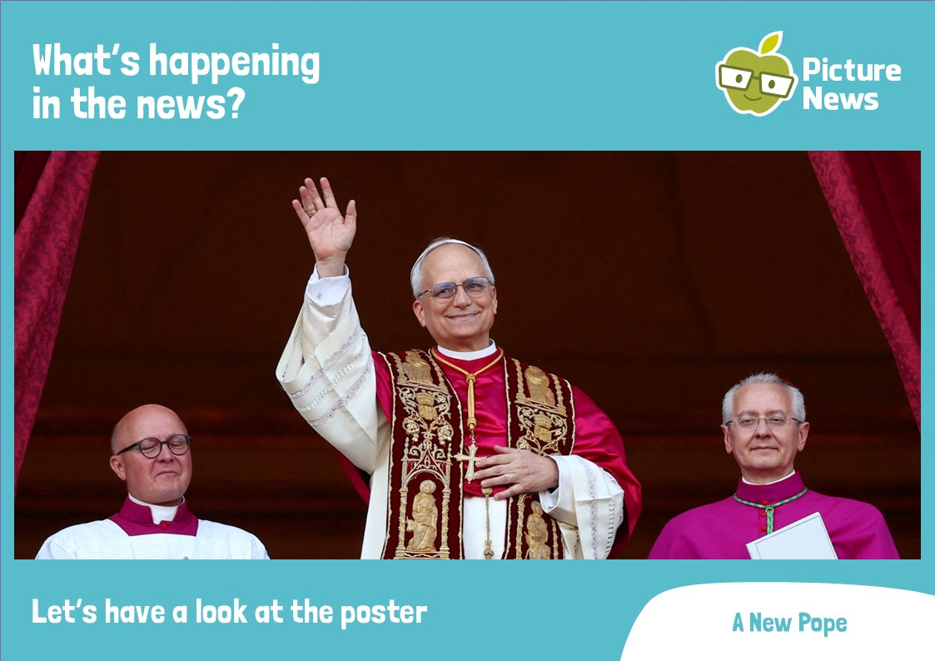
What’s happening
in the news?
Let’s have a look at the poster
A New Pope

Slide 2
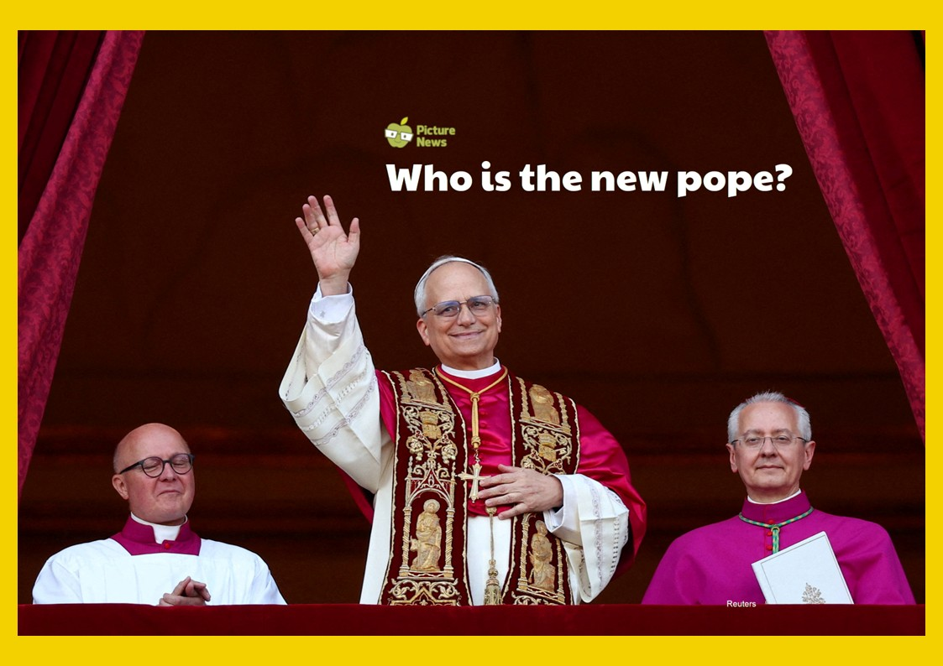
What’s happening
in the news?
Let’s have a look at the poster

Slide 3
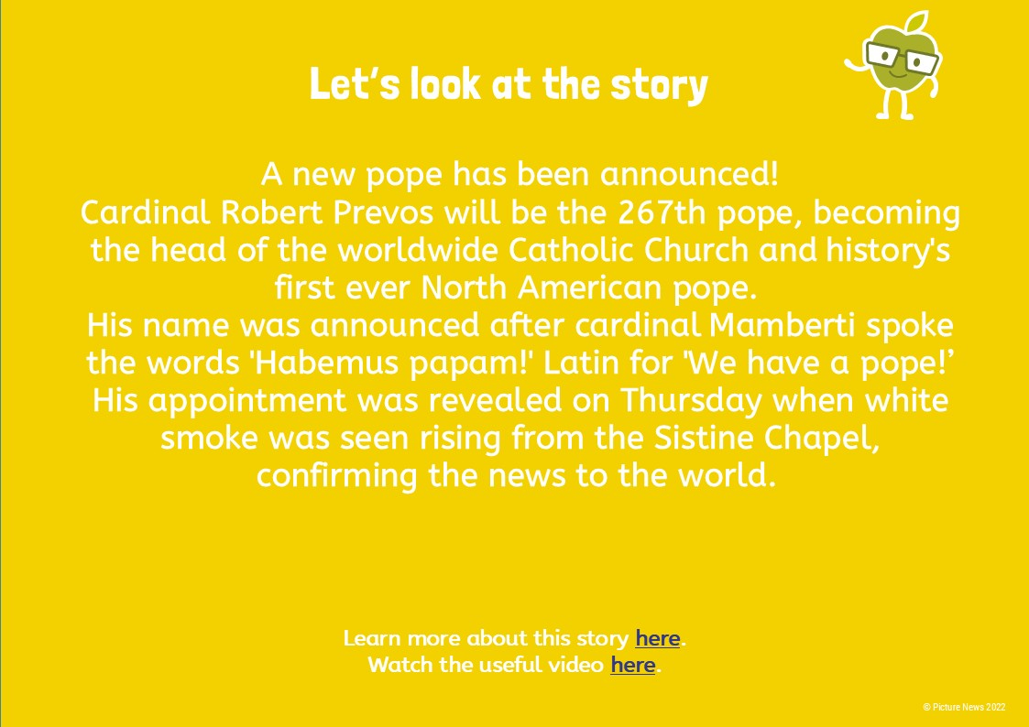
What’s happening
in the news?
Let’s have a look at the poster

Slide 4
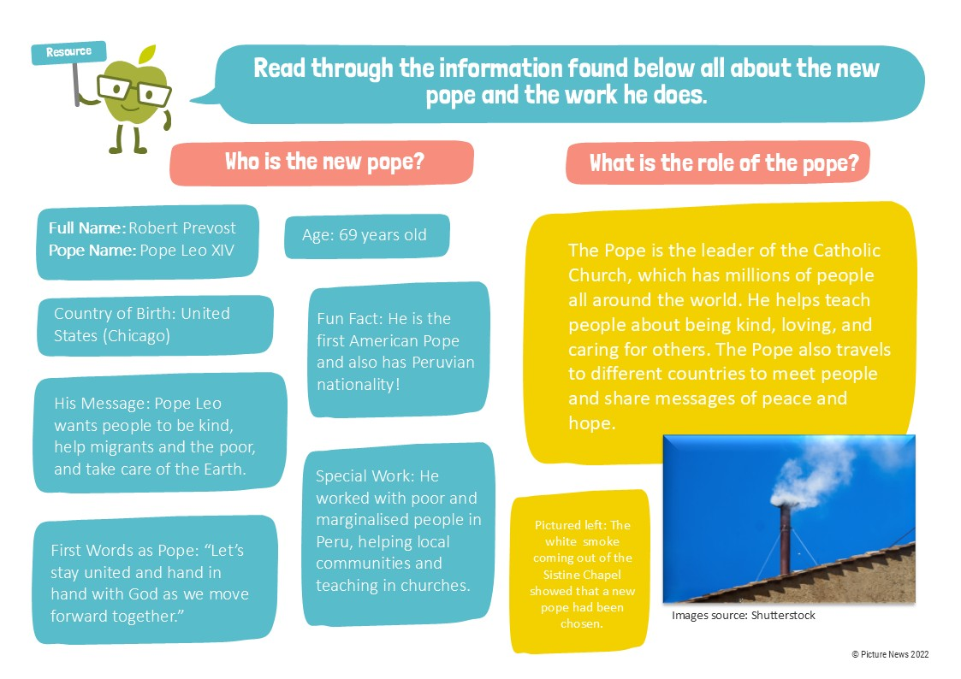
What’s happening
in the news?
Let’s have a look at the poster

Slide 5
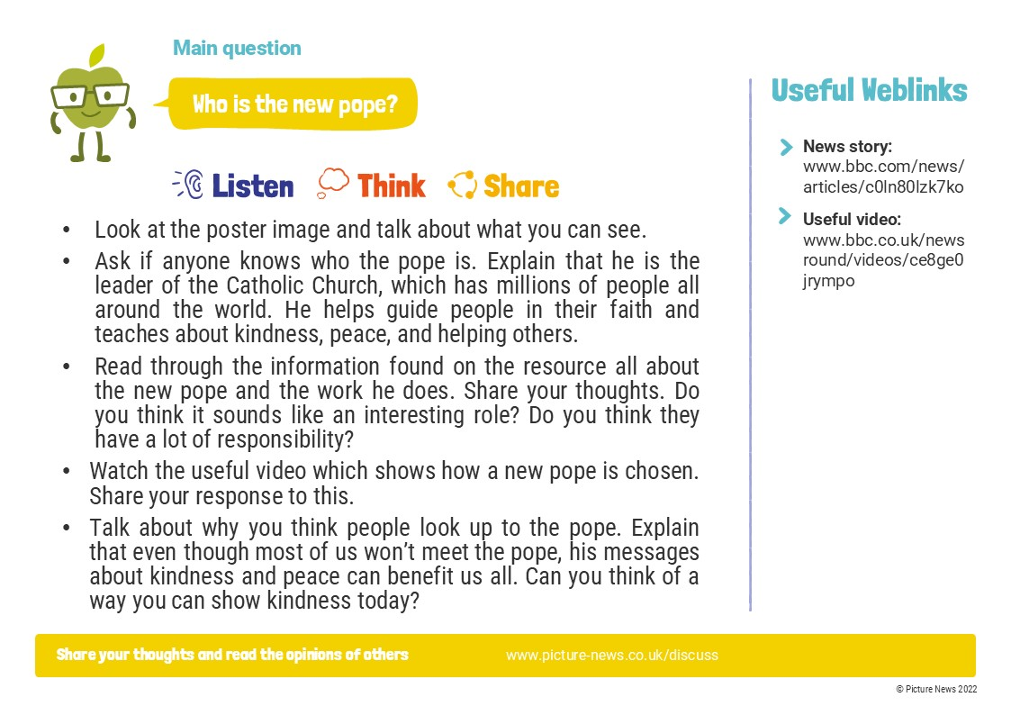
What’s happening
in the news?
Let’s have a look at the poster

