Slide 1
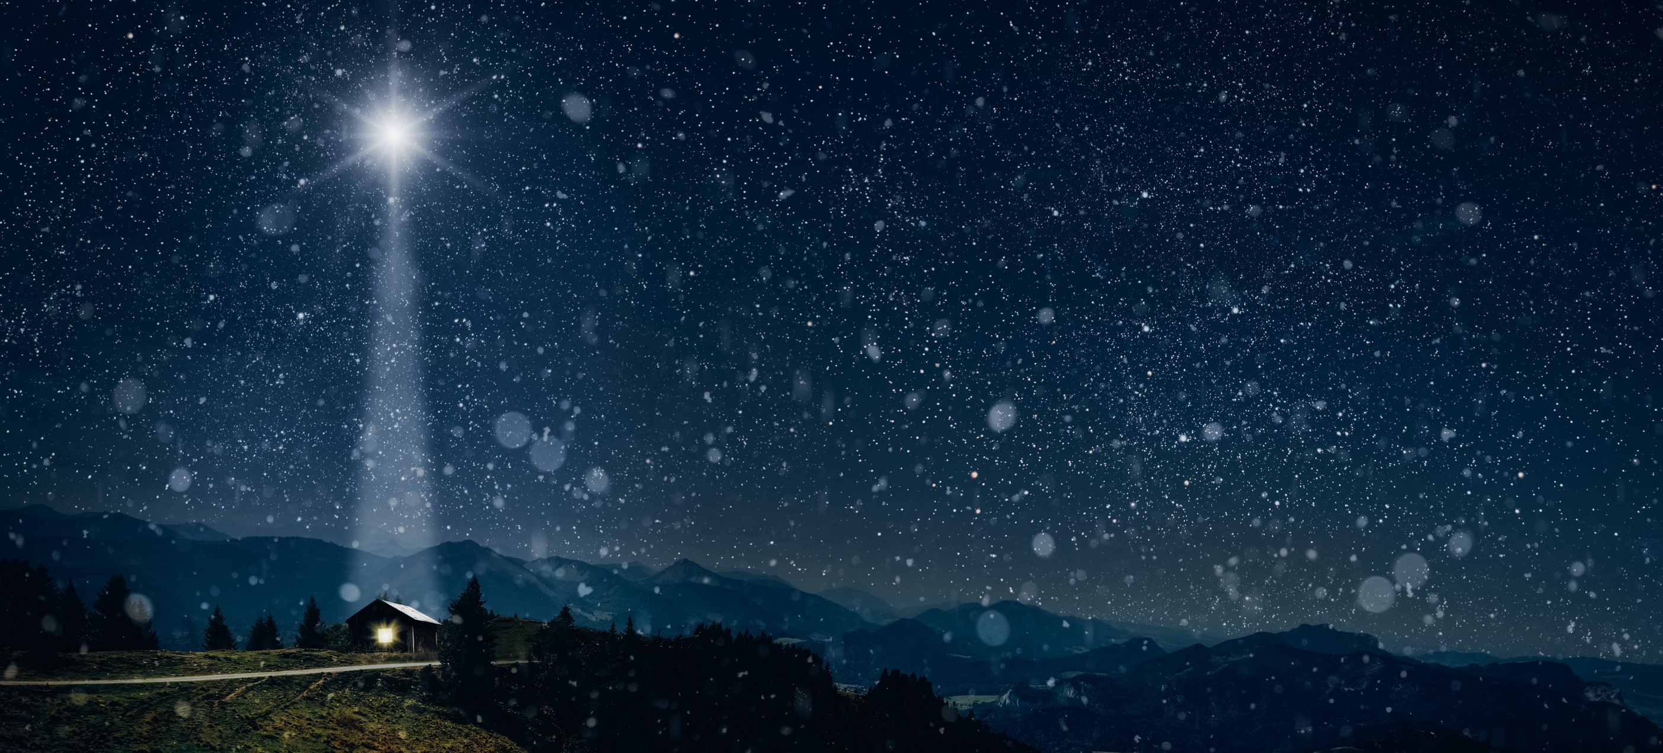

*Insert photo of school here*
Journeys
How did you get to school this morning?

Slide 2


1
2
3
How
was it?
4
5
6
7
8
9

Slide 3
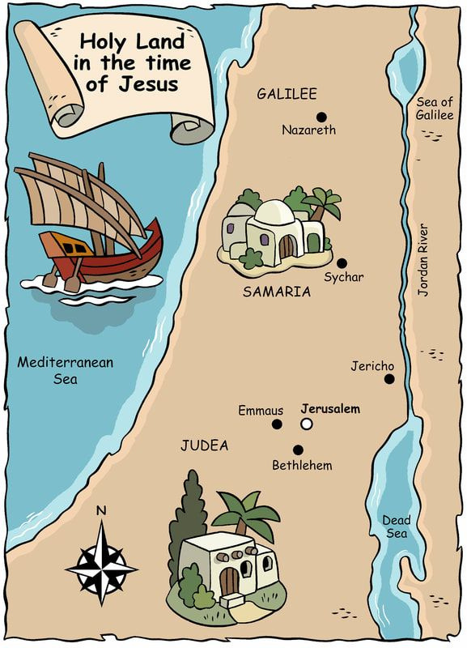


A special
journey
Nazareth
Bethlehem

Slide 4
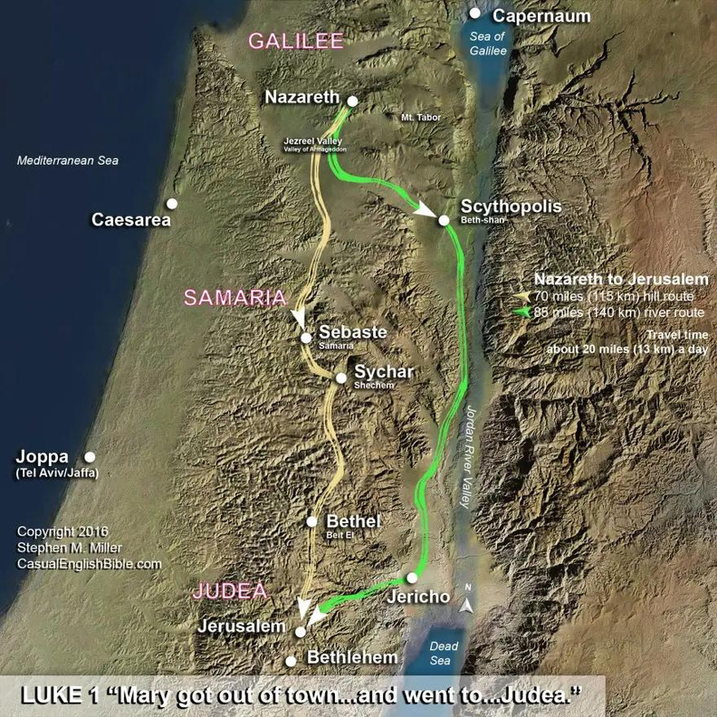



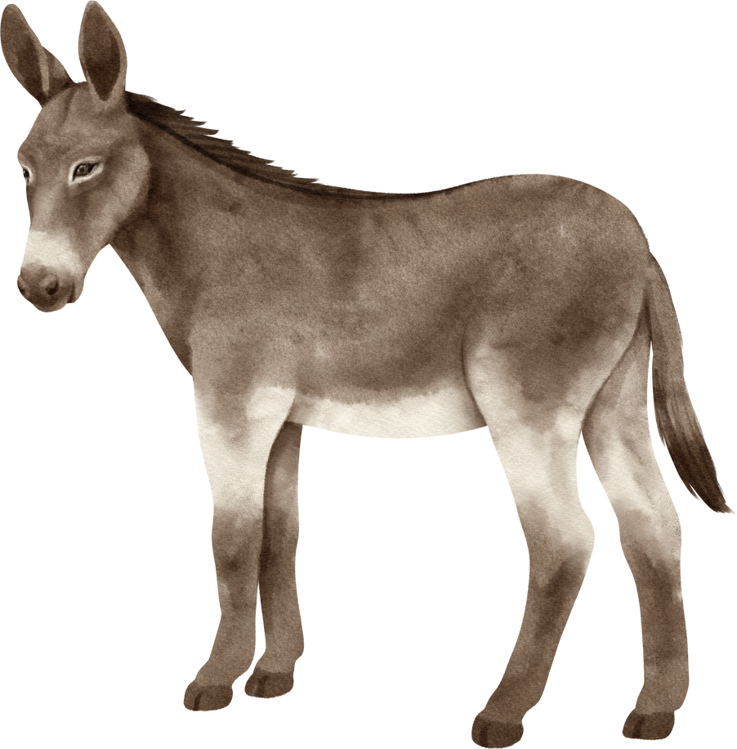
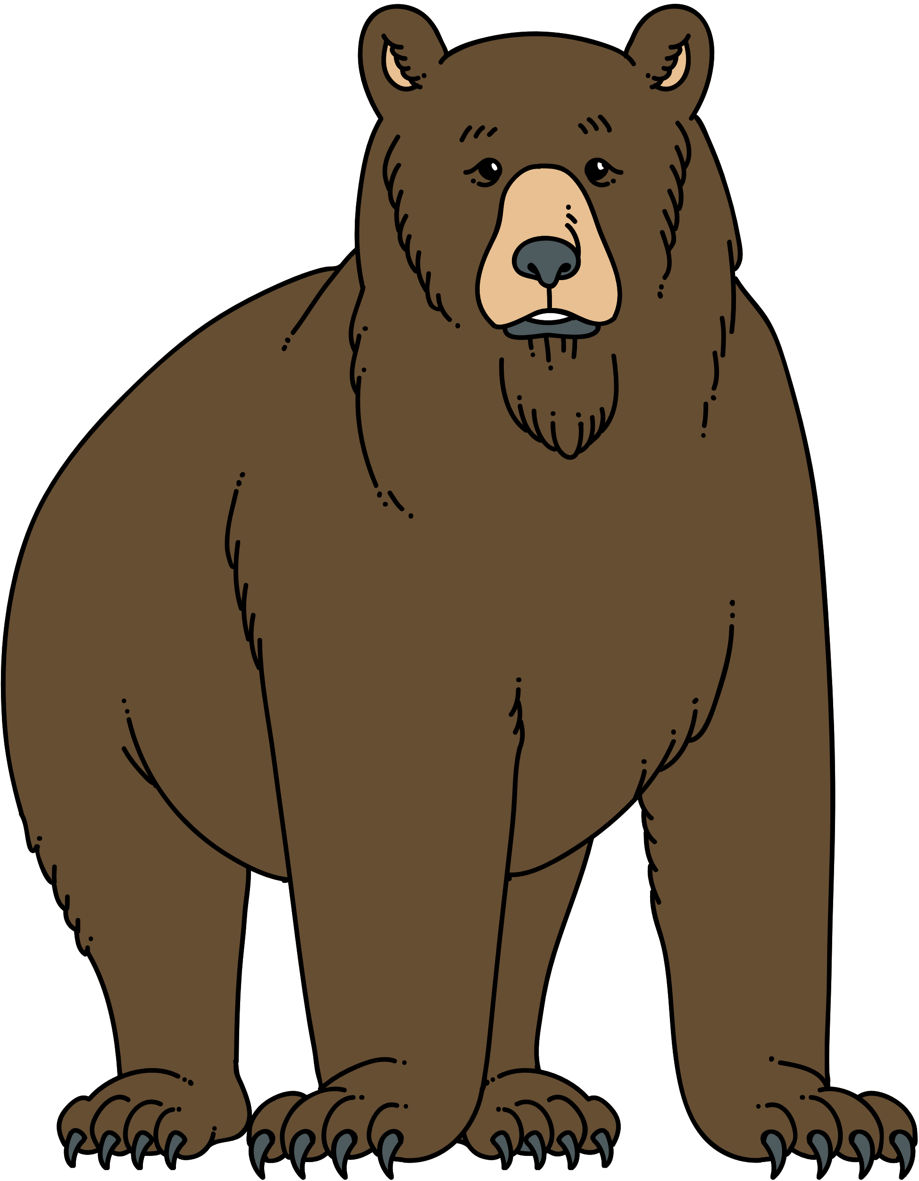

  90 miles
  2 weeks
  8 hours a day
What was
it like?

Slide 5

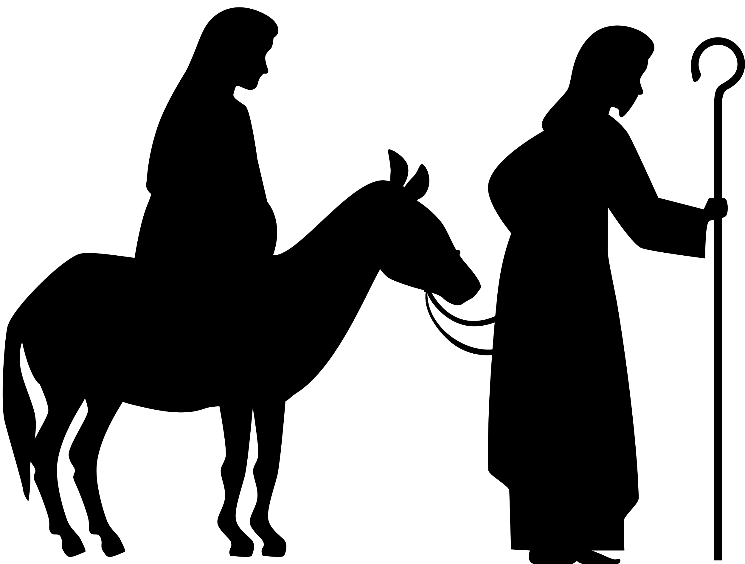
1
2
3
4
5
6
7
8
9

Slide 6
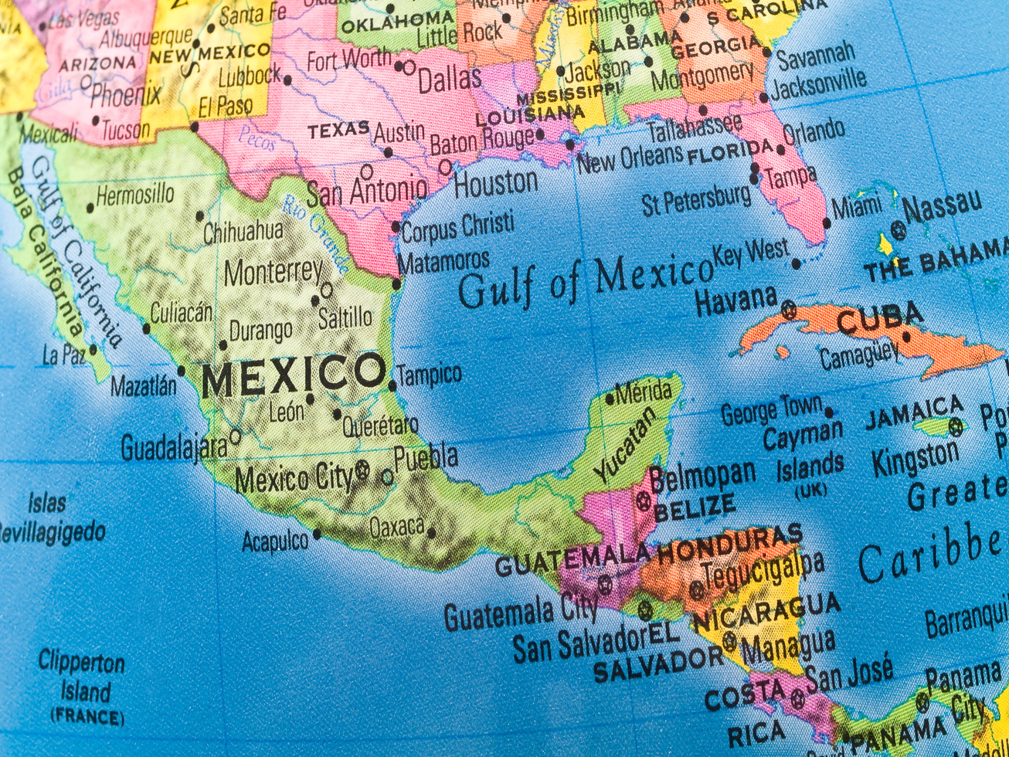
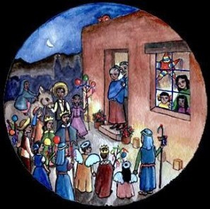

Los posadas

Slide 7
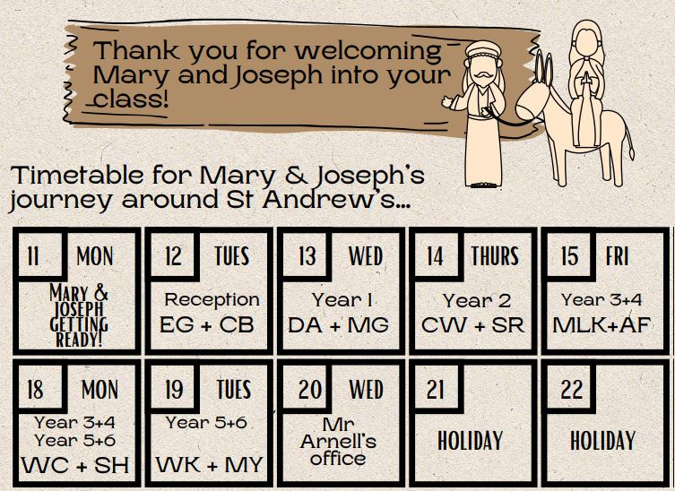






Los posadas
*Insert your own timetable*

Slide 8
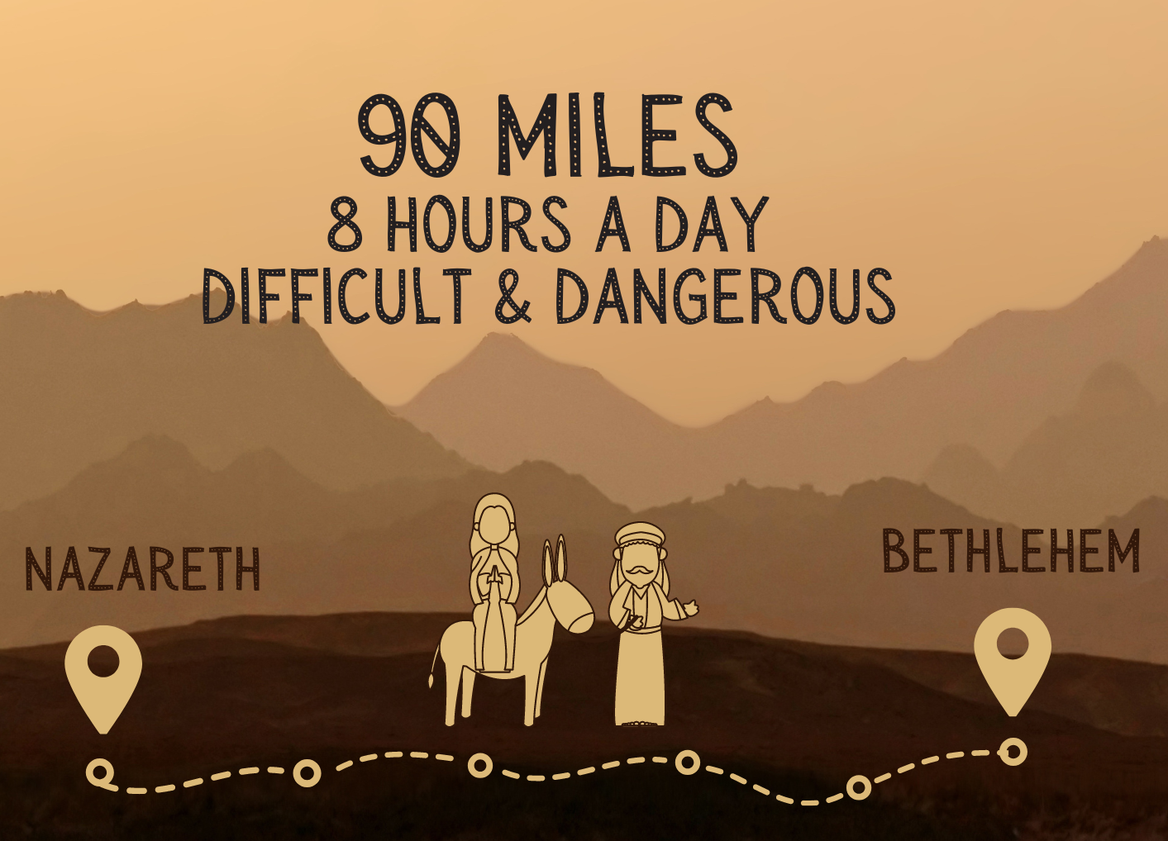

Los posadas

