Slide 1
Welcome to add Church name Christmas trail
Add your own directions / instructions/ map

Slide 2
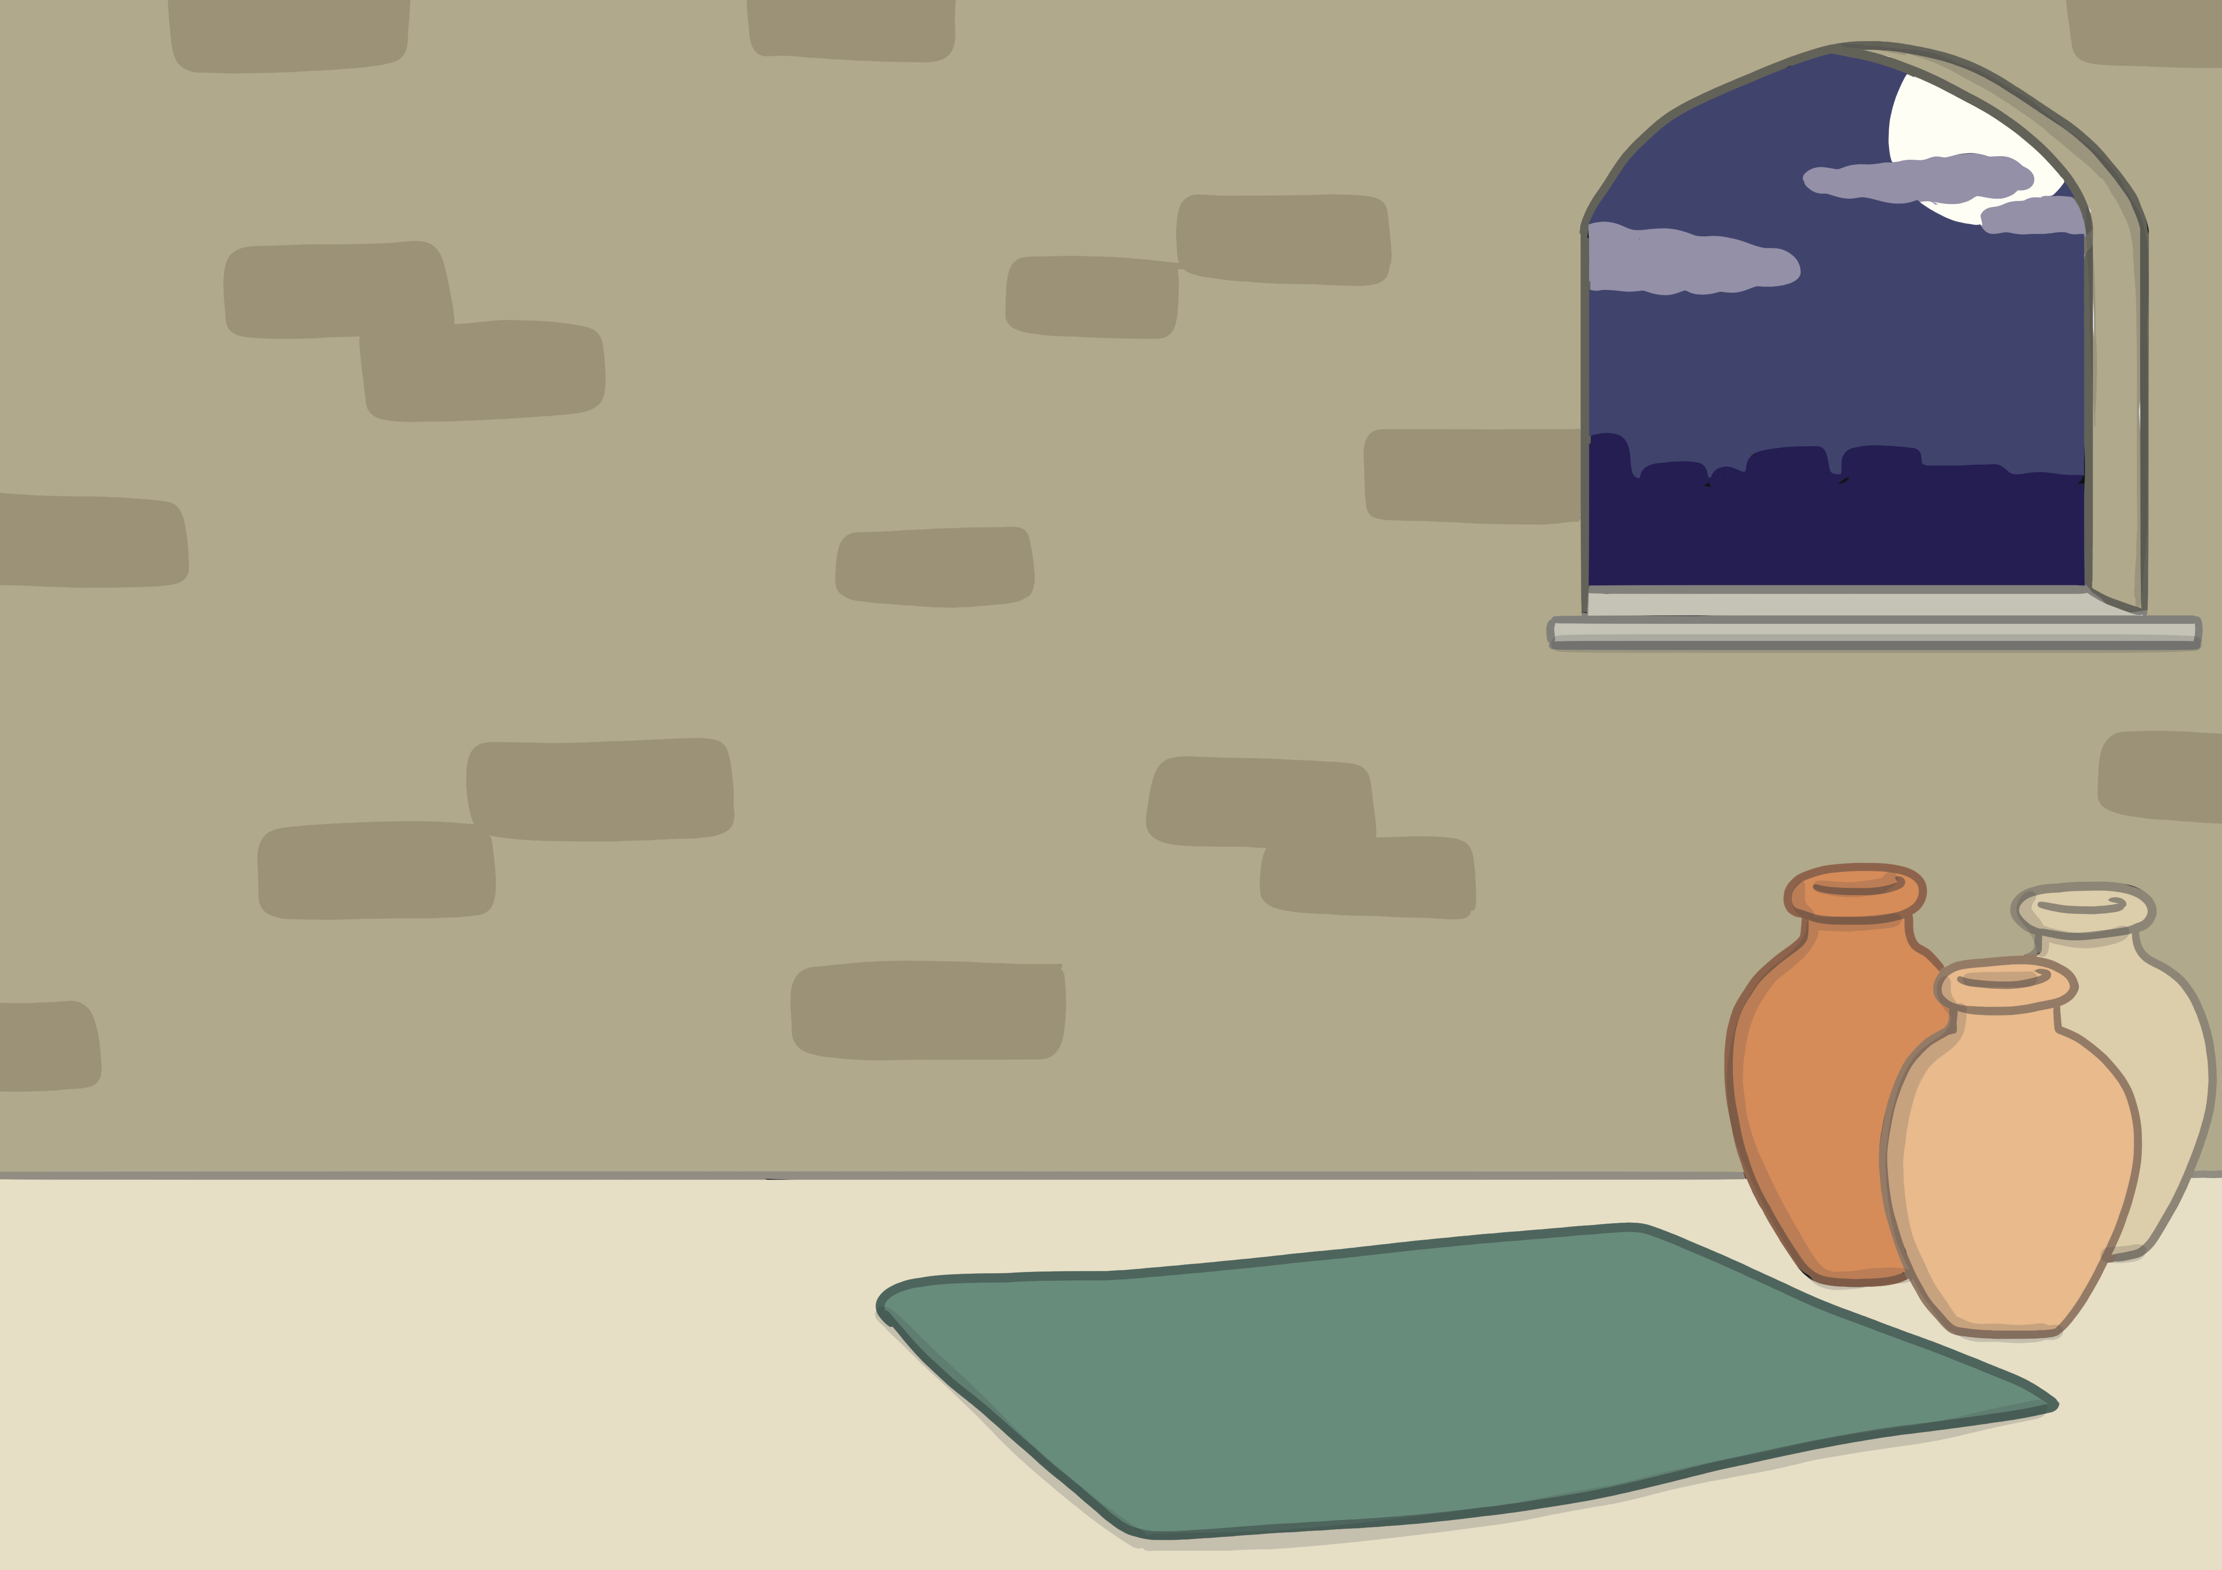

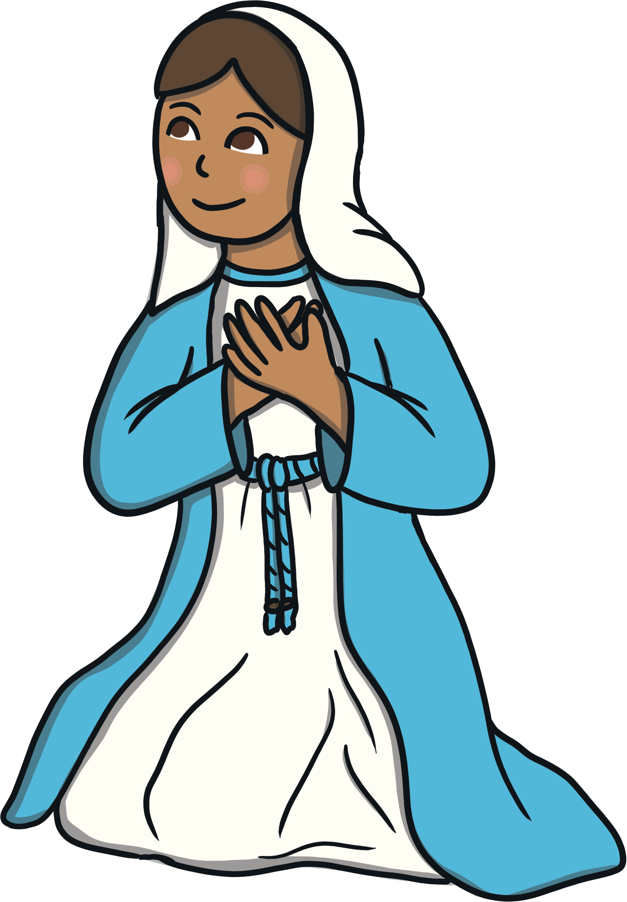
The Angel Gabriel visited Mary and told her she was going to have a baby called Jesus. The baby would be God’s son.
How do you think Mary would have felt?

Slide 3
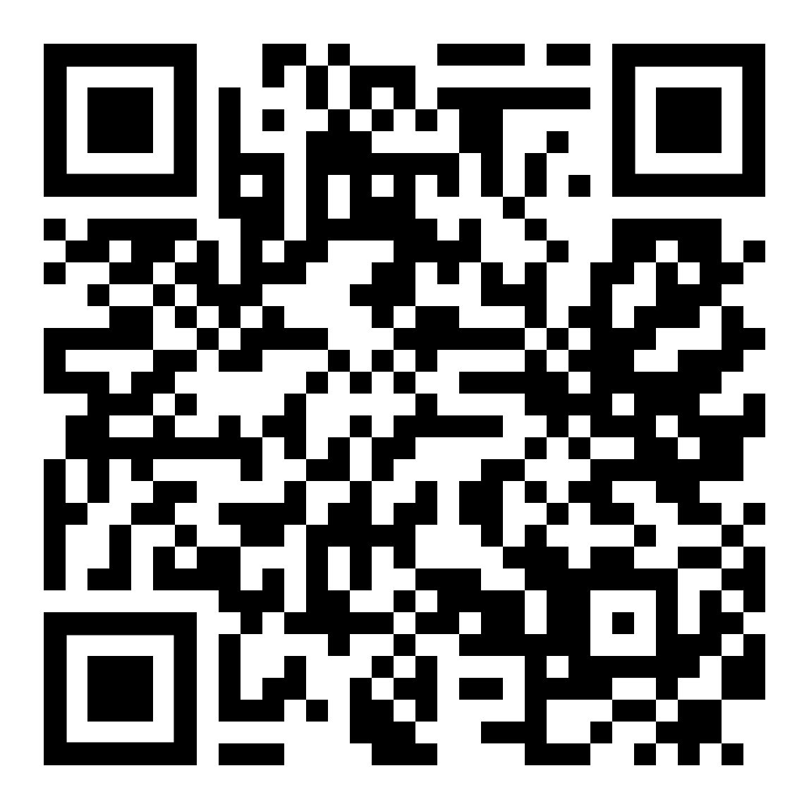
Scan the QR code to hear the first part of the story
Take a photograph of this picture of a stone so that you can make one at home

Slide 4
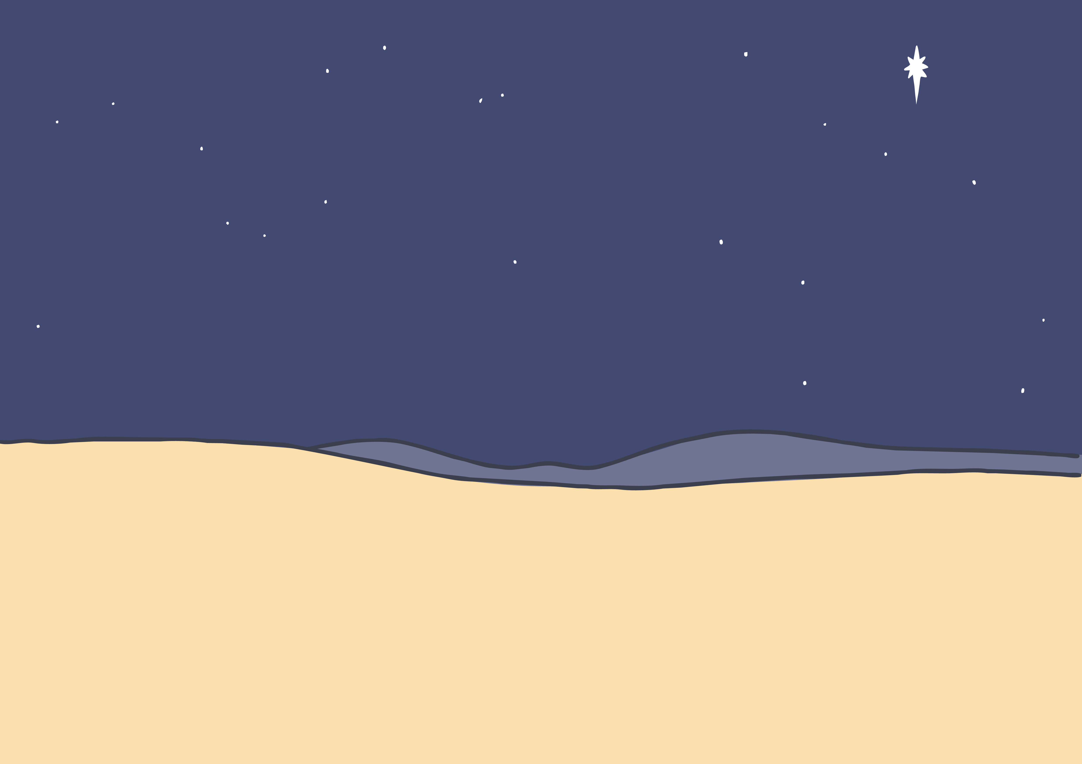
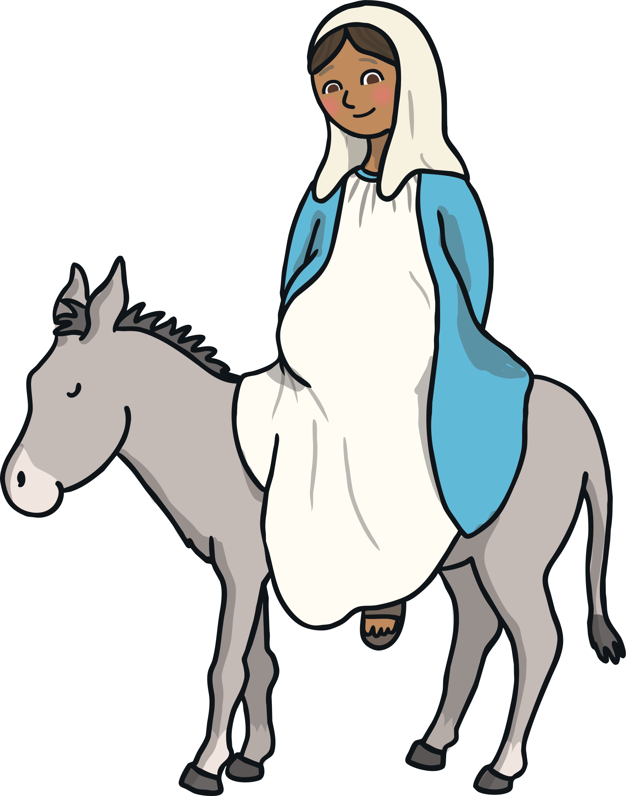
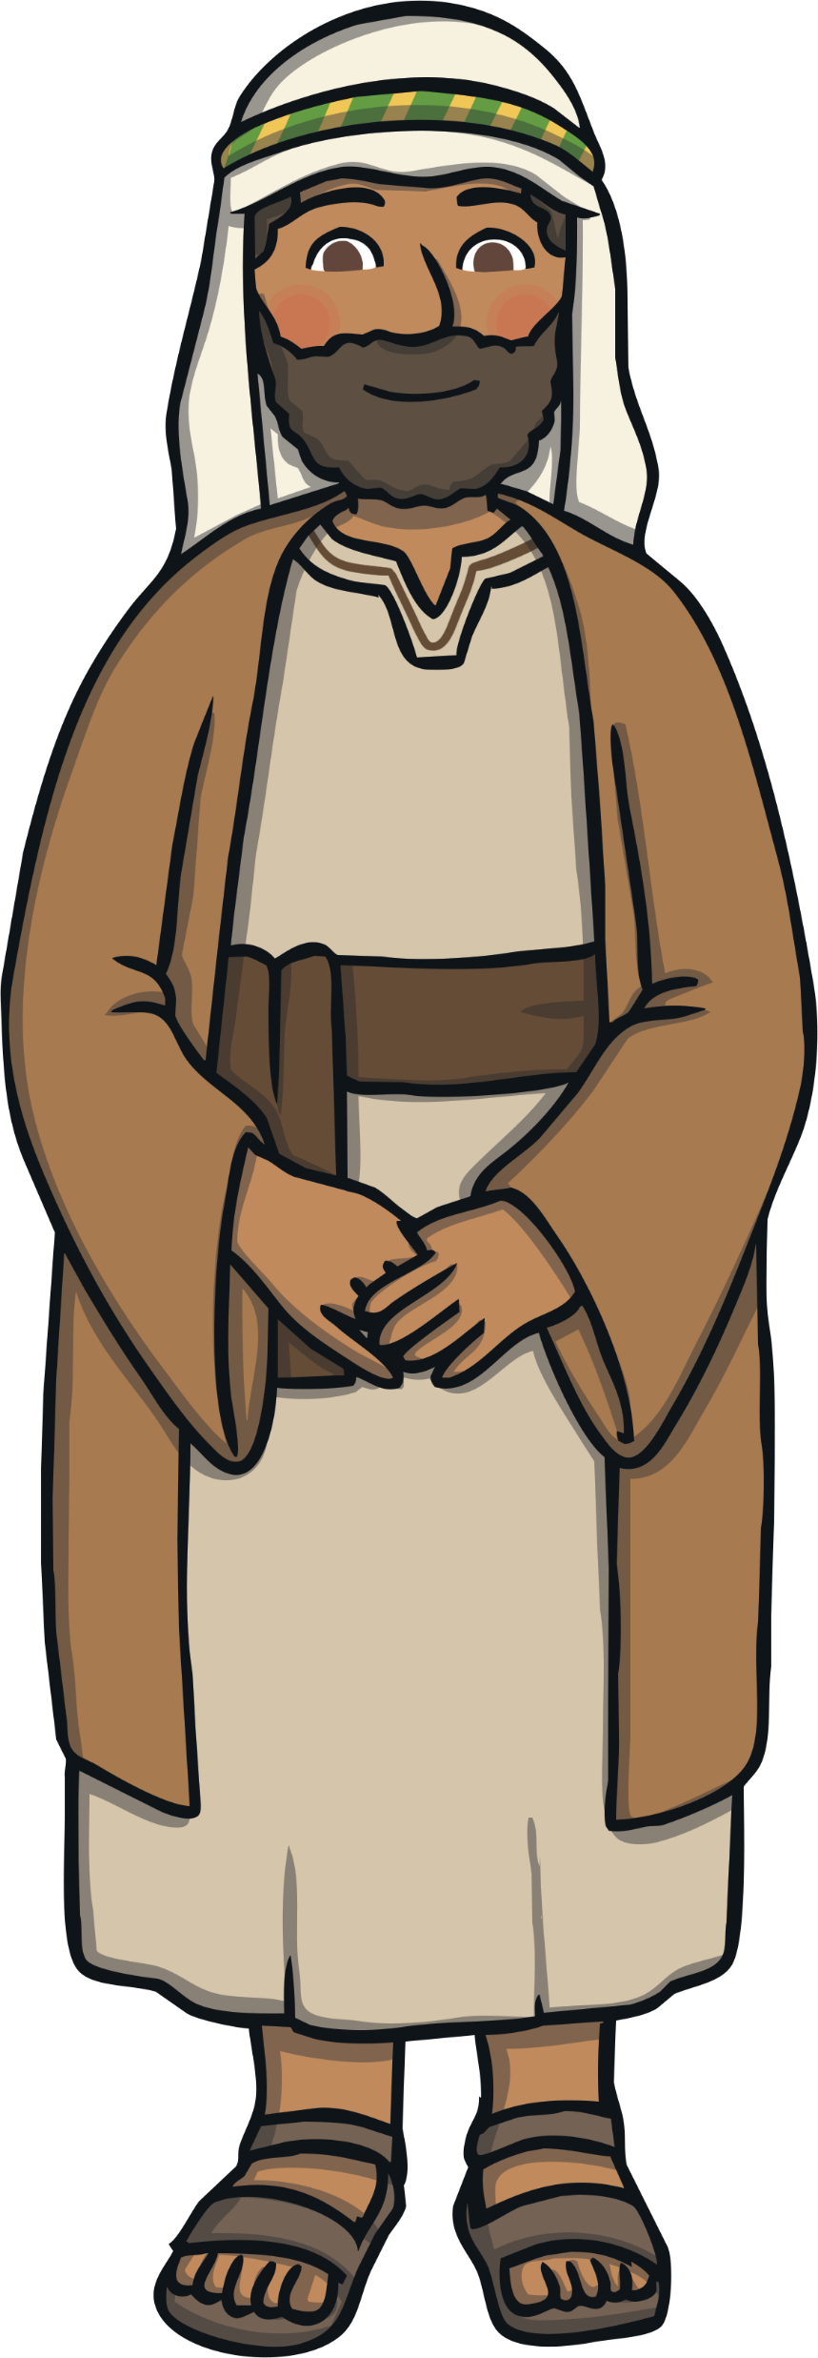
Mary and Joseph had to travel to Bethlehem to register in a census.
How do you think Mary would have felt knowing she had a long journey to Bethlehem to make?

Slide 5
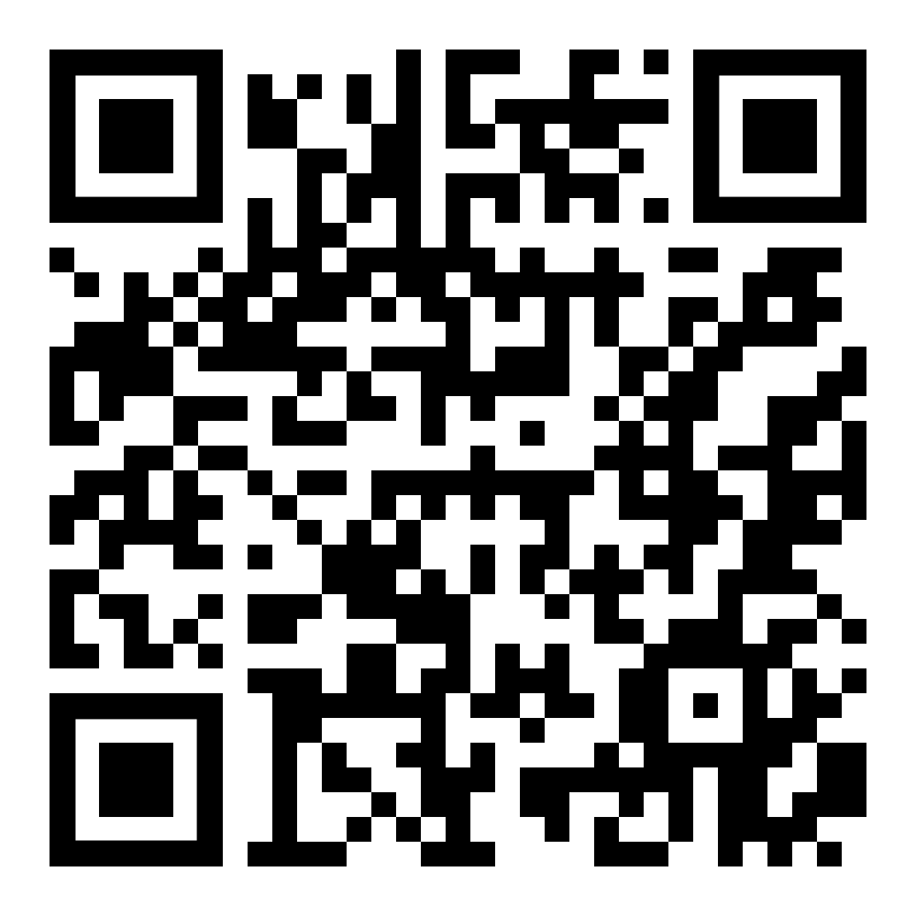
Scan the QR code to hear the next part of the story
Take a photograph of this picture of a stone so that you can make one at home

Slide 6
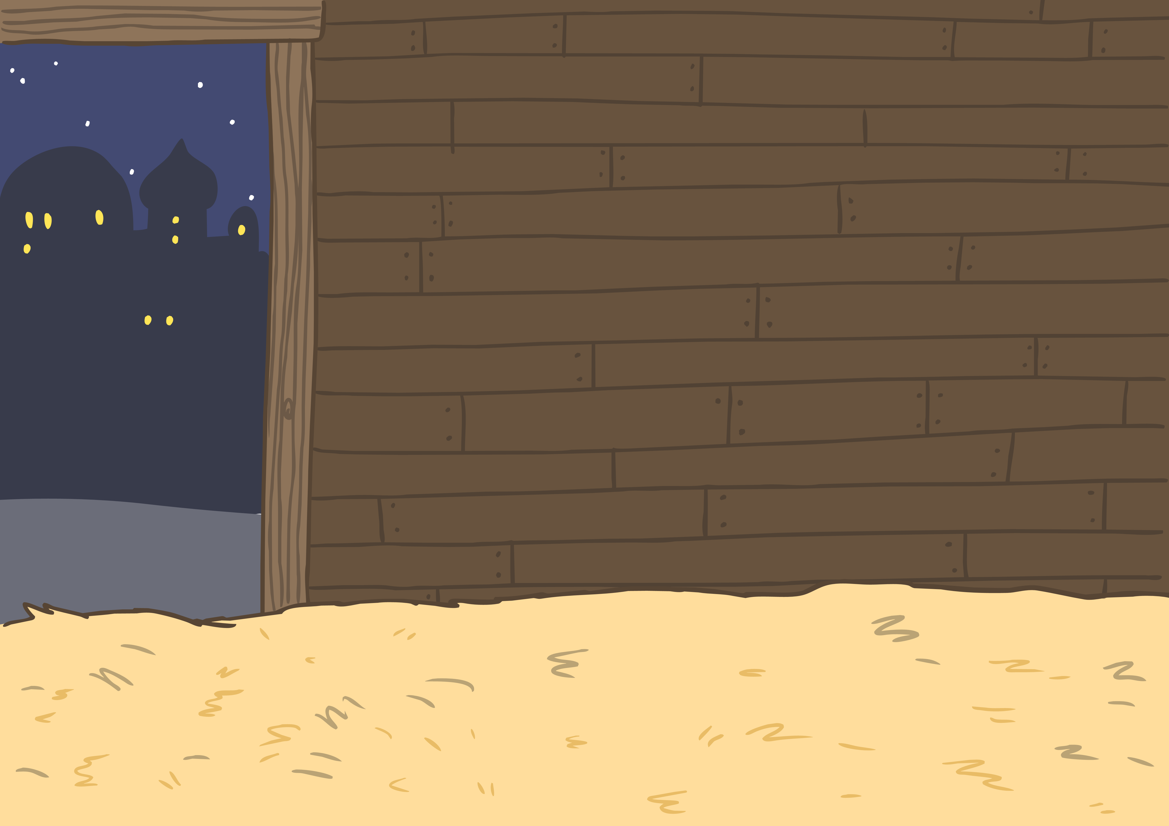
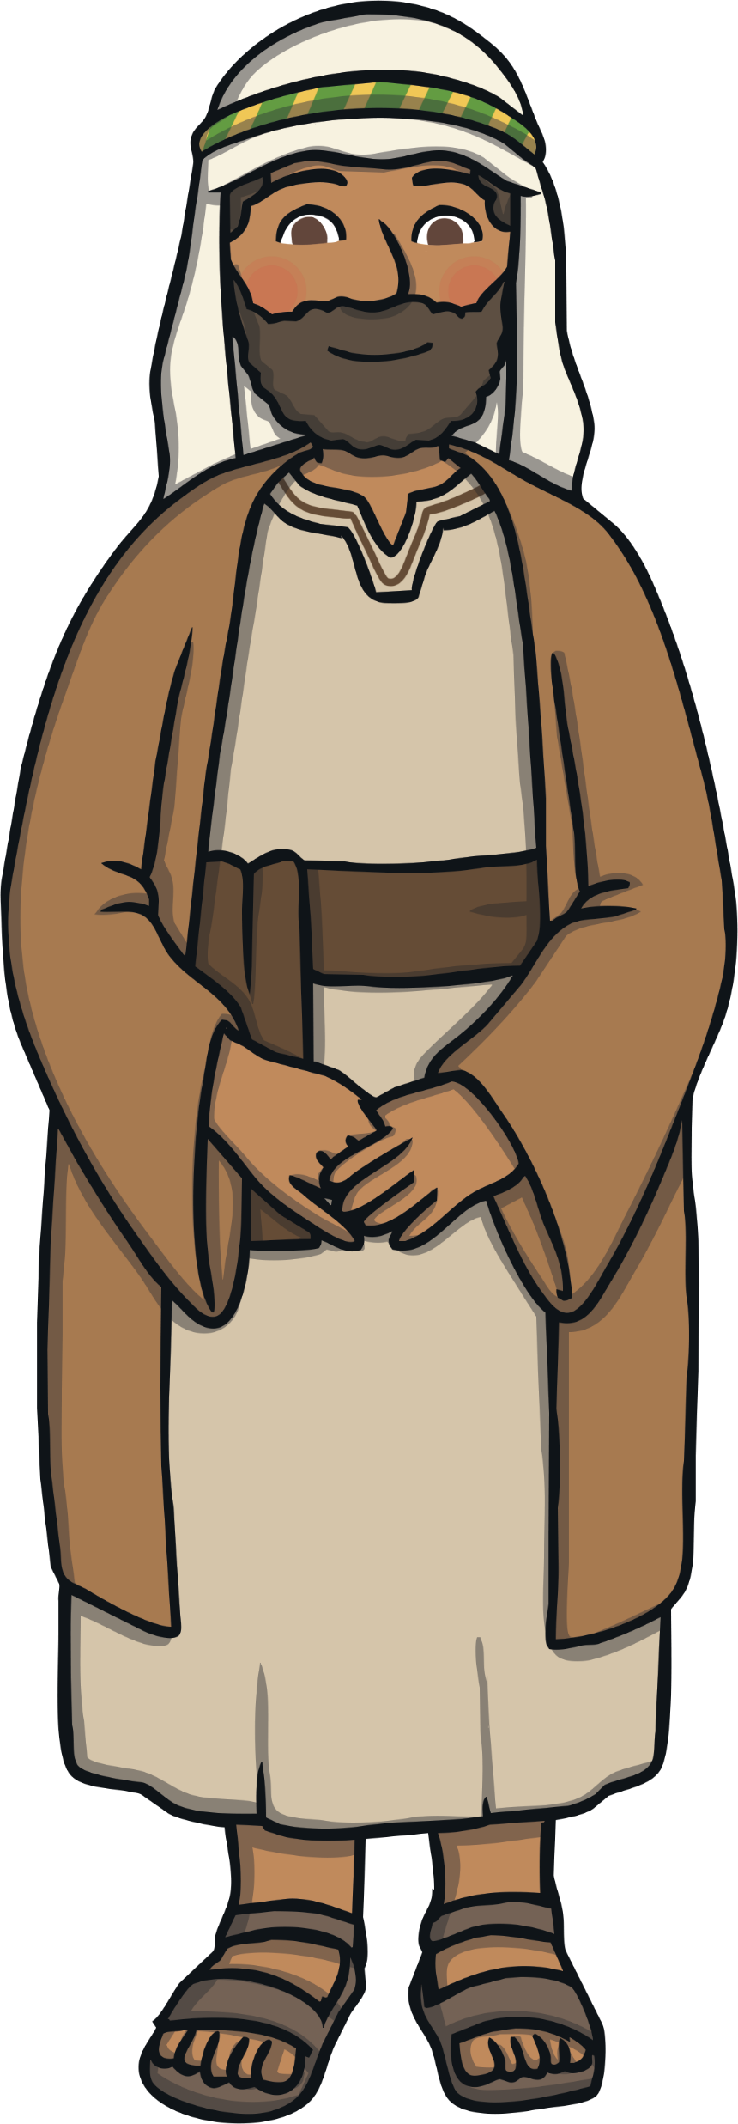
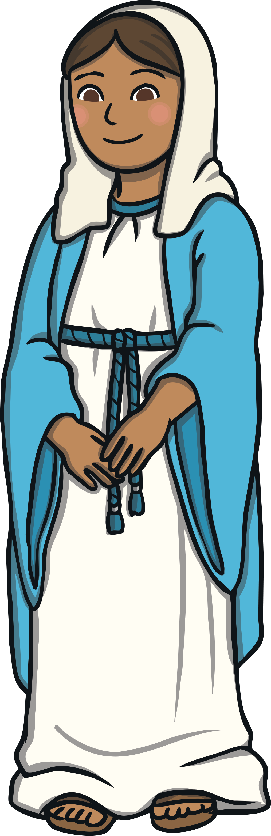
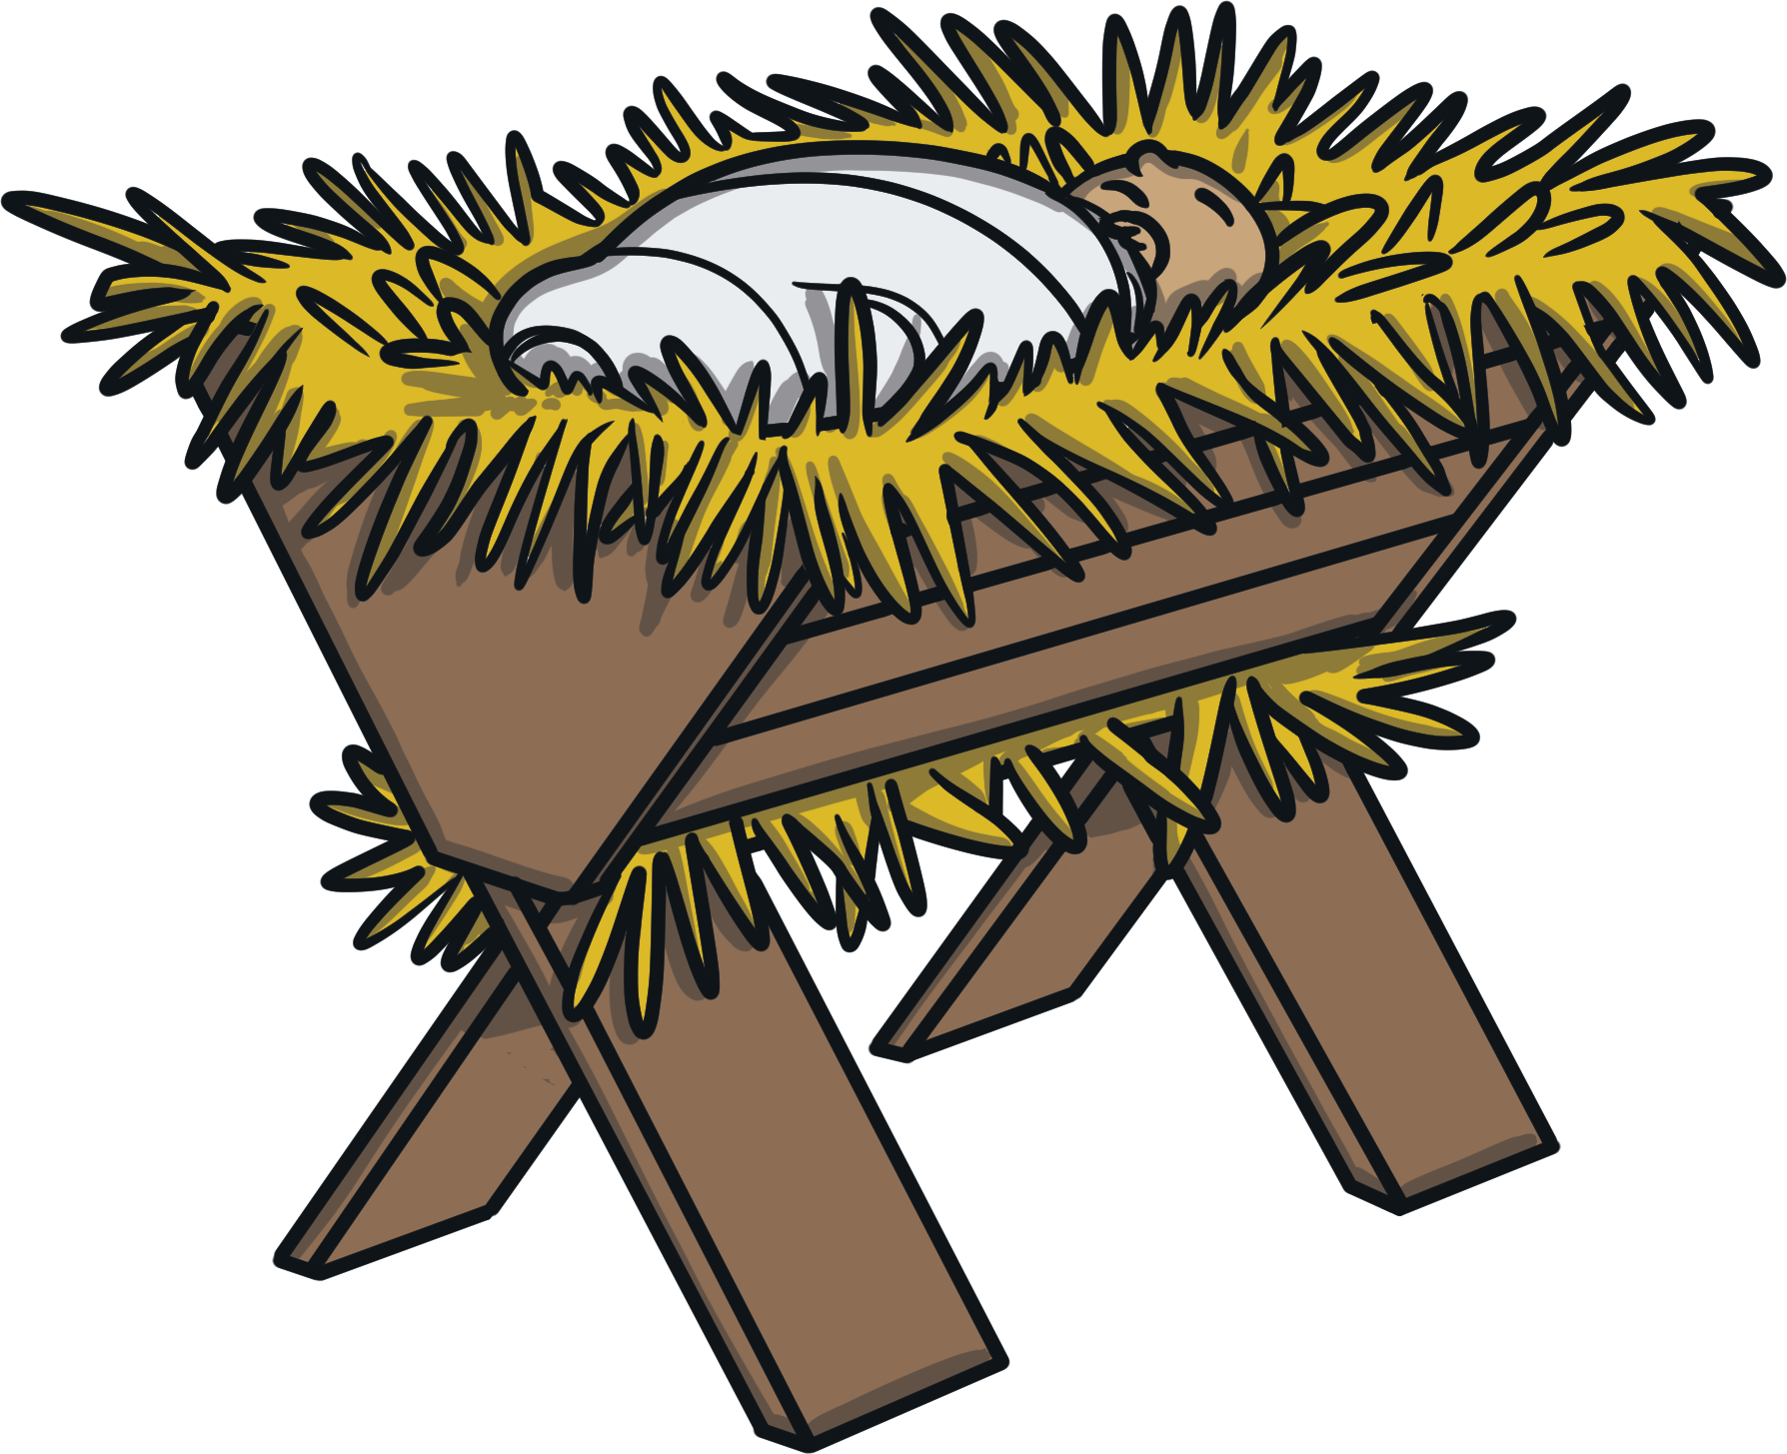
Baby Jesus was born in the stable.
Christians believe Jesus is God’s Son, why do you think he was born in a stable rather than a palace?

Slide 7
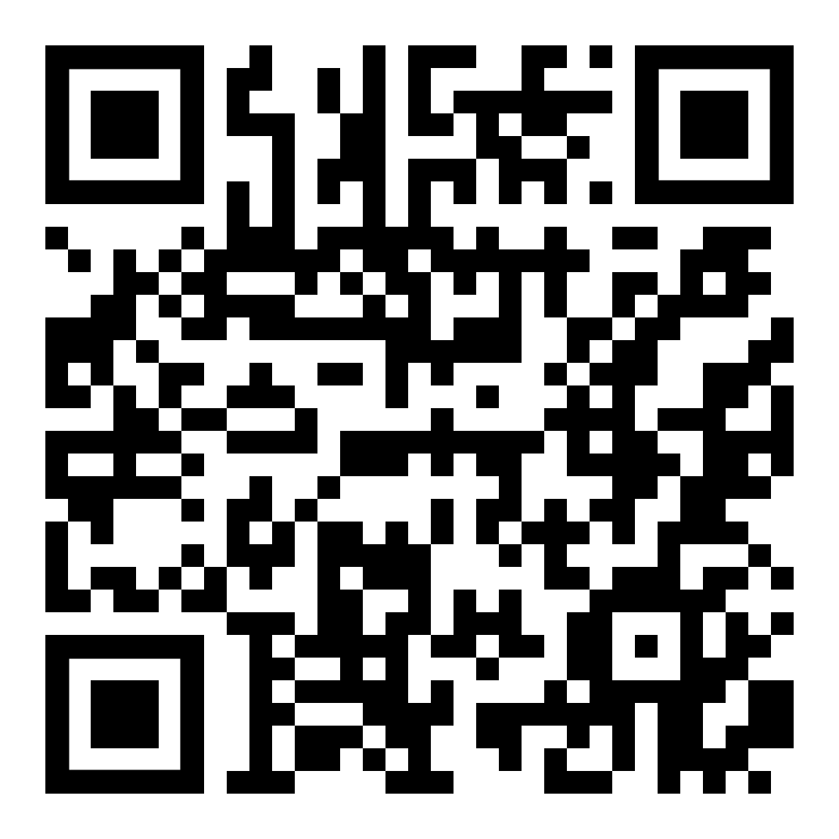
Scan the QR code to hear the next part of the story
Take a photograph of this picture of a stone so that you can make one at home

Slide 8

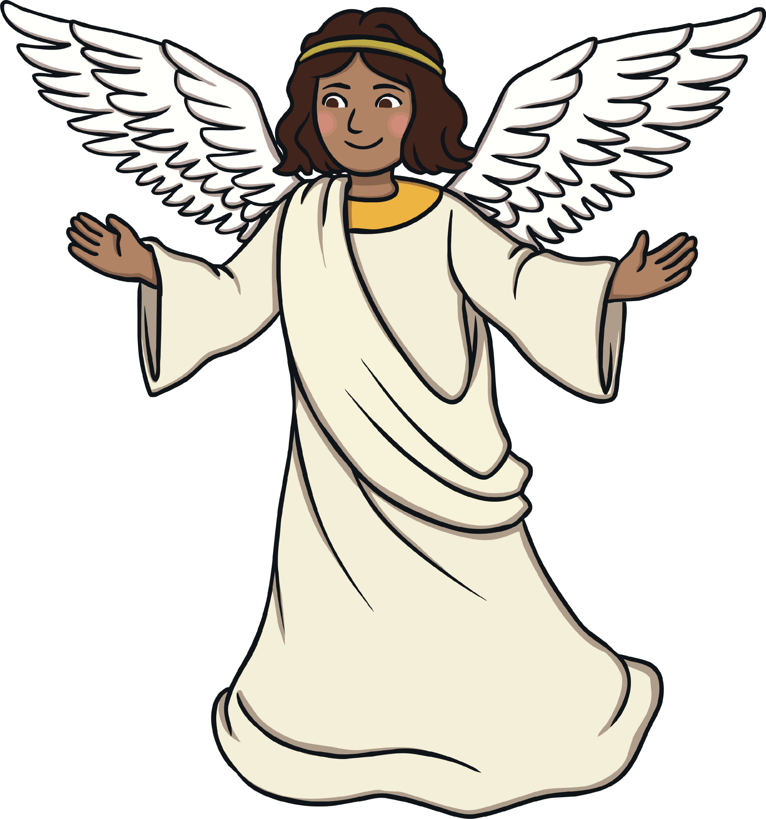
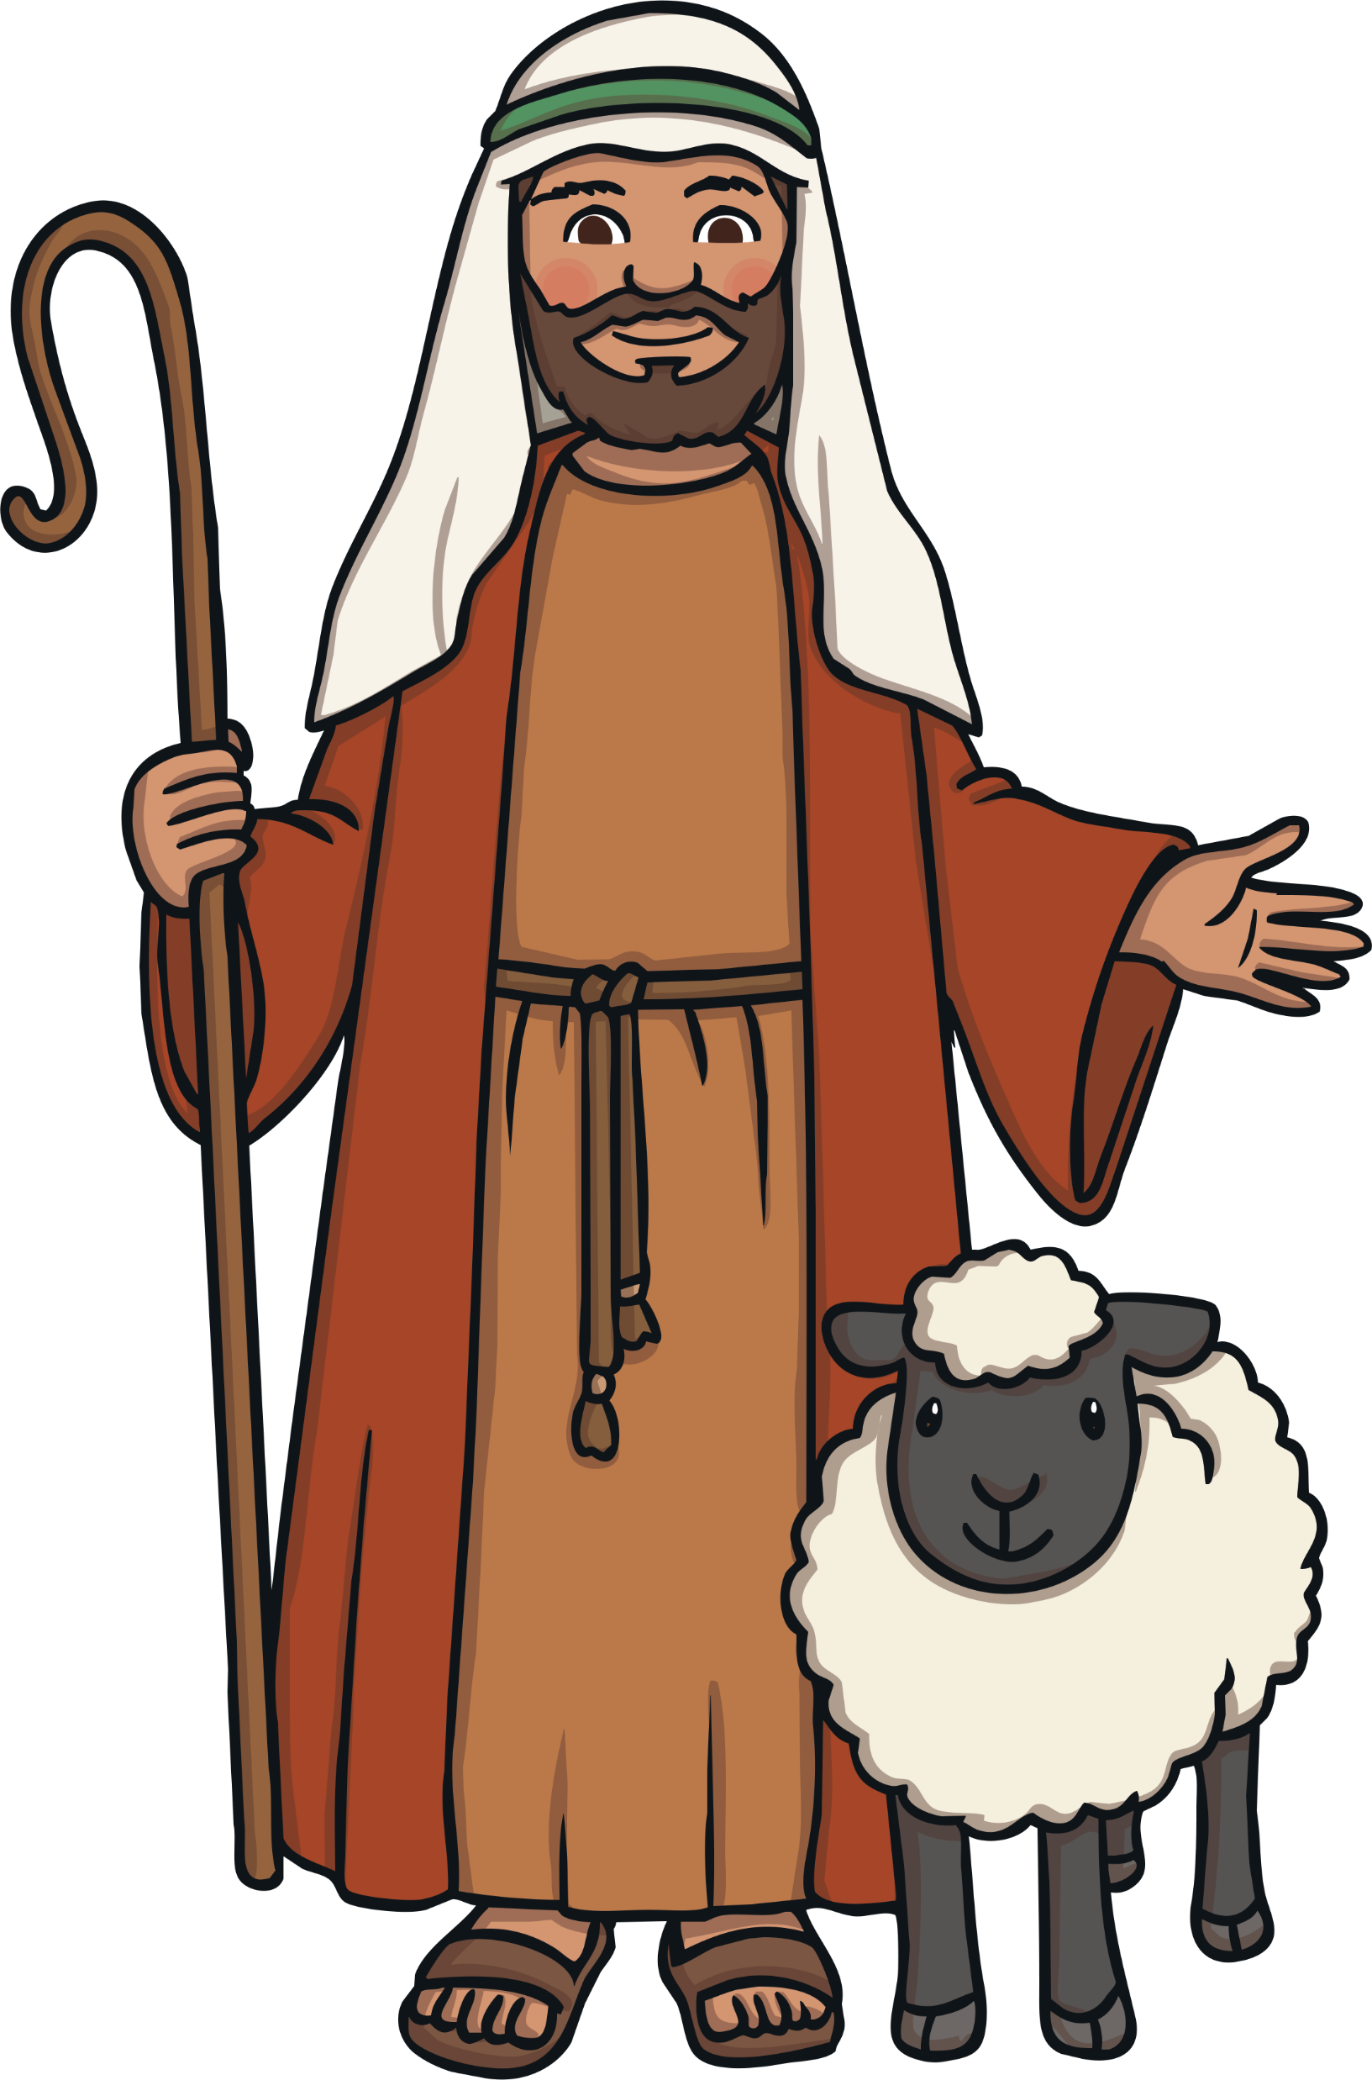
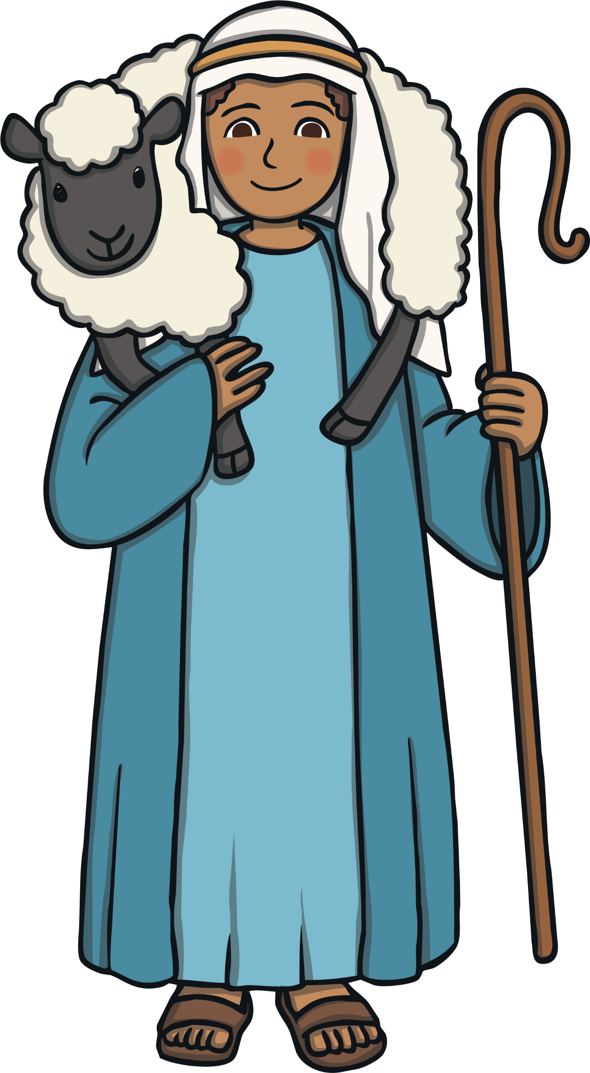
At the same time, an angel appeared to some shepherds. The angel told them that the son of God had been born in Bethlehem.
Shepherds were considered very lowly, why do you think the Angel appeared to them not the King?

Slide 9
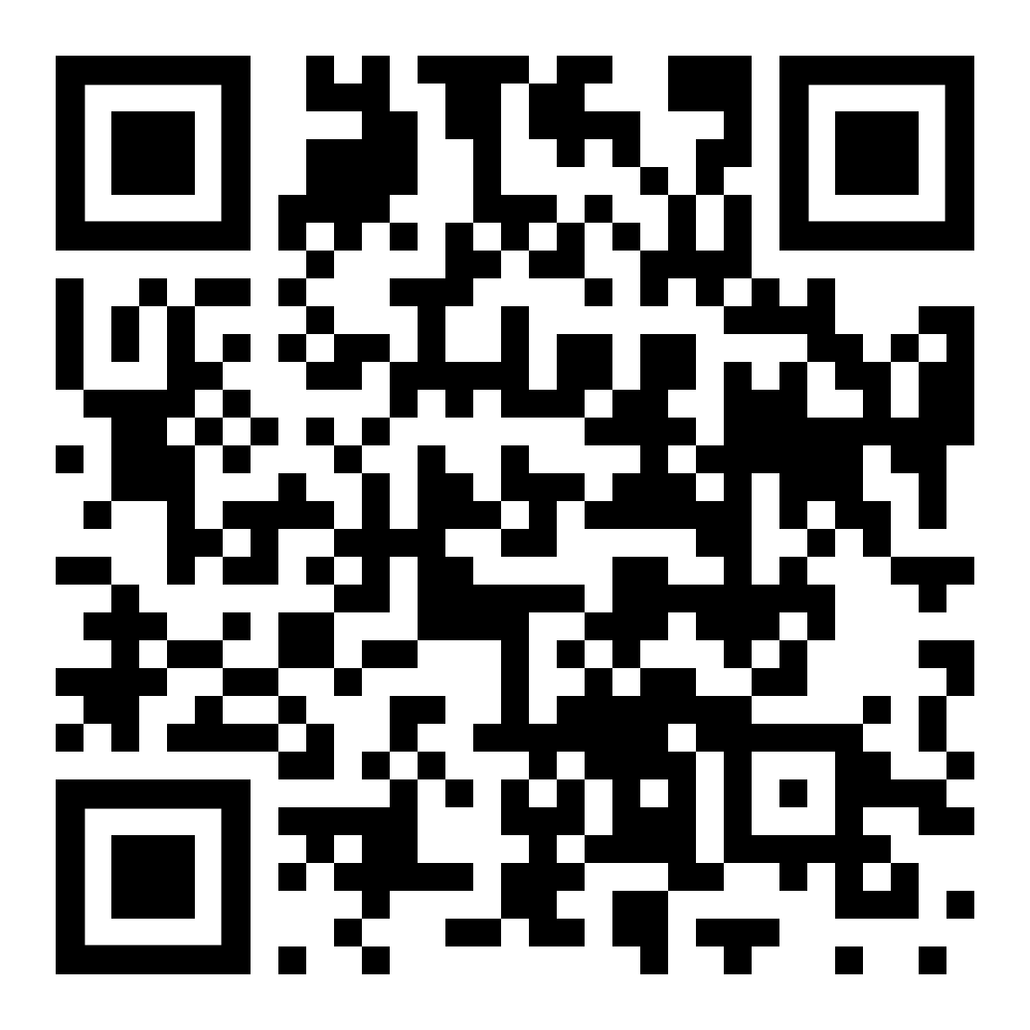
Scan the QR code to hear the next part of the story
Take a photograph of this picture of a stone so that you can make one at home

Slide 10
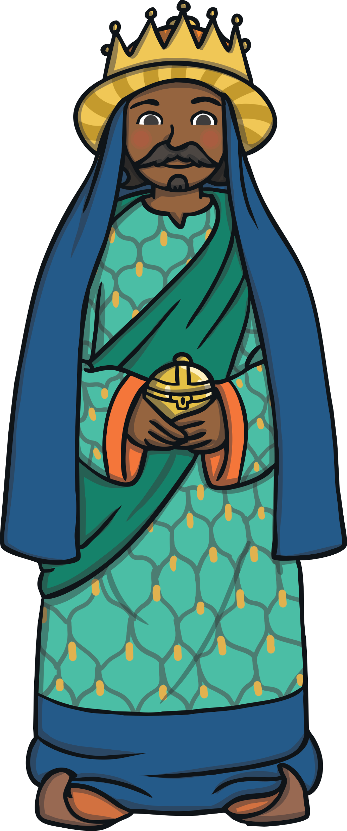
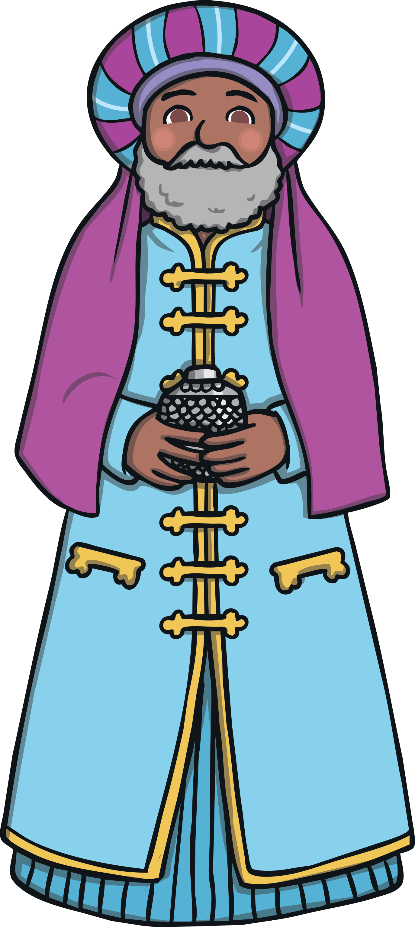
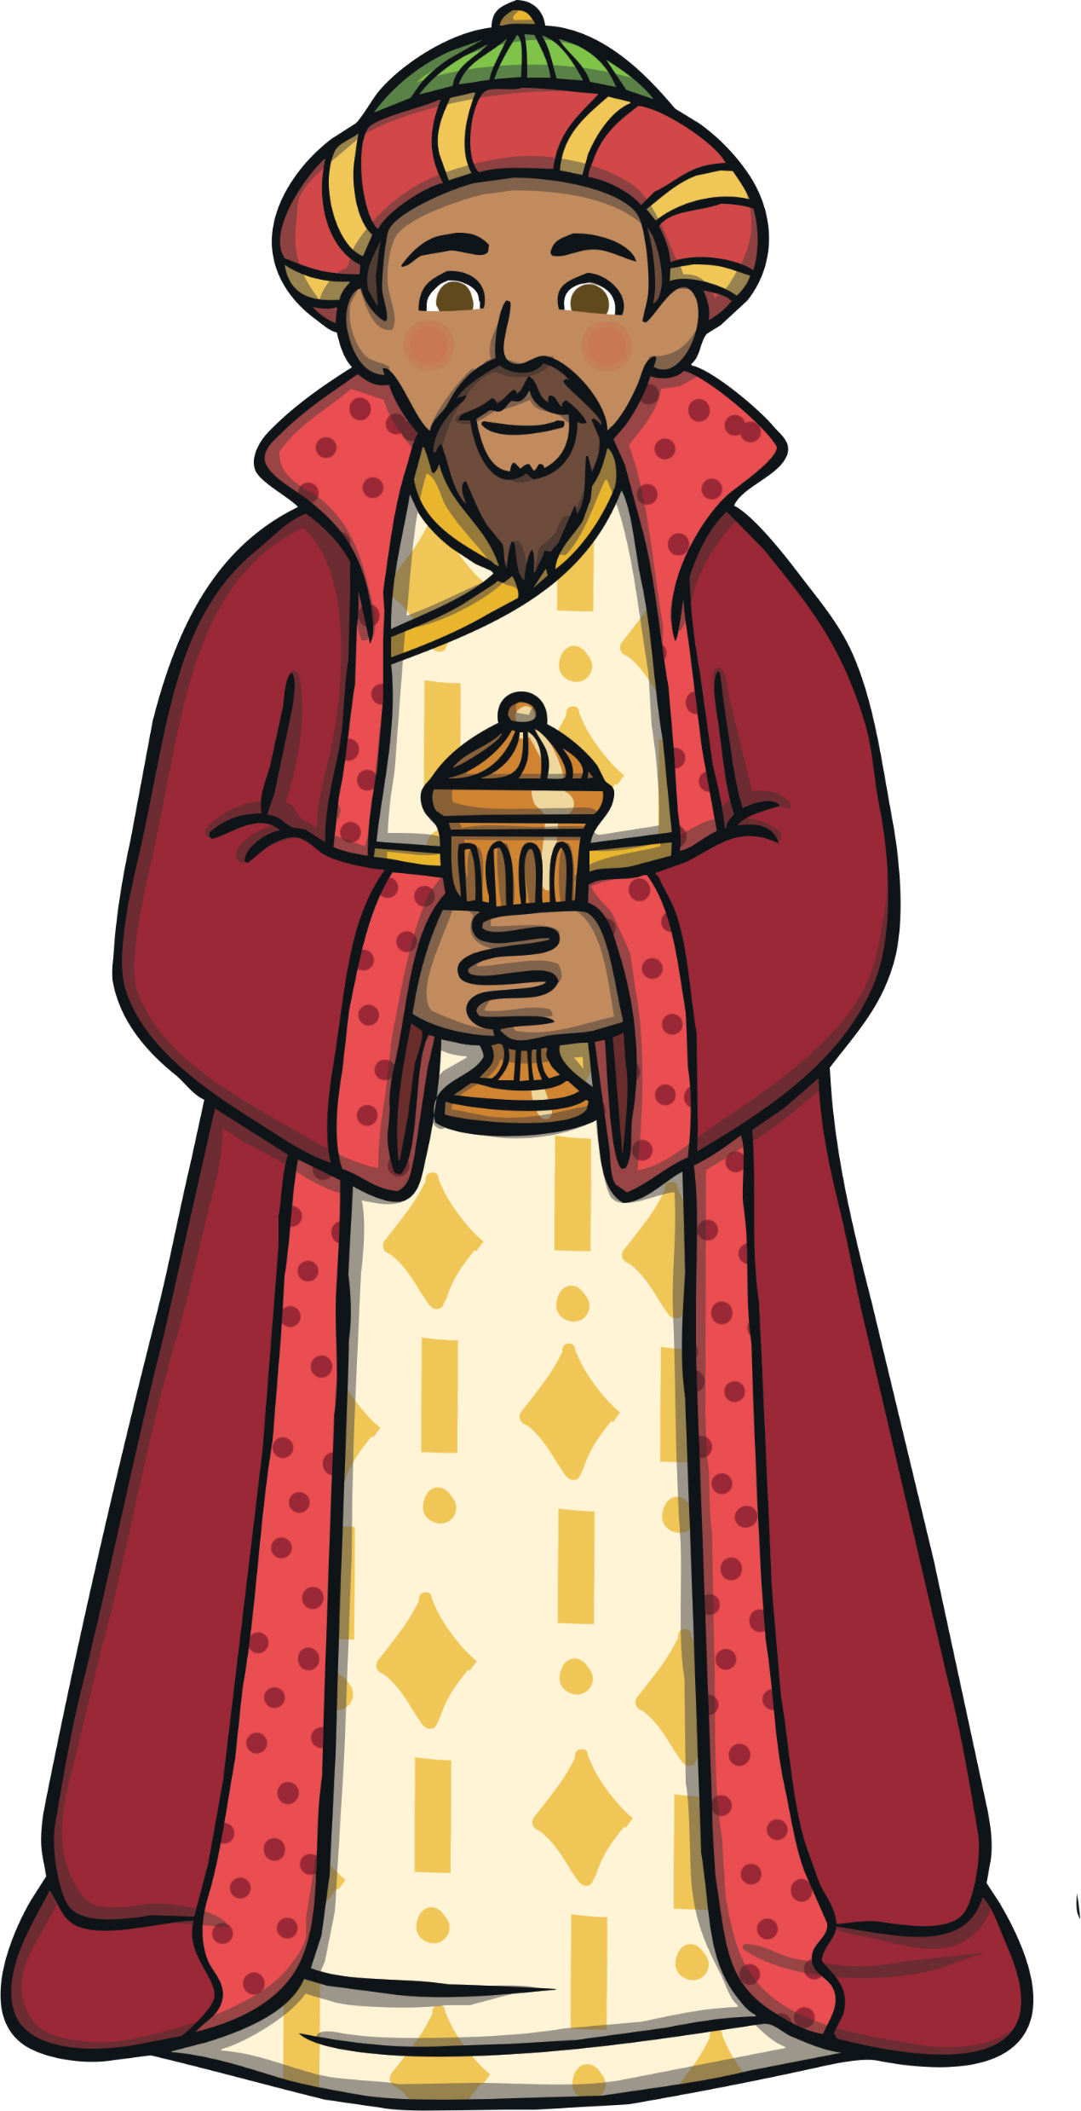
Far away in the East, wise men saw a bright star in the sky. They knew it meant that a new king had been born and followed the star.
Where do you think the Wise men thought the star would lead them?

Slide 11
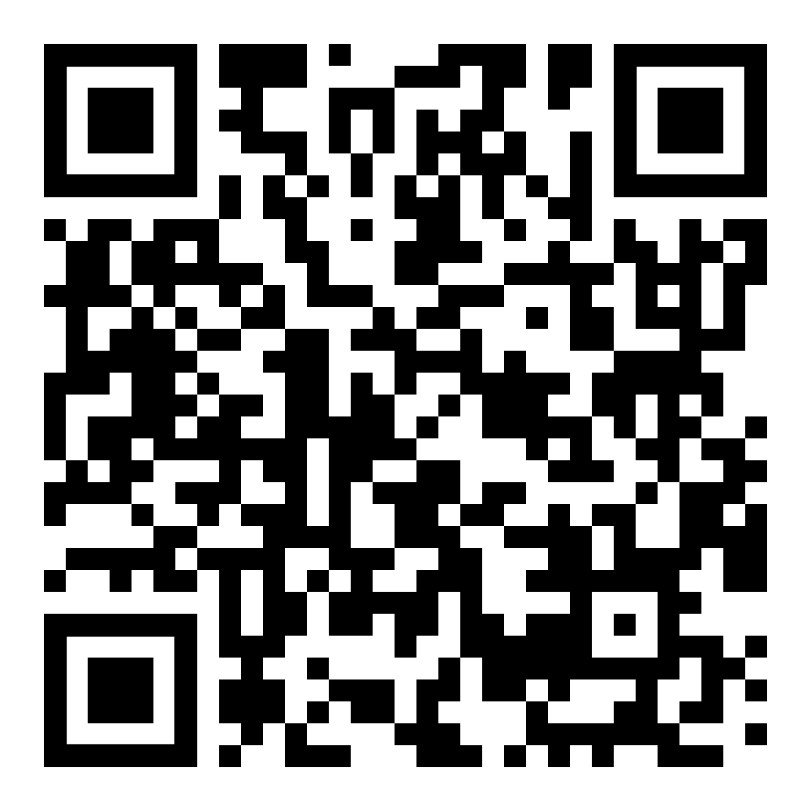
Scan the QR code to hear the next part of the story
Take a photograph of this picture of a stone so that you can make one at home

Slide 12


The wise men reached Bethlehem. They gave Jesus gifts of gold, frankincense and myrrh.
How do you think the Wise men felt when they arrived?

Slide 13
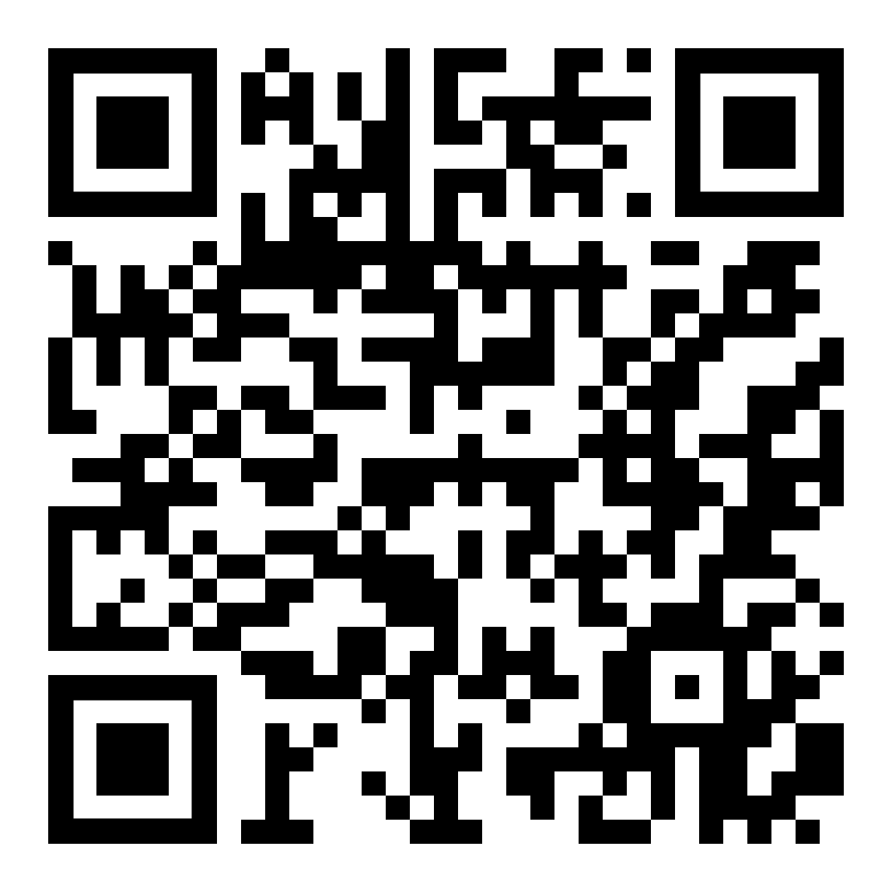
Scan the QR code to hear the next part of the story
Take a photograph of this picture of a stone so that you can make one at home, you could also draw your own stones to add.

Slide 14
Provide printed copies of the next slide so that the children can take it home to use to re-tell the Nativity story with their stones.

Slide 15
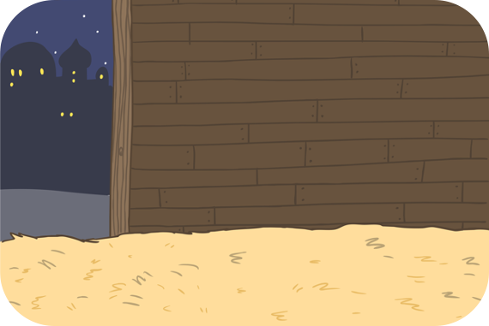
The Angel Gabriel visited Mary and told her she was going to have a baby called Jesus. The baby would be God’s son.
Baby Jesus was born in the stable.
The wise men reached Bethlehem. They gave Jesus gifts of gold, frankincense and myrrh.
Mary and Joseph had to travel to Bethlehem to register in a census.
At the same time, an angel appeared to some shepherds. The angel told them that the son of God had been born in Bethlehem.
Far away in the East, wise men saw a bright star in the sky. They knew it meant that a new king had been born and followed the star.

Slide 16
In our nativity story the wise men visit baby Jesus in the stable, however in the Bible this doesn’t happen until sometime after Jesus’ birth
If you would like to hear what really happened please join us at our Epiphany Service
On
……………………………..
(Add details of service)

Slide 17
You can use these questions as part of your Epiphany service
Children could decorate their Wise men stones during this service

Slide 18
What did the Wise men follow to find baby Jesus?
What animal did the Wise men travel on?
What were the 3 gifts the Wise men brought for baby Jesus?
Did the Wise men come from the East or the West?
Which King did the Wise men visit before they saw Jesus?
How many times do you think the Wise men said ‘are we nearly there yet?’
The Wise men knelt down to worship Jesus, what do you think you would have done if you had been there?
Did the Wise men go back the way they had come?

