Slide 1
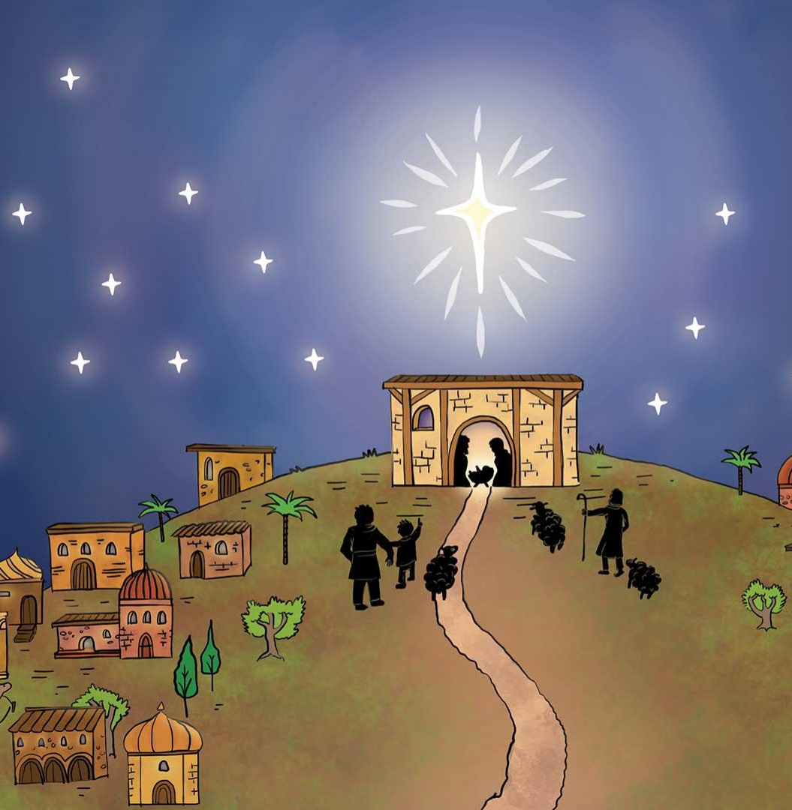
How Well Do You Know The Christmas Story?

Slide 2
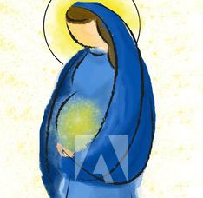
1. Who told Mary she was pregnant?

Slide 3
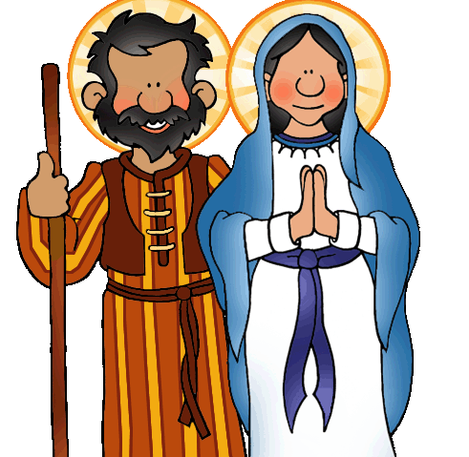
2. Where did Mary and Joseph live?

Slide 4
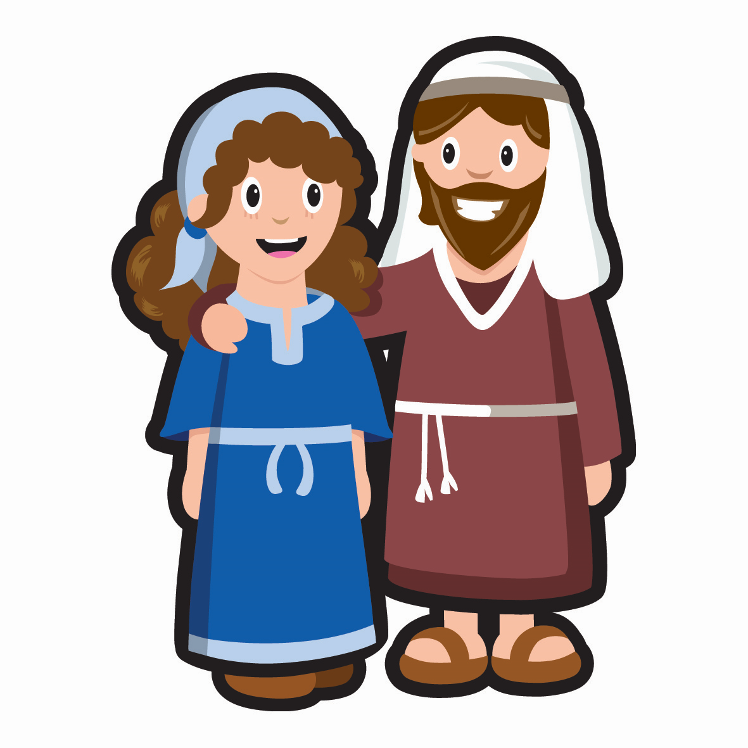
3. What did Mary ride on the journey to Bethlehem?

Slide 5
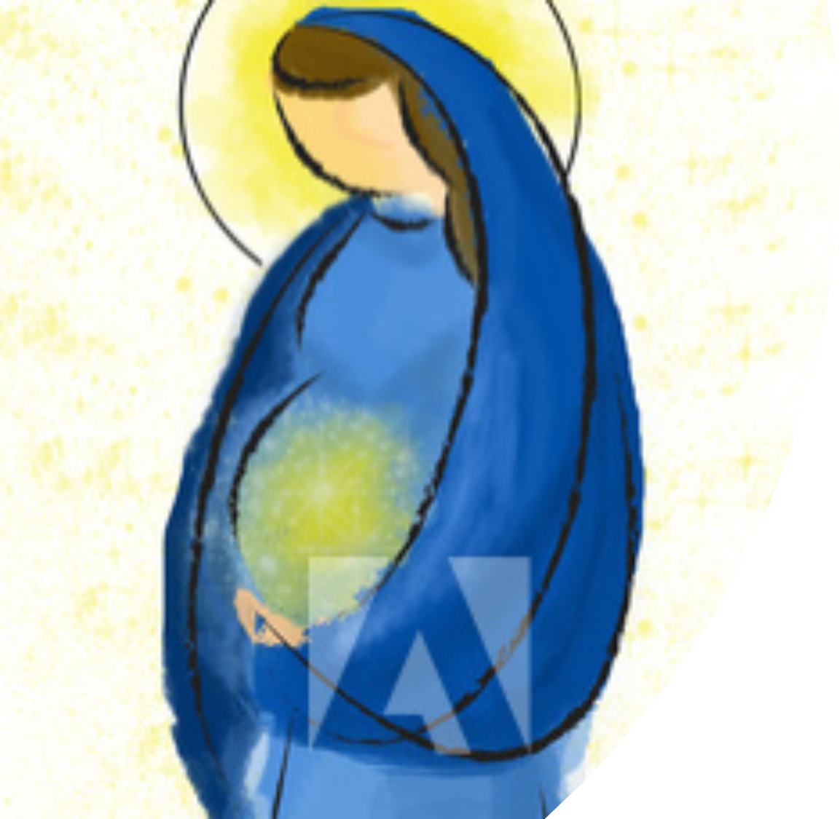
4. Who went with Mary?

Slide 6
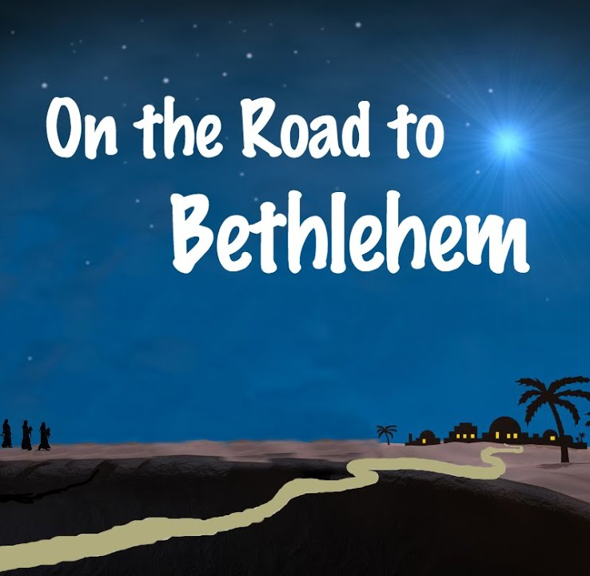
5. How soon after they reached Bethlehem was Jesus born?

Slide 7
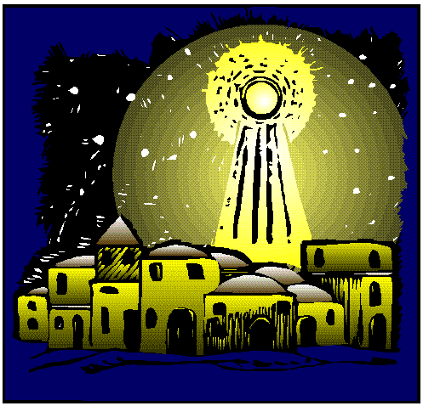
6. What was the weather like?

Slide 8
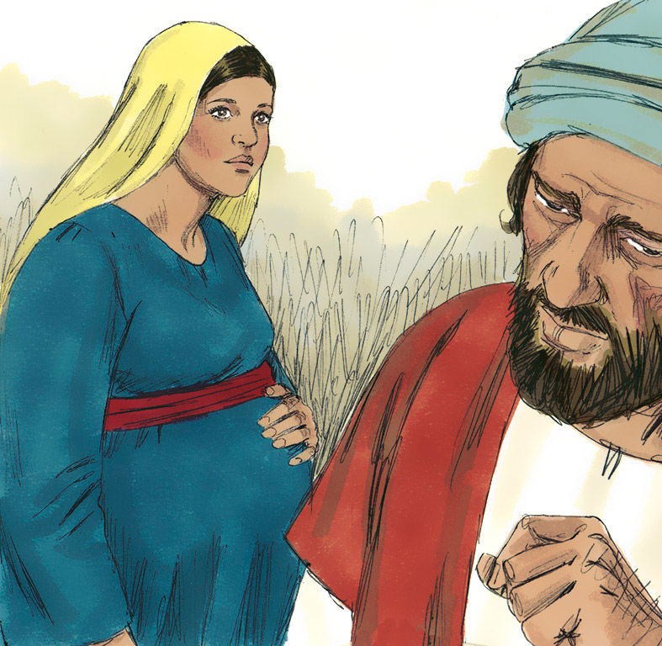
7. What sort of building was Jesus born in?

Slide 9
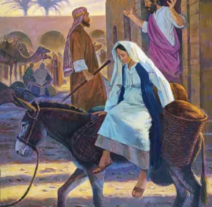
8. What part did the innkeeper play in the story?

Slide 10
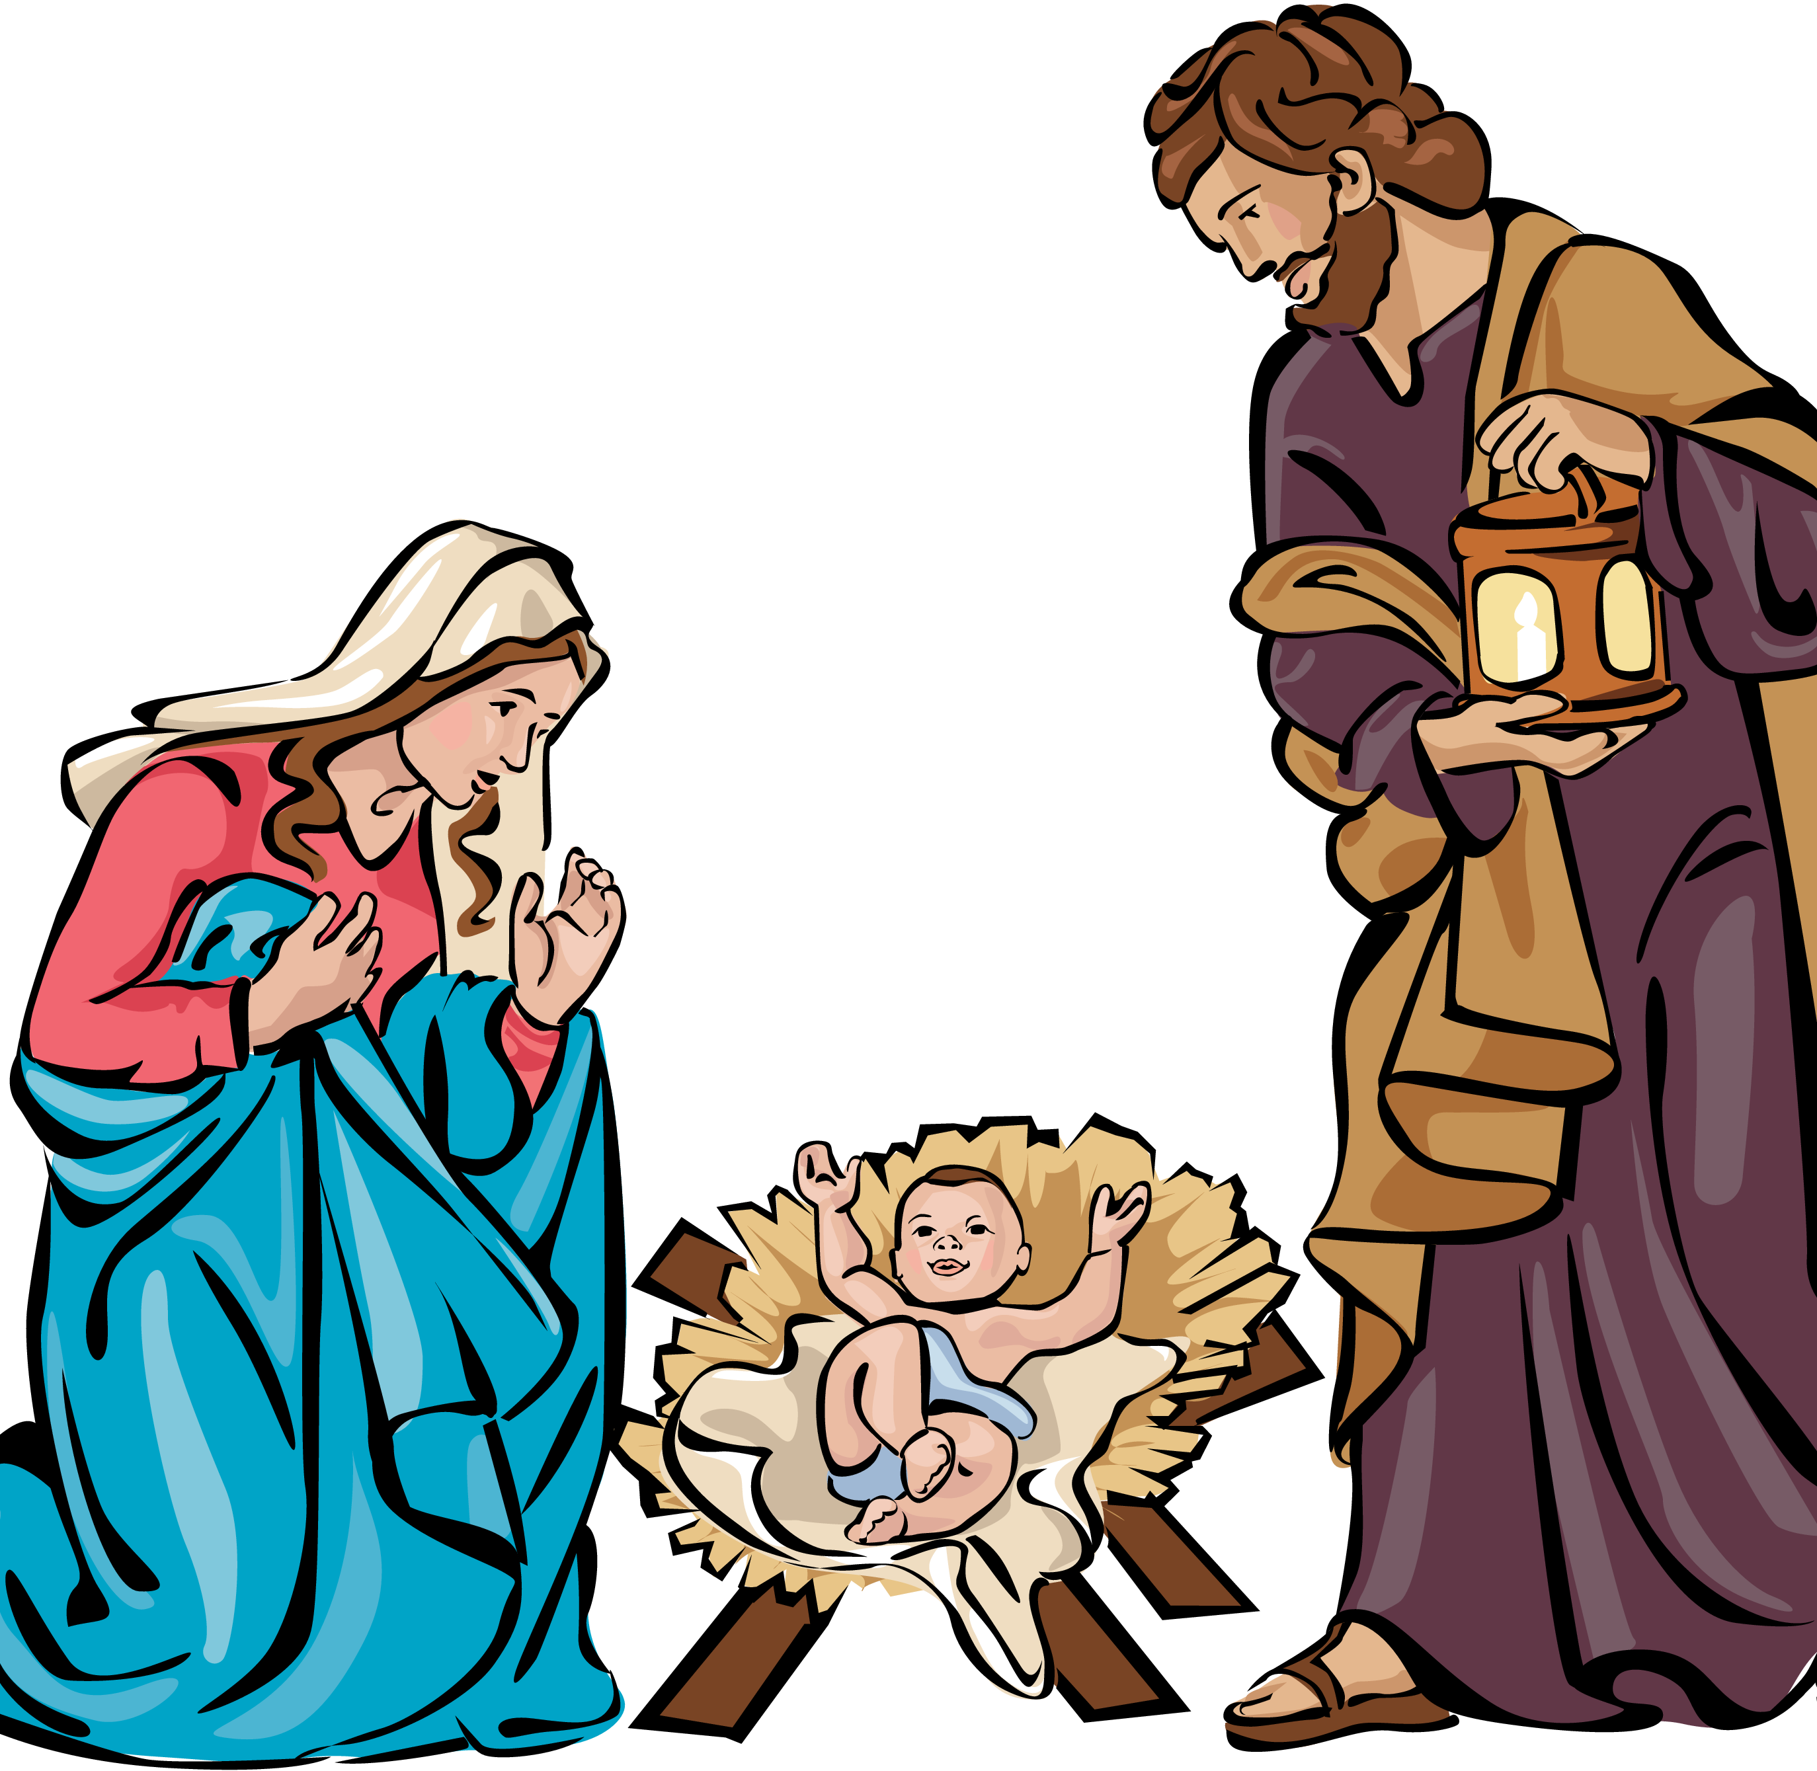
9. What animals were gathered around the manger?

Slide 11
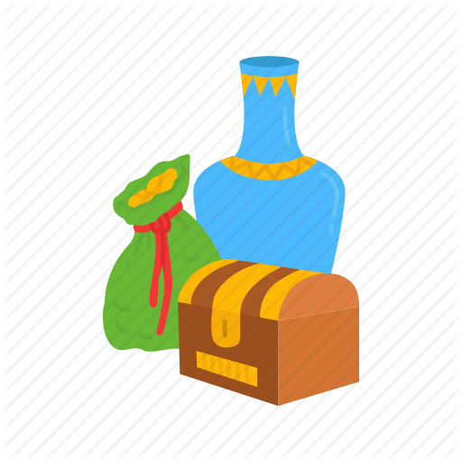
10. How many wise men were there?

Slide 12
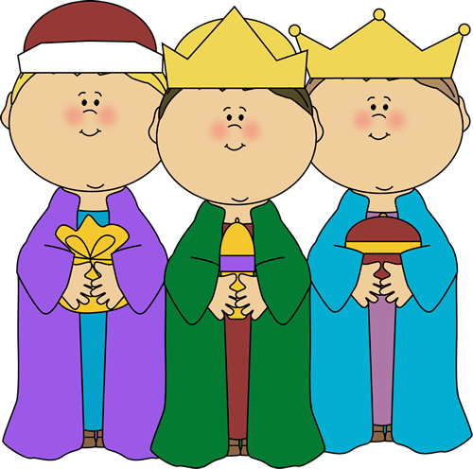
11. How soon after Jesus’ birth did the wise men arrive?

Slide 13
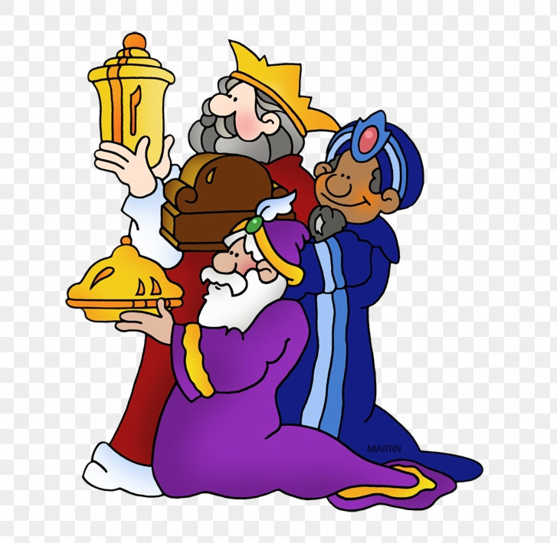
12. How did the wise men travel?

